Slide 1
FEE and DAQ in the 6x6x6
Antonio Verdugo de Osa & Daniel Belver Fernández
Spanish WA105 Meeting 12/01/2018

Slide 2
LRO FE block diagram
Mother-board (commercial)
µTCA backplane
Mezzanine-board
Bittware S4AM
µTCA
MCH
LRO FE
ADC
12
PMTs
FPGA
DAQ
computer
CatiROC
Trigger in/out
Main functions:
ADC: Signal sampling for charge calculation
CatiROC ASIC: Time-stamping
FPGA: Trigger decision and digital signal processing (charge calculation, data reduction and transmission, …)

Slide 3
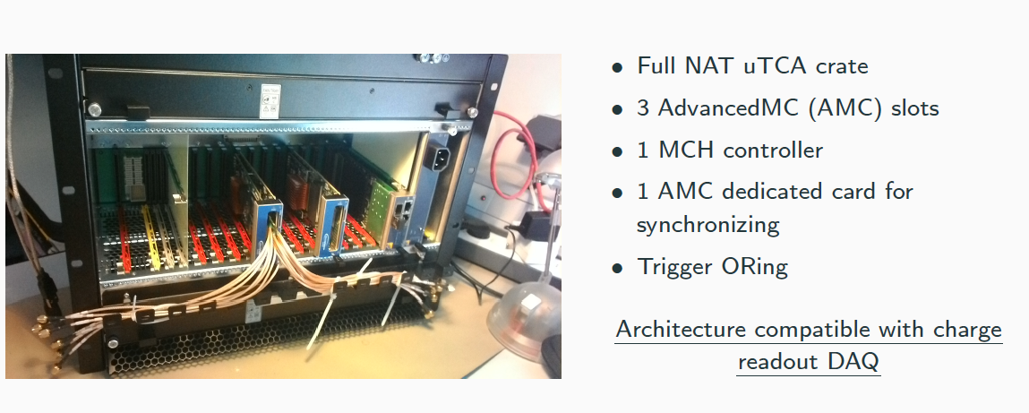
LRO Crate

Slide 4
Mezzanine board

Slide 5
CATIROC ASIC
16 inputs for negative signals that work in trigger-less mode: each input auto-triggers according to a programed threshold. External input available for external trigger or to make a “veto” of the internal one.
All the channels are handled independently by the digital part and only channels that have created triggers are digitized and then sent-out.
Each input signal follows two paths:
Slow path for charge and time measurement:
Programmable shaping time (up to 100ns)
Two programmable gain preamplifiers working in auto-range mode.
Two track and hold circuits working in “ping-pong mode”.
Fast path for auto-trigger:
Two programmable gain preamplifiers working in auto-range mode.
Fast shaper (5ns) + programmable discriminator (same level for all the channels).
One trigger output pin is available per channel and also a pin with a NOR of the 16 trigger signals.
Provides the “time of arrival” operating in self-triggered mode with a time resolution of 200 ps RMS. Given by the combination of :
Coarse time from a 26 bit counter at 40 MHz (set to 0 at the chip restart).
Fine time obtained by two TACs (Time to Amplitude Converters) per channel.
Two 10-bit Wilkinson ADCs convert the charge and the TAC ramp fine time values into two serial data-out lines (8 channels each) at 80 MHz.
The conversion (dead) time depends on the input signal magnitude. Conversion of large input signal could take up 6.4 µs, the average conversion duration is 3.2 µs.
The dead time limits the hit rate to 100KHz per channel (worst case).

Slide 6
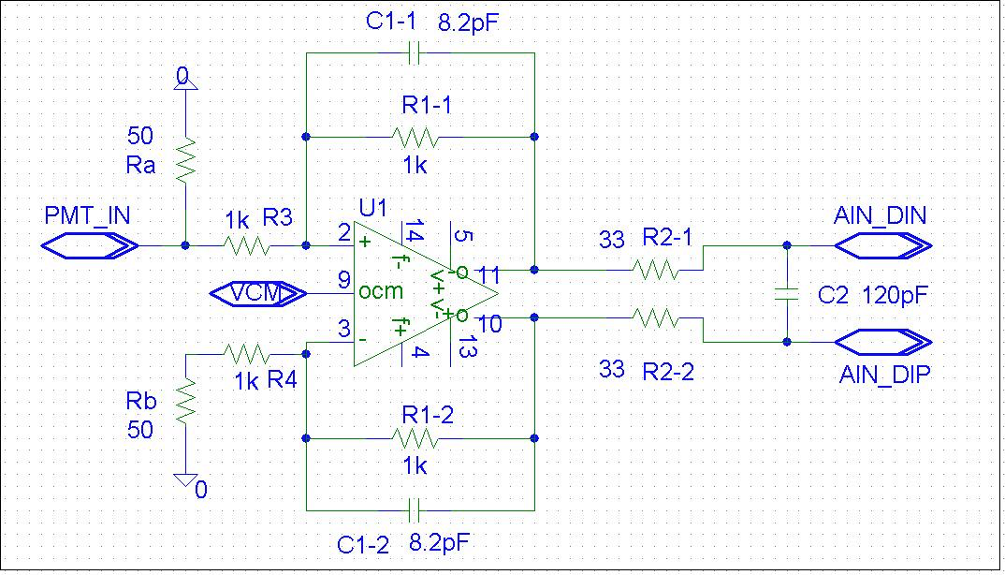
ADC AD9249
16 channels with 14 bits resolution.
Sampling frequency up to 65MHz (40 MHz on the FE).
Differential inputs with 2Vpp voltage range and common mode voltage at 1V. So, only 1V of dynamic range.
Conversion from unipolar PMT signals to differential ADC inputs is done in the anti-aliasing filter.

Slide 7
Minimum requirements for the DAQ
S1 fast component shape, charge and timing
S1 slow component length
S2 shape, charge and timing
Trigger signal generation by the coincidence of signals (programmable level) from a programmable number of PMTs (particular or random ?).
SPE charge adquisition for gain calculation during the calibration.
Operation modes:
Trigger-less (default).
External trigger via White-Rabbit during beam time.
External trigger from aux input during the calibration.

Slide 8
FE requirements for the Calibration System
The ADC must run at the maximum speed to acquire the SPE shape as well as possible in order to obtain a reliable SPE charge spectrum.
One of the spare ADC channels is required to acquire the signal from the SiPM reference sensor.
A specific trigger input is required for PMT calibration.
On each AMC board there are 4 spare signals (3 inputs and 1 output). One input can be used for the calibration system external trigger. The other two inputs and one output per board can be used for the local trigger distribution between AMC boards

Slide 9
Comments to the FE design
The ADC dynamic range is 1V, but, for the light signals expected on the detector, the PMTs dynamic range will be higher.
The CatiROC charge dynamic range goes from 160fC up to 100pC (62 SPEs with PMT gain of 10e7). It was designed for PMTs with gain around 10e6 !
The maximum integration time is 100ns (shaping time) and there is a dead time of µs so the CatiROC cannot be used to get a continuous charge measurement of the inputs.
The CatiROC does not provide a coincidence window for the trigger. Channels are handled independently. The coincidence has to be done in the FPGA.
The CatiROC dead time limits the hit rate to 100KHz per channel, so it cannot be used to measure times on signals with rates higher than 100KHz.

Slide 10
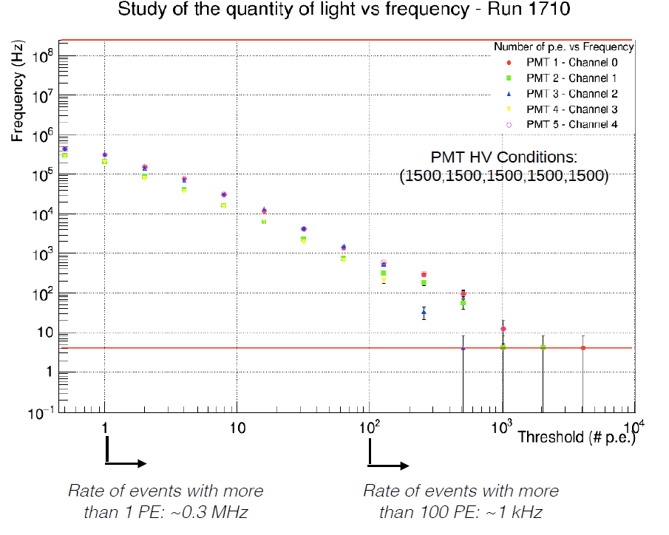
Event rate as a function of the #pe on the 3x1x1

Slide 11
To be tested
CatiROC trigger outputs: according to the FE designer they are analog but reading the information on the CatiROC datasheet it seems that they are digital. If they are analog we have to determine the signal variation at the CatiROC signal input that produce a change of level detectable by the FPGA on the trigger input lines.
Delay from the CatiROC signal input to the trigger output to compute the total trigger delay.
Check if it is possible to reduce the signal amplitude on the unipolar to differential conversion circuit to adapt the ADC to the PMT signals dynamic range.

Slide 13
Global architecture
WA105 Online Computing – Elisabetta Pennacchio, 15/12/2015 : https://indico.fnal.gov/event/11030/contribution/4/material/slides/0.pdf

Slide 14
