Slide 1
Voxel Imaging Pizza
Gianluca De Lorenzo

Slide 2
Positron Emission Tomography
www.vip-erc.com

Slide 3
Limits Set By Physics
Positron range:
~ 0.5 mm for FDG in water
Photon-photon acollinearity from positron electron annihilation:
~ 0.9 mm for 400 mm diameter detector.
0.5 mm

Slide 4
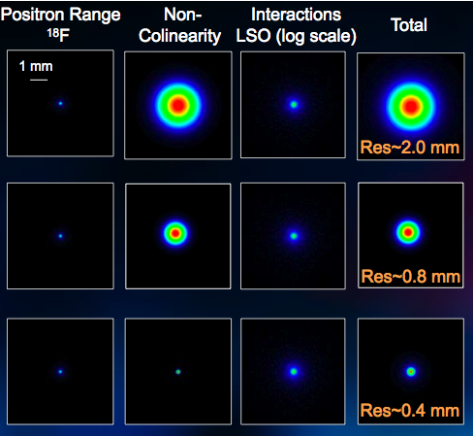
Best Achievable Resolution
Whole body PET
(~ 80 cm diameter)
FWHM = ~ 2 mm
Human brain PET
(~ 40 cm diameter)
FWHM = ~ 1 mm
Mouse scanner
(~ 8 cm diameter)
FWHM = ~ 0.5 mm

Slide 5
State-of-the-art
Photo detection with scintillating crystals (BGO, LSO, …).
Single layer of monolitic crystals: 4 x 4 x 20 mm³
Typical energy resolution: 10% at 511 keV

Slide 6
Limitations
Parallax error
reduced with DOI techniques.
best DOI > 3 mm
Scatter events
depends on energy resolution.
typically 50% of the total events
Random events
stopping power
angular coverage
source activity

Slide 7
Typical Performance of a Crystal PET for human brain scan
Brain PET Scanner Performance | Crystal PET
Efficiency | 5 cps/kBq
Scatter fraction | 50 %
Image resolution | 4 mm
Time for full brain scan (100 MBq) | 30 minutes

Slide 8
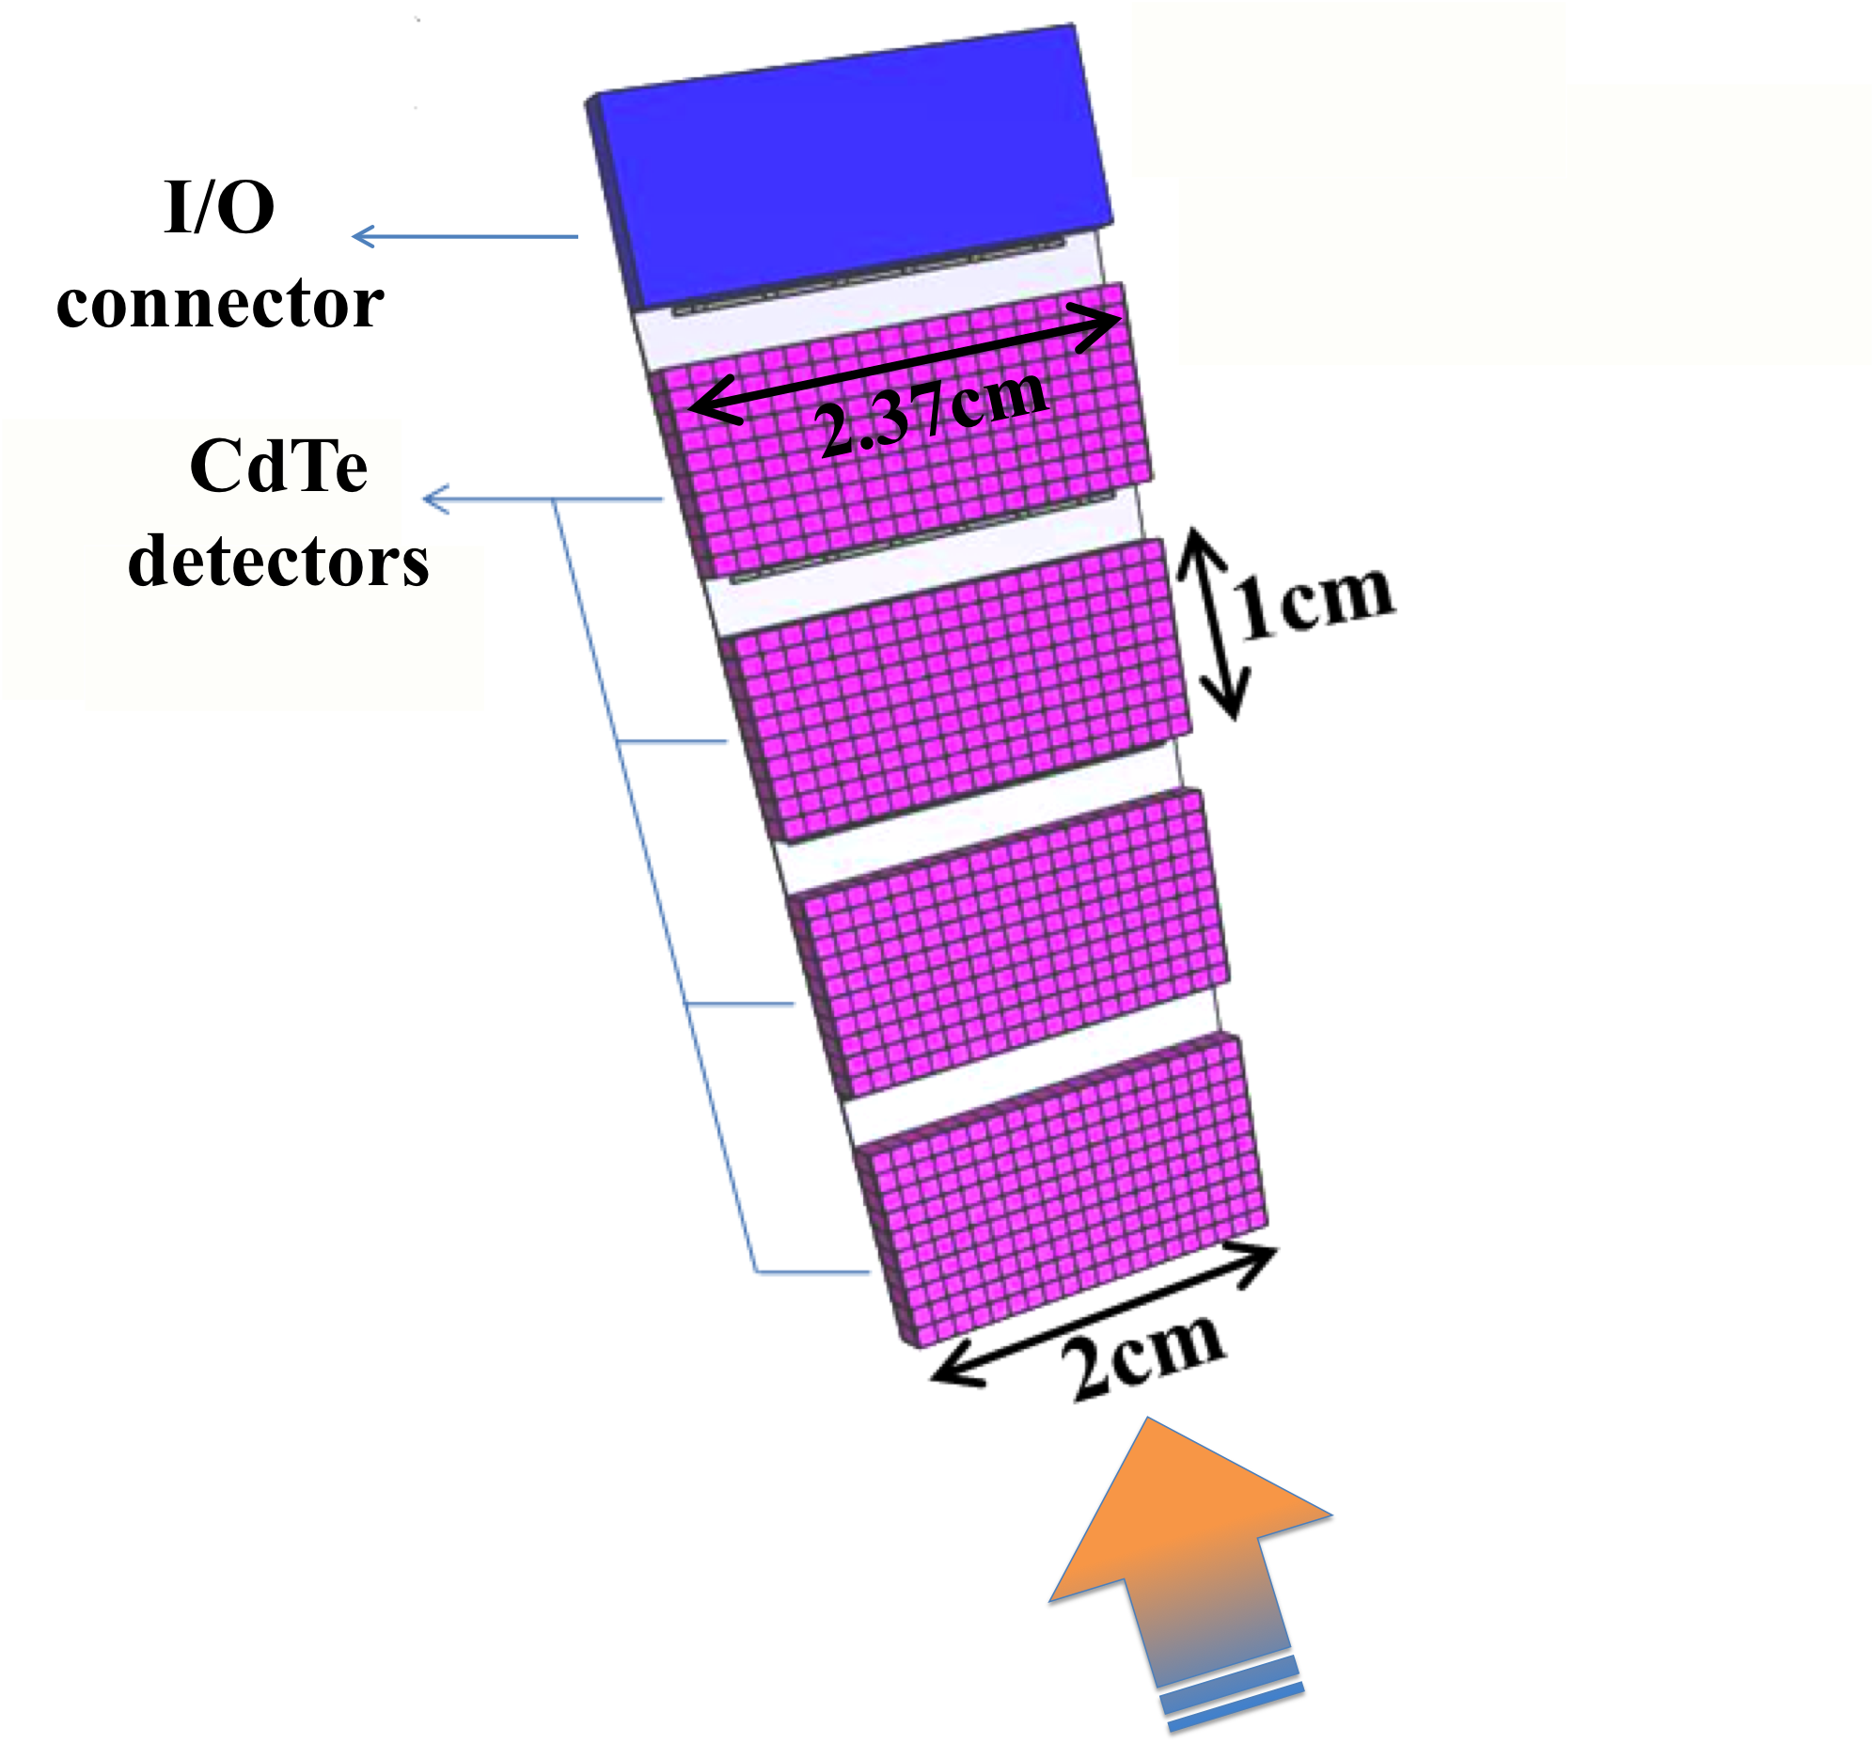
VIP “All Inclusive” Solution
Pixelated CdTe on thinned ROC.
1x1 mm² pixel pitch with 800 channels per module.
1% energy resolution for 511 keV.
Incident radiation from the bottom facing 4 cm sensitive volume.
Trapezoidal shape, 2 mm thick.
Arbitrary detector geometry with stack of modules for a channel density of 450 voxels per cm³.
Need for a totally independent read out per channel.

Slide 9
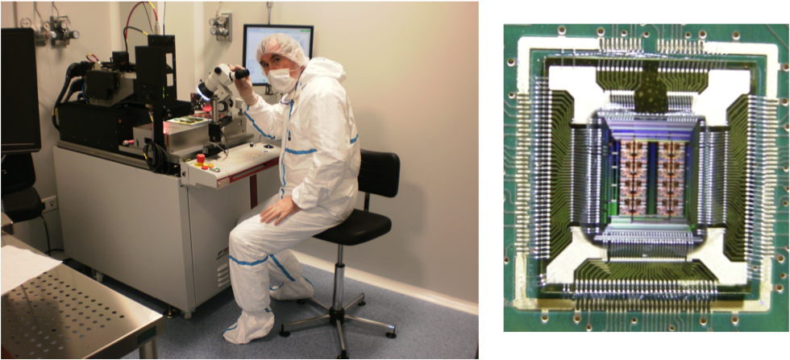
The VIP Readout
Low noise.
Low consumption (< 200μW per channel).
Excellent energy resolution (<1%).
Excellent time resolution (<1ns).
Designed by José Gabriel.

Slide 10
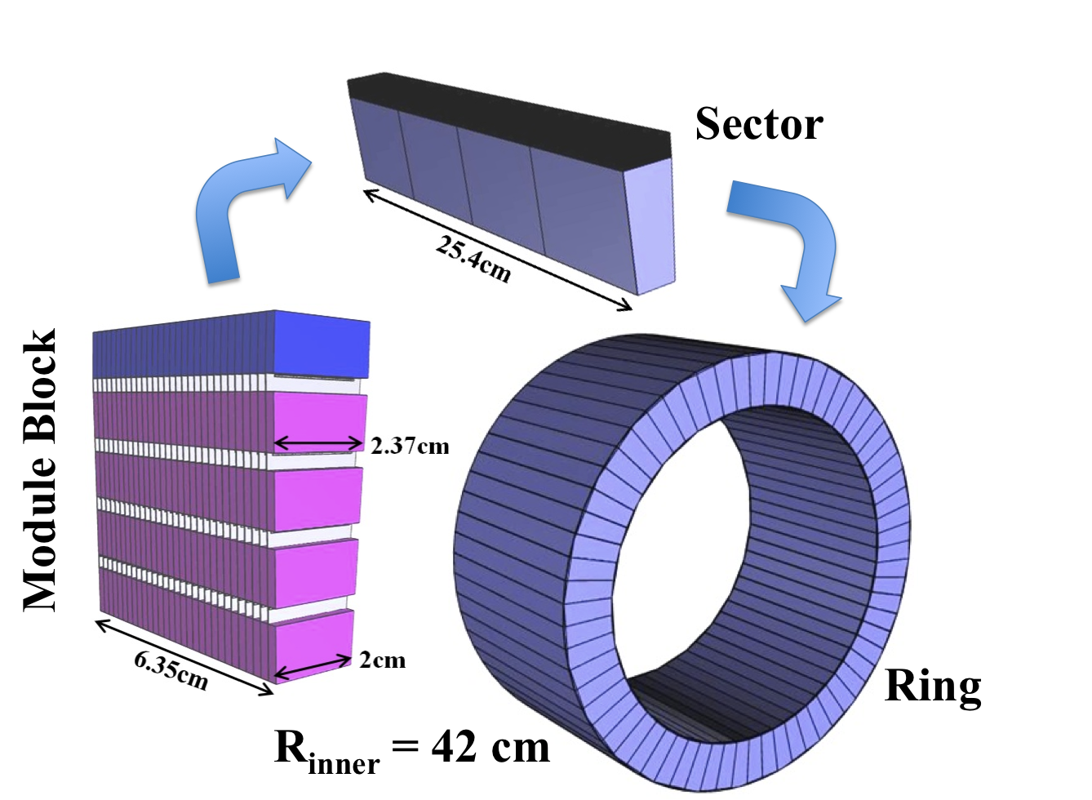
The Full Voxel Imaging PET
6.6 M
channels
seamless
ring

Slide 11
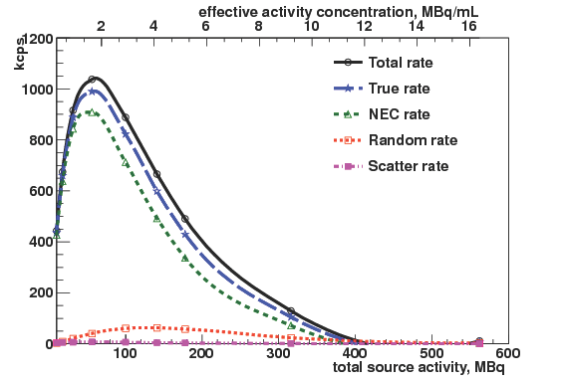
Counting Performance
- The total peak rate at 50 MBq is 20 cps/kBq
- Scatter fraction ~ 1%

Slide 12
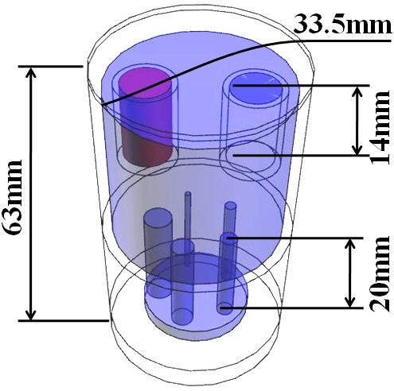
Imaging Performance
VIP scanner with phantom in air.
scan time: 20 seconds
VIP scanner with phantom in water.
same number of events as for previous case.
Inveon small animal pet (R = 8 cm) phantom in air.
scan time: 20 minutes

Slide 13
Comparing VIP to Crystal PET
Brain PET Scanner Performance | VIP | Crystal
Efficiency | 20 cps/kBq | 5 cps/kBq
Scatter fraction | 1% | 50 %
Image resolution | 1 mm | 4 mm
Time for full brain scan (100 MBq) | 1 minute | 30 minutes

Slide 14
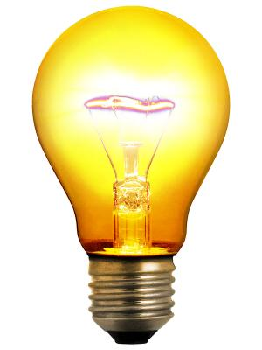
Simulation of a Brain Scan
LET ME TELL YOU ONE THING
dirty jokes
impossible bets

Slide 15
Simulation of a Brain Scan

Slide 16
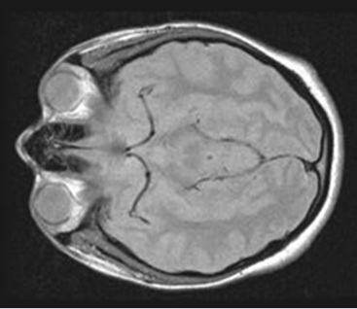
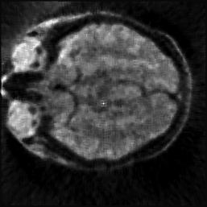
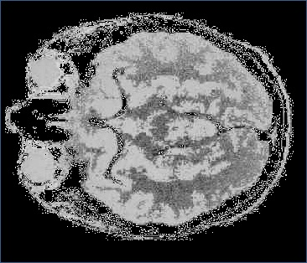
Simulation of a Brain Scan
by Katya Mikhaylova

Slide 17
Problems
Challenges
COMPLEXITY:
VIP has 6.6 M channels with a data throughput of 100 MB/s .
Crystal PETs have ~30k channels.
ATLAS pixel detector has 80 M channels.
COST:
CdTe is very expensive.
What if big players step in?

Slide 18
Project Timeline
ASIC design start:
March 2011
single analog circuits:
November 2011
START:
July 2010
single pixel ASIC:
June 2012
4x4 analog ASIC:
April 2013
clean room operational:
March 2013
4x4 full ASIC:
Dec 2014
10x10 ASIC:
May 2014
END:
July 2015
first module:
Sep 2014
full prototype:
Jan 2015

Slide 19
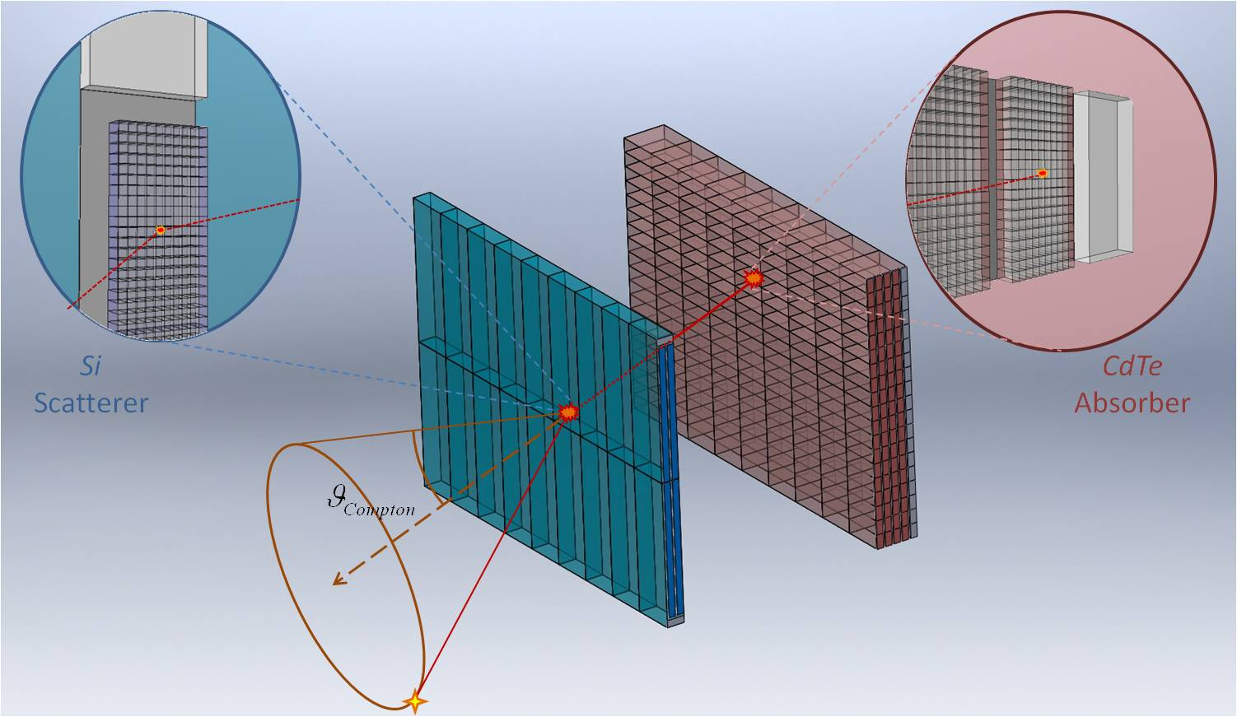
Future Prospects
Team up with industry to build the full ring.
Consider extending the VIP approach to other applications:
Positron emission mammography
by Dilber Uzun
Compton camera
by Yonatan Calderón

Slide 20
Summary
The VIP project explore the possibility of using highly pixelated CdTe photo-detectors for PET applications.
This is a pathfinder project aiming to prove the concept by building a fully operative PET prototype.
When successful, our results will revolutionize the nuclear medicine detectors.
One more year to go => plenty of things to do => more pizza meetings to come!
More details at our students thesis defences:
VIP Compton Camera: Yonatan Calderon, April 25th, 2014.
VIP positron emission mammography: Dilber Uzun, June 2014.
VIP PET: Katya Mikhaylova, June 2014.
Detector development and characterization: Gerard Ariño, June 2015.

Slide 21
Schrödinger’s cat walks into a bar…
…and doesn’t.
A logician’s wife is having a baby. The doctor immediately hands the newborn to the dad.
His wife ask impatiently: “So, is it a boy or a girl?”
The logician replies: “Yes”
It’s hard to explain puns to kleptomaniacs because they always take things literally.
Helium walks into a bar and orders a beer, the bartender says: “Sorry, we don’t serve noble gases here.”… He doesn’t react.
Three logicians walk into a bar. The bartender asks: “Do all of you want a drink ?”
The first logician replies: “I don’t know.”
The second replies: “I don’t know.”
The third replies: “Yes !”

