Slide 1
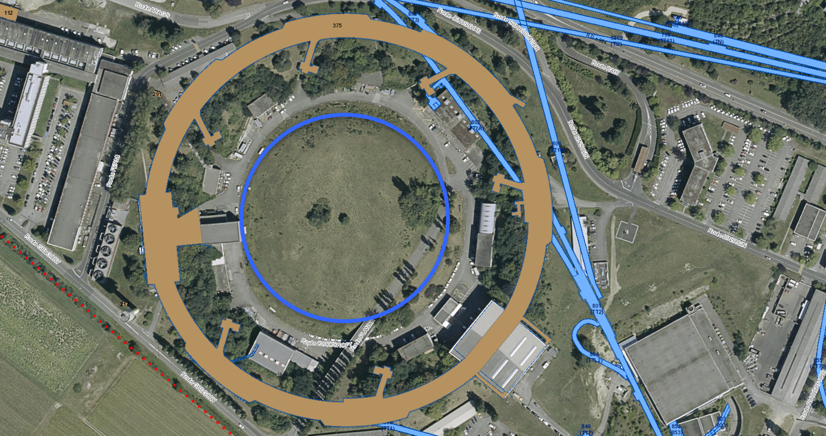
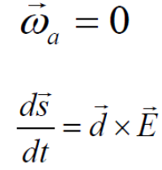
Proton EDM experiment proposal
Frederic Teubert
CERN, EP-LBD

Slide 2
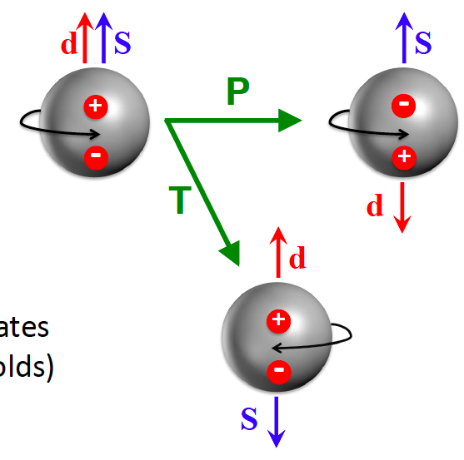
Preamble
E
E
Purcell and Ramsey (1950) first search for neutron EDM (d_{n} < 2x10⁻¹⁸ e cm). P and T must be conserved to a good approximation.
Since 1956 we know P is not conserved in weak interactions (𝞫 decay), and since 1964 we know CP is also not conserved in weak interactions (K⁰ decays).
If CPT holds, then CP violation implies non zero EDM → Most of the theories suggested at the time ruled out by EDMs.
E
Within the SM, leading order quark-W interactions contributing to EDMs come in pairs for which the only phase in the SM cancels → negligible EDMs.
However, strong interactions within the SM also include a phase leading to possible CP violation (𝛉_{QCD}) → Strong CP problem (motivation for axion searches).
dim-5 operator

Slide 3
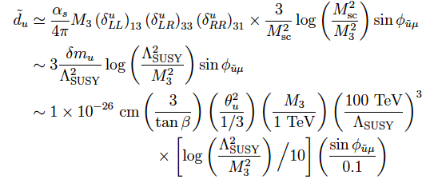
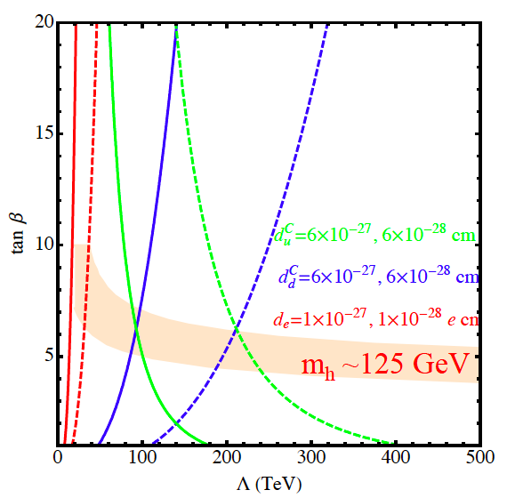
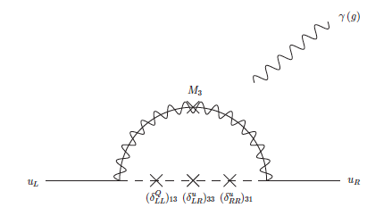
Why continue to bother with EDMs?
d_{n}SM ~ (10⁻¹⁶ e cm) x 𝛉_{QCD} + (1-6) x 10⁻³² e cm.
d_{n}^{BSM} ~ (10⁻¹⁶ e cm) x (v/𝛬)² x sin(𝚽) x y_{f}F
sin(𝚽) → CPV phase must be large enough to explain baryogenesis.
(v/𝛬)² → BSM mass scale?
y_{f}F → BSM dynamics: perturbative? strongly coupled? dependence on other parameters?
EDMs provide information on the three “frontiers”: cosmic frontier (baryon asymmetry), high energy frontier (scale of BSM) and intensity frontier (couplings of BSM).
For example, take ”minimally unnatural SUSY” → probing scales as several 100 TeV!
e
e

Slide 4
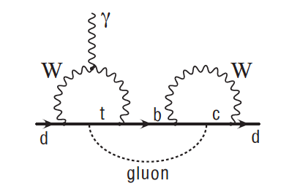
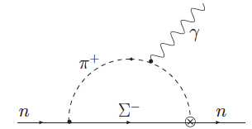
SM predictions for n/p/d EDMs
<10⁻³³ e cm
Direct quark EDMs vanish at one and two loop level!
Longer distance contributions dominate. Can be as large as 10⁻³¹.
So, at what values do we need to worry about the SM uncertainty in the predictions?
Consider an outrageous overestimate for d_{n} that puts loop factors like α_{s}/4π to be one, and chooses constituent quark masses (rather than current quark):
Therefore, any nonzero neutron/proton EDM above 10⁻²⁹ e cm is guaranteed to be NP.
In principle, Deuteron dEDM, is an even better candidate in terms of sensitivity to NP, and complementary to proton and neutron EDMs.
The SM prediction gives similar uncertainties: d_{d} = d_{n} + d_{p} + [0.003 g_{π}⁰ + 0.2 g_{π}¹]e fm.

Slide 5
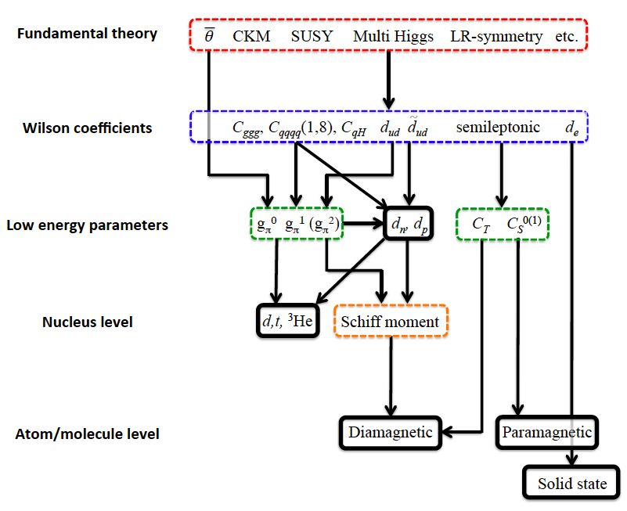
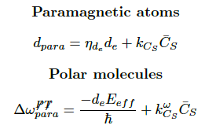
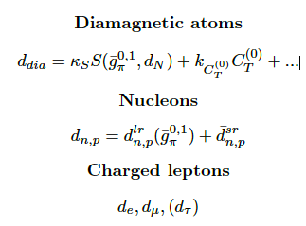
Sensitivities from different EDMs measurements

Slide 6
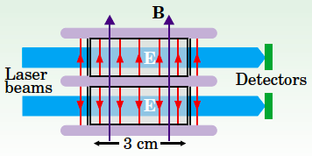
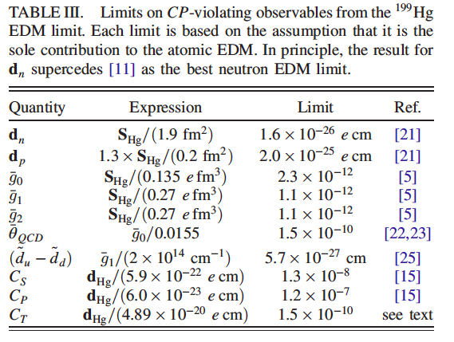
Status of ¹⁹⁹Hg (Diamagnetic) EDM measurements
Tabletop experiment at U. Washington (Seattle). Laser beamed through two cells with Hg vapor. Analysis phase, light plane polarized → nuclear spin precessed about B.
Two cells opposite E (10k V/cm). Recent result using four cells (outer pair cells no E).
PRL 116, 161601 (2016)
|d_{Hg}| < 7.4x10⁻³⁰ e cm @95% CL.
Sensitivity better than nHz! leakage current (<0.5 pA) so small that only upper limits → systematic uncertainties << 10⁻²⁹ e cm possible!
However, interpretation not straightforward: d_{dia} dominant contribution nuclear-spin dependent e-N interaction (C_{T}) and Schiff moment (long range pion and short range four-nucleon interaction).

Slide 7
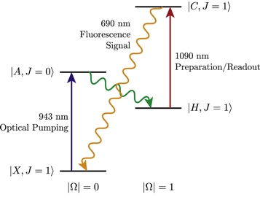
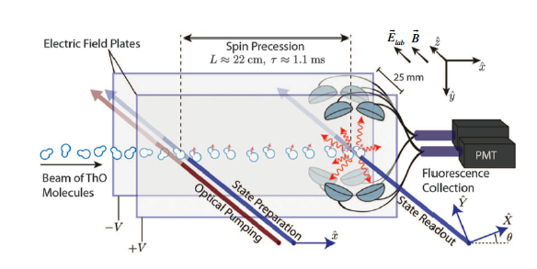
Status of ²³²Th¹⁶O (Paramagnetic) EDM measurements
NJP 19, 073029 (2017)
In paramagnetic systems with one (or more) unpaired e⁻, EDMs are dominated by d_{e} and the nuclear spin-independent e-N interaction (C_{S}). Great advantage is large internal E-field (GV/cm).
ACME experiment (Harvard), uses ThO molecule metastable states. The EDM signal is a rotation of the electron spin that reverses with the sign of E. The EDM frequency shift (𝚫ω^{EDM}) is the rotation angle divided by the transit time (τ~1.1ms). The angle is measured from the detection of fluorescence signal (690 nm).
Main syst. are due to imperfect reversal of E, but not dominant.
𝚫ω^{EDM} = (2.6±4.8±3.2)mrad/s → |d_{e}| < 9.7x10⁻²⁹ e cm @95% CL. (C_{S}=0)

Slide 8
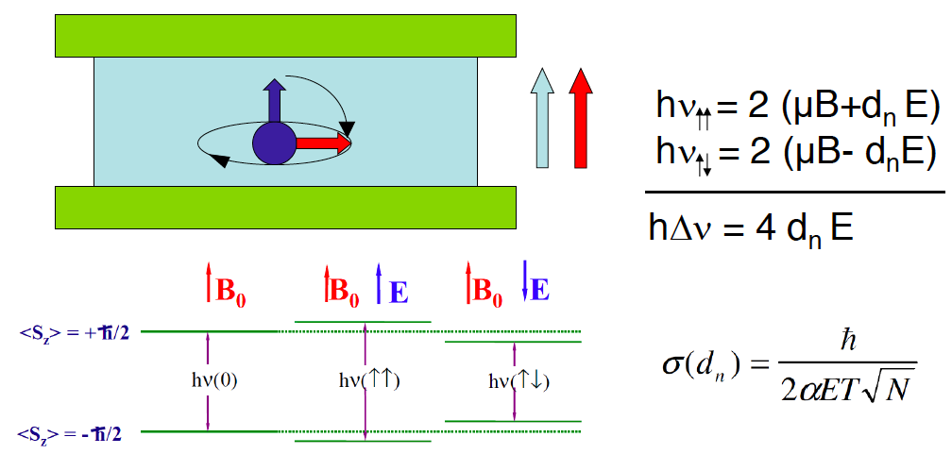
Status of neutron EDM measurements
Key to any EDM measurement: see small effect due to coupling to E, in a backgr. of much larger B using T-odd signature.
Measure Larmor precession with E parallel (antiparallel) to B.
Need large E(~10 kV/cm), and well know B(𝚫B~fT) that does not change between measurements.
Since 1980 advances in UCN production (specially at ILL Grenoble) enabled storage of neutrons in a “cell”, improving dramatically the statistical uncertainty due to the increase in observation time, and requiring advances in magnetic shielding.
Currently sensitivity is still dominated by the statistical uncertainty. The main systematic uncertainty requires the control of leakage current about 1nA (depending of the size of the experimental setup).

Slide 9
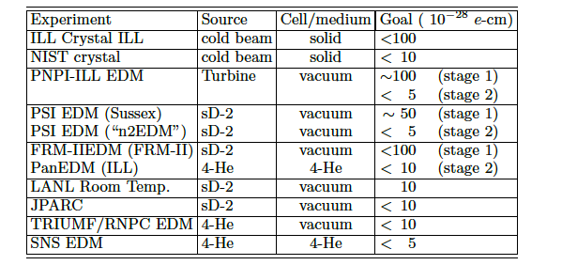
Status of neutron EDM measurements
Best current sensitivity from ILL, with data collected (1998-2002):
Current effort lead by PSI (nEDM Collaboration), expect sensitivity to 10⁻²⁶ e cm with data collected (2015-16). FRM-II reactor (Munich) could also reach similar sensitivities
Future efforts at PNPI-ILL, PSI and in particular at SNS (Oak Ridge) promise sensitivities O(10⁻²⁸)
d_{n} < 3.6x10⁻²⁶ e cm @95% CL.
PRD92 092003 (2015)

Slide 10
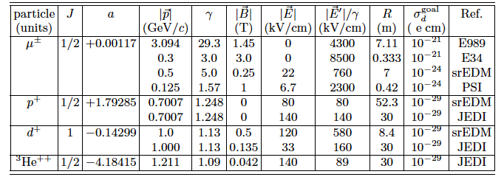
Status of μ EDM measurements
While the primary goal of the E821(g-2) Collaboration (BNL) was to measure a_{𝜇}, they were able to produce the best direct EDM limit on a fundamental fermion. In fact, in the presence of E and B, the rate of spin precession relative to the momentum is given by: ω_{a} + ω_{EDM}.
A non-zero EDM slightly tips the direction of ω_{a} out of the vertical,
and increases frequency: Therefore, and EDM measurement requires the detection of oscillations in the vertical momentum of the decay positrons.
New experiment at Fermilab to measure a_{𝜇} should as byproduct improve d_{μ} sensitivity to 10⁻²¹.
It could be possible to reach 10⁻²⁴ e cm sensitivities with a dedicated (small) storage ring.
with E, B, and β perpendicular
|d_{μ}| < 1.8x10⁻¹⁹ e cm @95% CL.
PRD80 052008 (2009)
In this case, E and 𝛾 must be chosen such that ω_{a}=0. However, spin coherence time is limited by the muon lifetime in the lab frame.

Slide 11
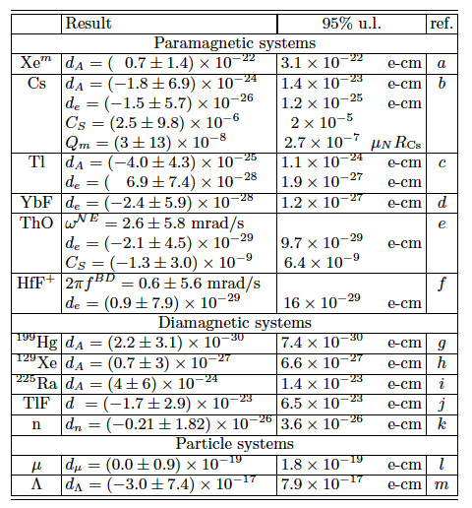
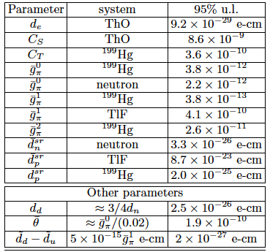
Status of EDM measurements
Sole-source limits on EDM parameters (arXiv: 1710.02504)

Slide 13
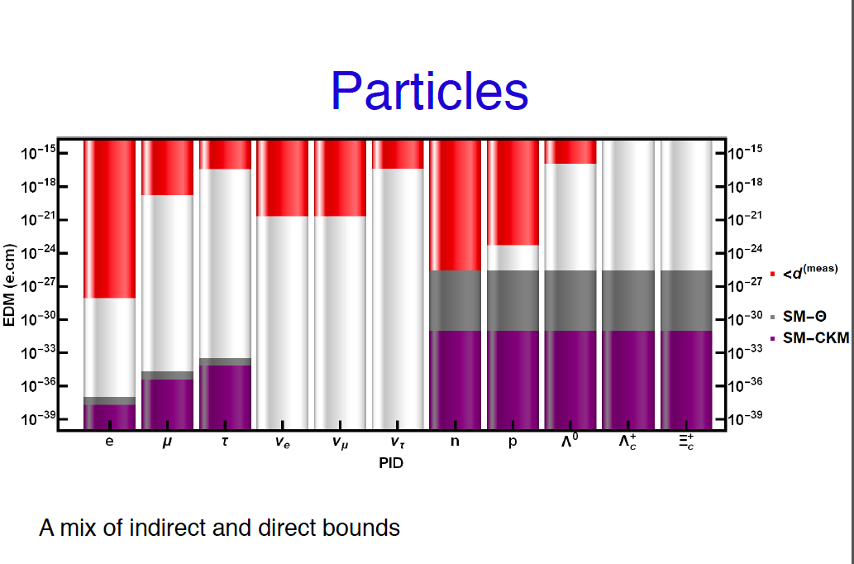
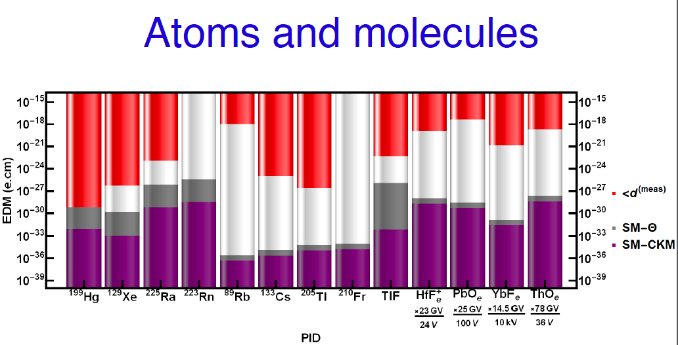

Slide 14
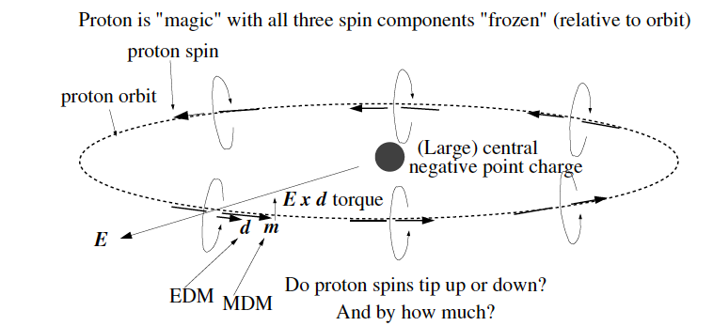
Storage Ring: experimental method
“Frozen spin” in all-electric storage ring is only possible for e or p, with “magic” momentum (15 or 701) MeV. Not possible for deuteron, without B-field.
10⁻⁶ mrad/sec for EDM~10⁻²⁹ e cm
Inject transverse polarized protons at 0.7 GeV (~100 bunches of ~10⁸ protons). Use RF solenoid to rotate spins, producing protons with both helicities. Measure difference between vertical polarization at earlier and later times, extracting part of the beam in a polarimeter.
To reach 10⁻²⁹ e cm, requires impractical small B (few aT). Therefore, inject both CW and CCW rotating beams. In the presence of a radial B field, a vertical separation will develop → key issue is monitoring beam trajectory!
Statistical precision:
With P=0.8, A=0.6, E₀=8 MV/m over 65% of the ring, N_{tot,c} = 5x10¹⁰ particles/cycle, f=0.011, T_{tot}=10⁷ sec and SCT=10³sec →
σ_{d}=2.5x10⁻²⁹ e cm

Slide 15
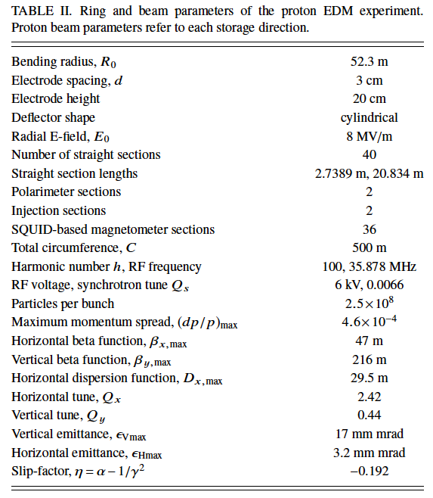
Ring and beam parameters
K₃: Quadrupoles to focus beam
20.8m long straight sections (with K_{1,2} quads.)
K₄: Quadrupoles to defocus beam
500m circumference, with 40 sections of concentric cylindrical deflectors: 52.3 m bending radius.
The 36 2.7m sections will include SQUIDS as magnetometers, and of the four 20.8m straight sections, two will have polarimeters.
Deflector plates (3cm space) will be ~8MV/m.
Ring elements:
Deflectors: Store beam and probes EDM
Quadrupoles: Focus beam
RF cavities: Improves SCT
BPM: Indirectly measures radial B
Polarimeters: Measures spin precession
Sextupoles: Further improves SCT

Slide 16
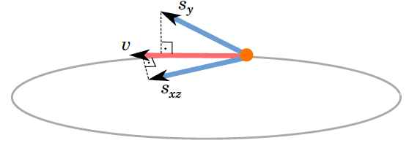
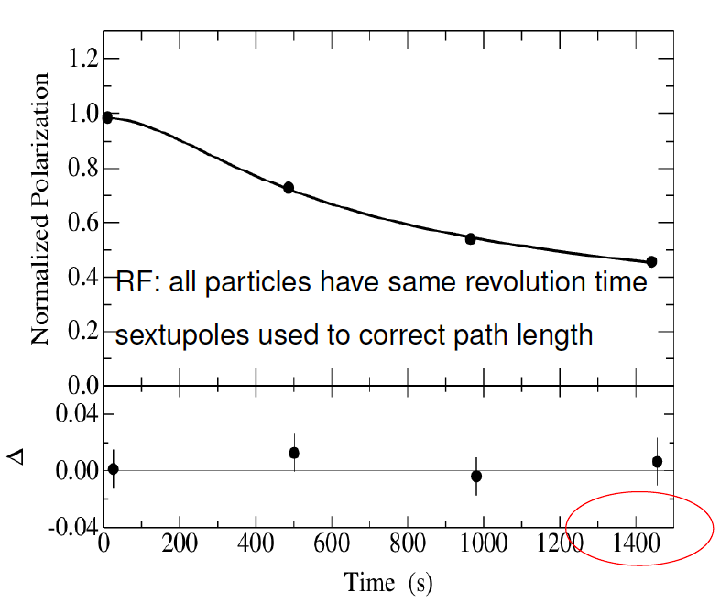
Spin Coherence Time
Not all protons in the bunch are at the “magic” momentum. Momentum spread induces S_{xz}. Spin coherence time (SCT) is the time we can keep under control this spread. Design of the lattice is critical to achieve O(1000)sec SCT.
Cooler Synchrotron (COSY): polarized p and d with p=0.3-3.7 GeV
😀

Slide 17
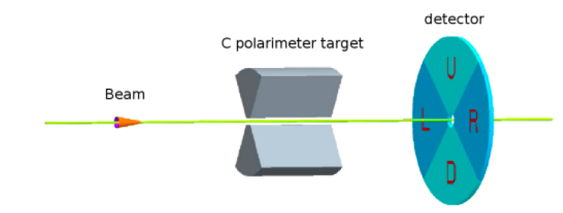
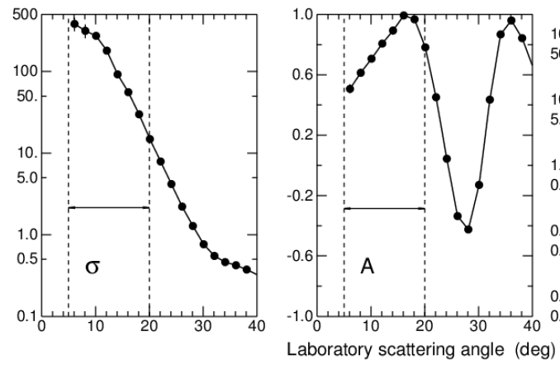
Polarimetry
Using pos. and neg. helicity protons in both CW and CCW beams cancels potential systematic uncertainties.
Protons scattered by 6 cm thick Carbon target. Extracted by slowly lowering vertical focus. About 1% of protons go through spin-dependent nuclear elastic scattering. LR asymmetry as a function of the proton vertical spin.
σ(mb/sr)
vector analyzing power
Several detector technologies under consideration:
GEM, Si Detectors, Micro-megas, Multi-resistive plate chambers,…
Again, nice work at COSY demonstrated ε~1% and A>0.6 (NIMA 664.1 (2012) 49-64).

Slide 18
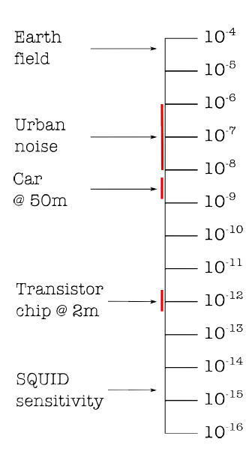
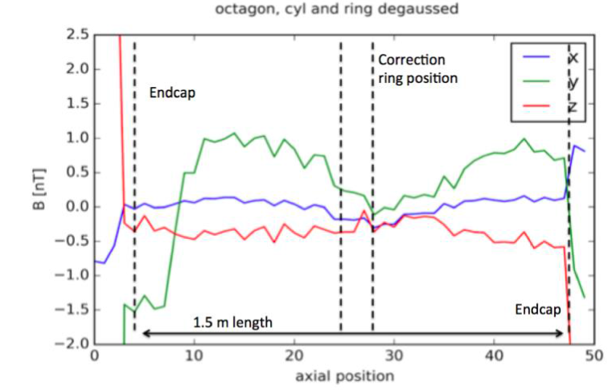
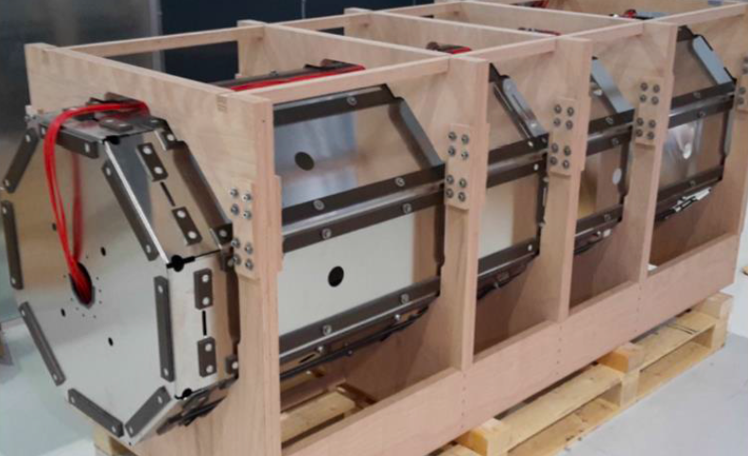
Main systematic uncertainty: radial B
B (Tesla)
The main worry for all EDM experiments. In an all-electrical storage ring, mostly environmental sources:
Mechanical movements nearby may generate few nT.
B-field distortions due to magnetic materials nearby.
Earth’s field is seen by the beam as a sinusoidal.
If we had continuous BPM along the ring we don’t need shielding. But there is a finite number of detectors. Simulations show that a shielding O(nT) at all points of the ring should do the job.
𝜇T
nT
Fetal Heart
pT
Brain
Spinal cord
fT
Shielding prototype: layers 𝜇-metal
fT/√(Hz)

Slide 19
Orbit distortion due to radial B
Vertical precession induced by a radial magnetic field. An average radial field of 10 aT cause a spin precession similar than EDM ~ 10⁻²⁹ e cm.
However, the radial B would split the CW and CCW beams vertically, as a function of the modes of the radial B-field:
Where Qy is the vertical tune, which will oscillate between (0.44-0.48) at 10kHz.
B~3 aT
For a 10 aT B, the split between beams is O(pm). BPMs are required to determine the beam position with this resolution over the duration of the experiment (O(10⁷)sec).
Vertical split induces a DC magnetic field in the horizontal plane, proportional to beam current and splitting → SQUIDs
1picometer

Slide 20
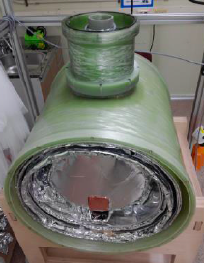
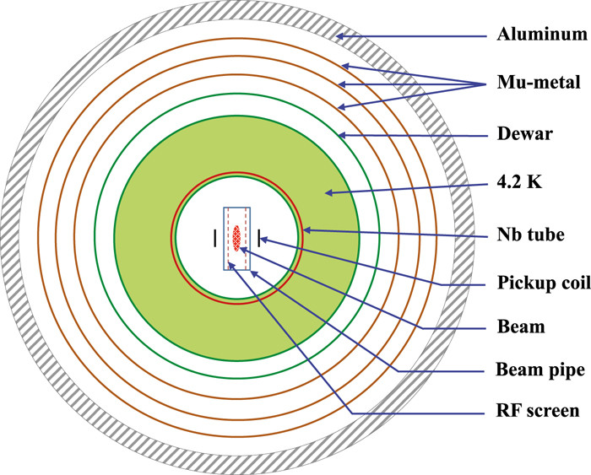
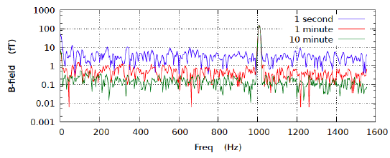
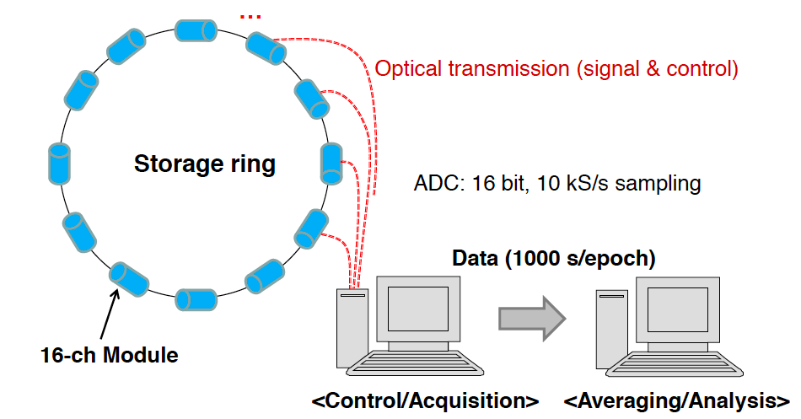
BPM: SQUID
prototype at CAPP
Current prototypes at KRISS/CAPP at Korea, provide 1.2fT/√(Hz) @ 1kHz, expect an order of magnitude better performance with new generation SQUIDs.
Sensitivity only to time dependent B fields (high harmonic contribution negligible).
DAQ/Software development at KRISS.
Interference-free control, noise-free acquisition, no time-delay between modules.

Slide 21
Geometric phases
In 3D spin rotations about different axes do not commute → significant systematic in nEDM.
In a storage ring it’s easier to control/cancel them.
Perturbations of E and B fields induce distortions of the closed orbits.
Analytical calculations show that the geometric effect of B-fields splitting the counter-rotating beams can be kept below the experimental sensitivity if shielding is effective at 10-100 nT level. Depending on the design of the storage ring optics (β-function) may require stricter shielding (work at CERN going on).
B-shield requirements completely dominated by geometric phase requirements.
Similarly E distortions due to plate misalignment can be controlled by using beam-based alignment, to better than 100μm. Excellent results obtained at IKP/Juelich. Beam-based alignment works. Optimal beam position inside the quadrupoles could be determined with ~10μm resolution, both horizontally and vertically.

Slide 22
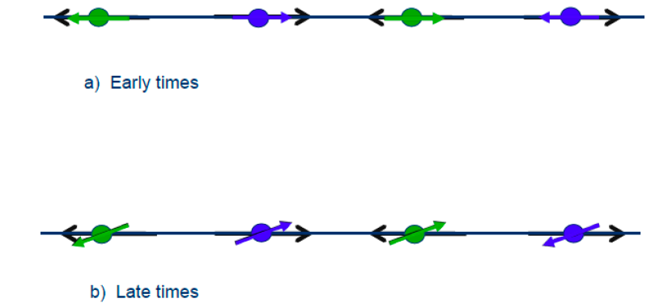
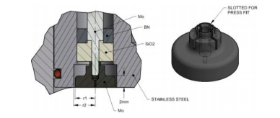
Non-radial E field
EDM signal
Vertical E fields (possibly balanced by gravity) cannot be neglected at this level of precision. However the effect is opposite(same) than the EDM signal for the CW(CCW) beams.
Other potential sources of vertical E fields are vertical misalignments of RF cavity. Only a problem if particles lose energy, e.g., due to longitudinal impedance around the ring. The plan is to minimize the longitudinal impedance well below 10 KΩ limit.
A vertical offset quadrupole could cause vertical beam oscillations. The plan is to use button BPMs (sensitive to beam E fields), as E-fields will add for CW and CCW beams while their magnetic fields subtract. These should feedback the beam-based alignment.
Blednykh et al. Proceedings of IPAC 2015

Slide 23
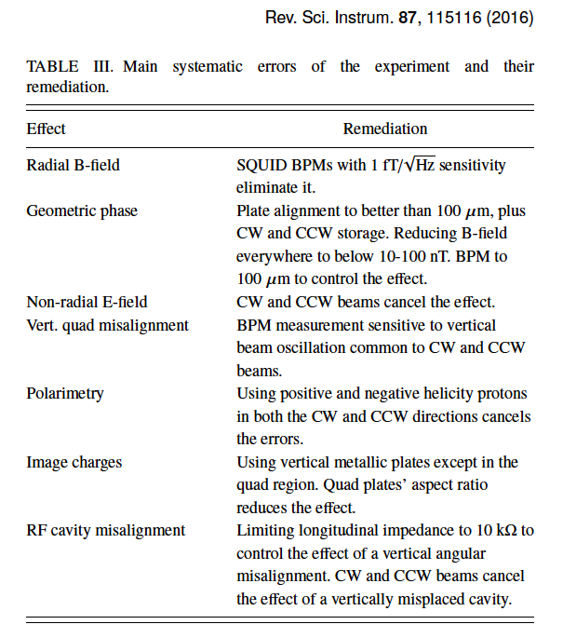
Summary of systematic uncertainties

Slide 24
A bit of history on the proposal
It all started at Brookhaven… first all-electric electron storage ring (AGS-analog) built 1953-57 and worked successfully. BNL experiment (E821 (g-2) Collaboration), following ideas and previous experiments at CERN, successfully measured ”a_{𝜇}” at a E/B storage ring using “frozen spin” method (1995-2004).
SrEDM collaboration proposed (2009-) to build an all-electric storage ring to search for the proton EDM. Technical reviews at BNL (Dec 2009 and March 2011) successful. Comprehensive review at Fermilab (Fall 2013) by world experts (Levedev) consider the project sound (even suggest improvements in lattice design). Engineering costs then $70M + tunnel costs. In 2014 strong endorsement from the P5 DOE and NSF panel!
JEDI Collaboration (COSY/Juelich) (2014-) built and commissioned an E/B storage ring to search for the deuteron EDM, supported by ERC. Key technical advancements: Polarimetry, SCT, cooling, simulation, etc…
CERN started PBC study in 2017 in preparation for the European Strategy discussion 2019-20, aiming at exploiting the full scientific potential of CERN’s accelerators and infrastructure through projects complementary to the HL(E)-LHC, FCC or other future colliders.

Slide 25
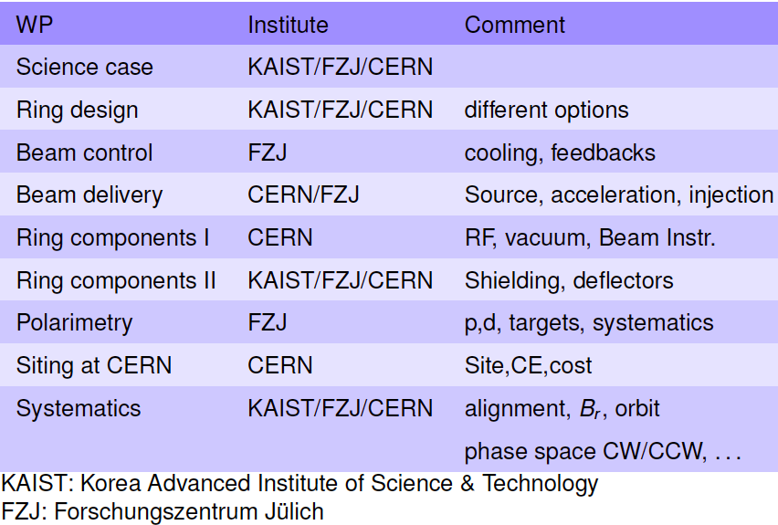
CPEDM Collaboration
Kick-off meeting in March 2017 at CERN, joining efforts from different communities. Several workshops since then → aim to submit a proposal by Autumn 2018, in time for the European Strategy discussion. Prototype of all-electric ring (1/10) under serious consideration to test in situ: proton storage, SCT, SQUID-based BPMs, B-shielding, alignment, etc…

Slide 26
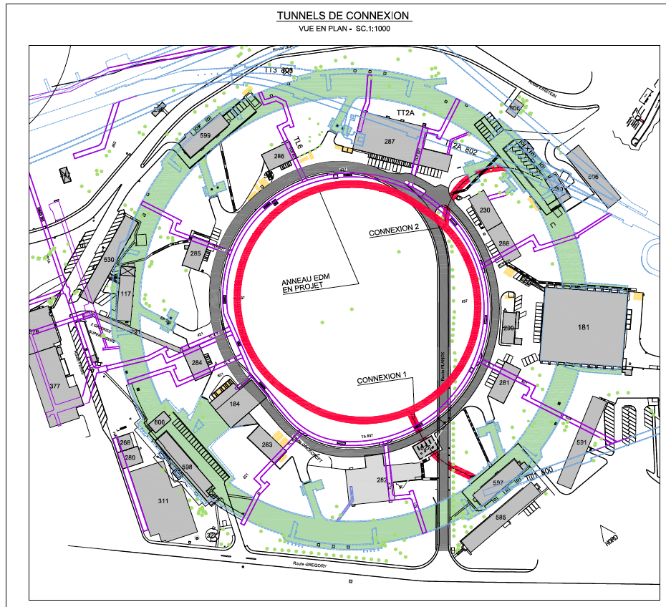
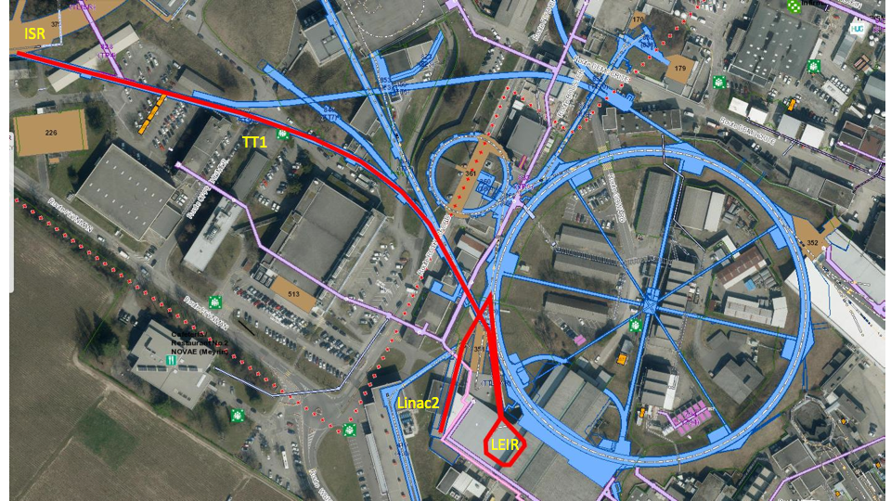
CERN site studies
Identified potential solutions for beam delivery, and injection system of 0.7 GeV polarized protons.
Storage ring fits nicely within the ISR area!

Slide 27
Messages to take home
EDMs are very sensitive probes for new CP-violating mechanisms…(for instance, constrains to 10⁻⁴ CP-odd H→𝛾𝛾 operator, …) these searches are considered to be one of the most promising paths towards NP.
The search in different systems (leptons, nucleons, atoms, molecules, etc…) are complementary and needed to discriminate between EDM sources (𝛉_{QCD},C_{ggg}, C_{qqqq} C_{qH},d_{n},C_{T},C_{S},…)
Current (and future) efforts in neutron EDMs are limited by the available sources of UCN. Statistics is not a problem for a proton (deuteron) storage ring. Moreover, the possibility to have CW (CCW) beams in an all-electrical storage ring is a key aspect to be able to control systematic uncertainties at the 10⁻³⁰-10⁻²⁹ level. The other key aspect is the BPMs to control the beam trajectories.
The European Strategy discussion (2019-20) will be critical to define the importance (and the budget) that CERN will allocate to experiments complementary to the High Energy frontier facilities.

Slide 28
BACKUP SLIDES

Slide 29
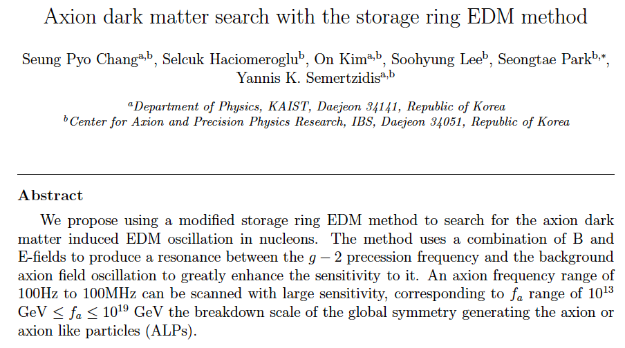
Search for axion dark matter in storage rings
arXiv:1710.05271

Slide 30
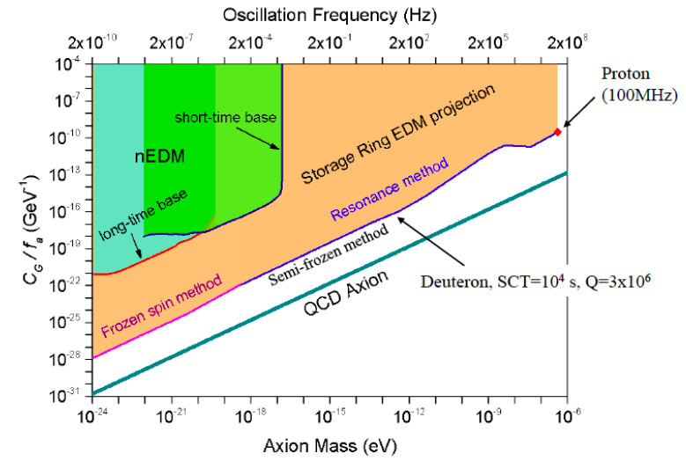
Search for axion dark matter in storage rings
An axion field oscillating coupled to gluons will originate an oscillating EDM.
An E/B storage ring can be designed such that the (g-2) precession frequency coincides with the axion frequency (m_{a}c²/h).

