Slide 1
Gas Detector R&D at IFAE
Thorsten Lux

Slide 2
Gas Detector Principle
Charged particles
(UV) Photons
X-ray
Cathode
CsI coating
mm - m
e-
Gas (Mixture)
E (+ B)
Amplification
Provides:
xy position
Energy
(z position)
Anode

Slide 3

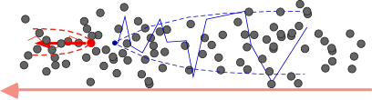
Charge Transport in Gas
ELECTRIC FIELD E = 0: THERMAL DIFFUSION
ELECTRIC FIELD E > 0: DRIFT AND DIFFUSION
IONS
ELECTRONS
E

Slide 4
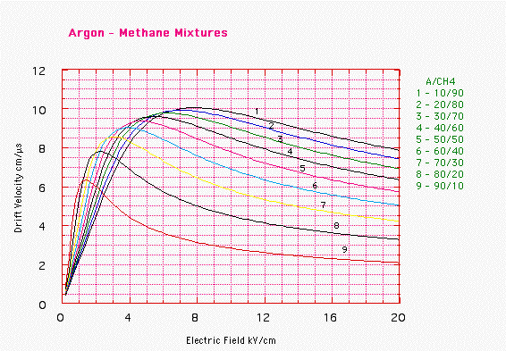
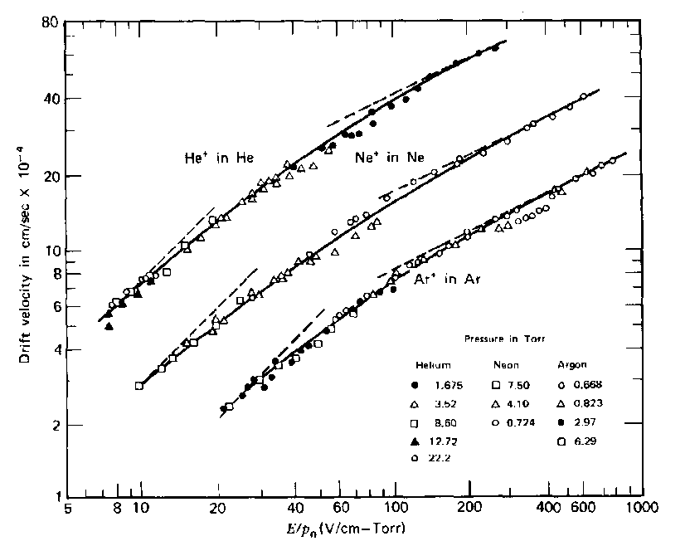
Drift
Electrons:
Drift velocity complex function of E field
normally in the order of few cm/μs
Ions:
Drift velocity ∝ E field
very slow, several 1000 times slower
⇒ causes sometimes problems

Slide 5
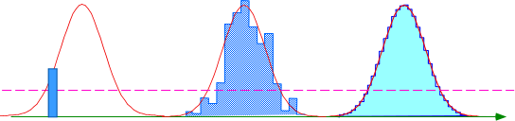
Diffusion
σ_{T}
E Field
σ_{L}
Drift
Drift
Electrons:
point-like charge cloud gets wider with drift distance
σ = D*sqrt(z)
transversal (E⊥) and longitudinal diffusion (E||)
transversal affects point resolution
longitudinal affects time information
B||E can reduce transversal dramatically
Ions:
Diffusion much smaller but rarely used in real detectors
=> Remember Federico’s graphene talk!
time

Slide 6
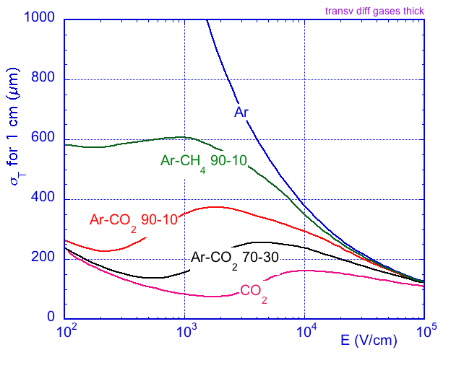
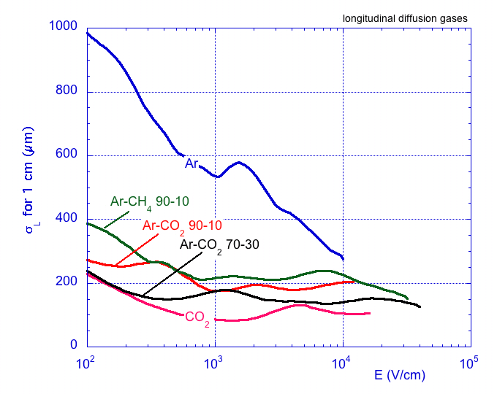
Diffusion
TRANSVERSE DIFFUSION:
LONGITUDINAL DIFFUSION:

Slide 7
Charge Amplification
Proportional Region
Pulse Height
Ionization Region
Recombination Region
Continuous Discharge Region
Limited Proportional
Region
Geiger-Mueller Region
α
β
γ
high voltage

Slide 8
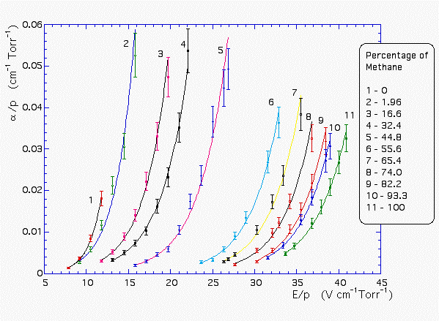
Maximal Gas Amplification
in Argon

Slide 9
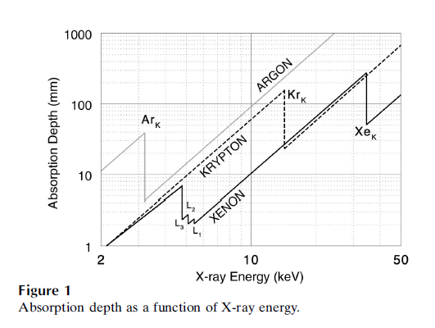
Gas Choice
Right gas choice fundamental for optimal operation! Depends strongly on application.
Normally noble gas + some additive gases
We can also play with the pressure
Important factors:
stopping power
energy resolution
costs: direct (e.g. Ar cheaper than Xe) and indirect ( e.g. pressure vessel)
…
pressure ↑

Slide 10
Quencher Gases
Pure noble gases are often not suitable:
slow
relatively large diffusion
stable amplification limited
⇒ Solution: Adding some amount of molecular gas
Some examples:
But … this can also complicate things:
more sensitive to impurities -> attachment, loss of electrons during drift
gas system might become more complex -> purification, flammability

Slide 11
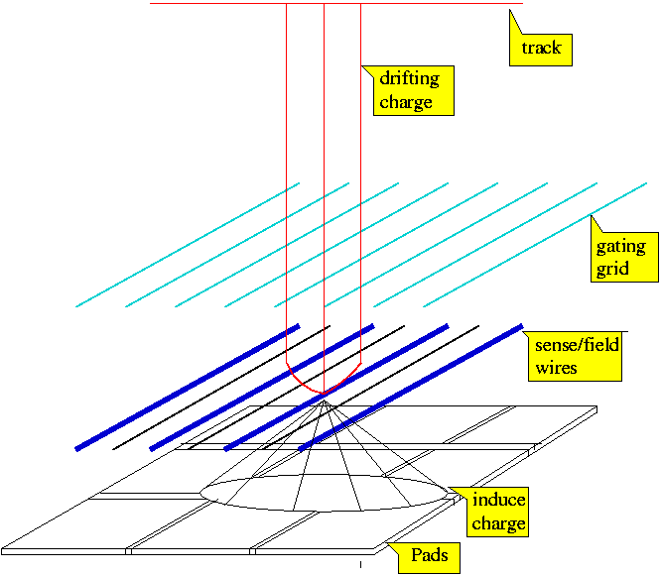
Gas Amplification Technologies
Wire readout (classically used)
Gas Electron Multiplier (GEM)
Micromegas
Charge amplification, for light amplification see Alfonso’s talk (soon)
Wire Readout the classical technology
good reasons to look for alternatives:
E x B effects
ions might drift back to gas volume
wire under tension requires a lot of material
slow ion signal

Slide 12
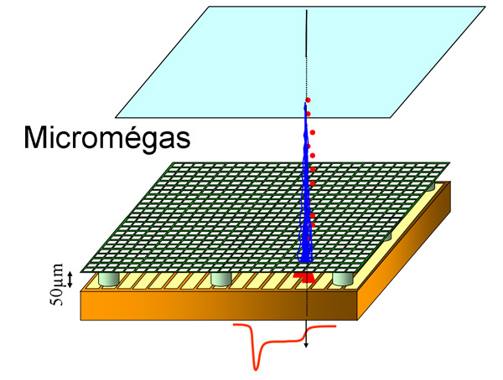
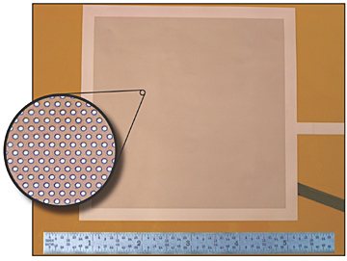
Micro Pattern Gas Detectors
Several advantages about the classical wire readout:
Excellent spatial resolution ( amplification structures: ~100 μm)
Very good energy resolution
Low material budget
No ExB effects
Cheap
Can be produced in large quantities
GEM

Slide 13
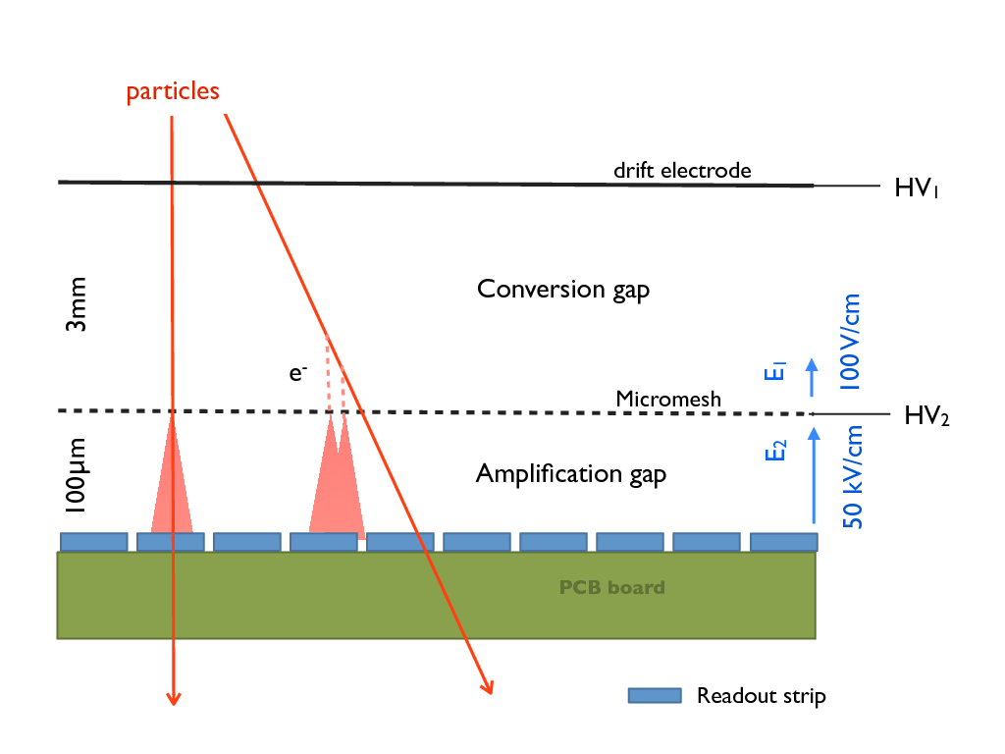
MicroMegas (MM)
1 stage amplification
Excellent energy resolution and low threshold (600 eV)
Time resolutions below 1 ns possible

Slide 14
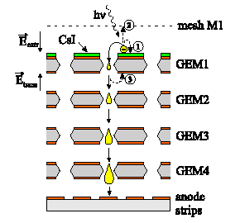
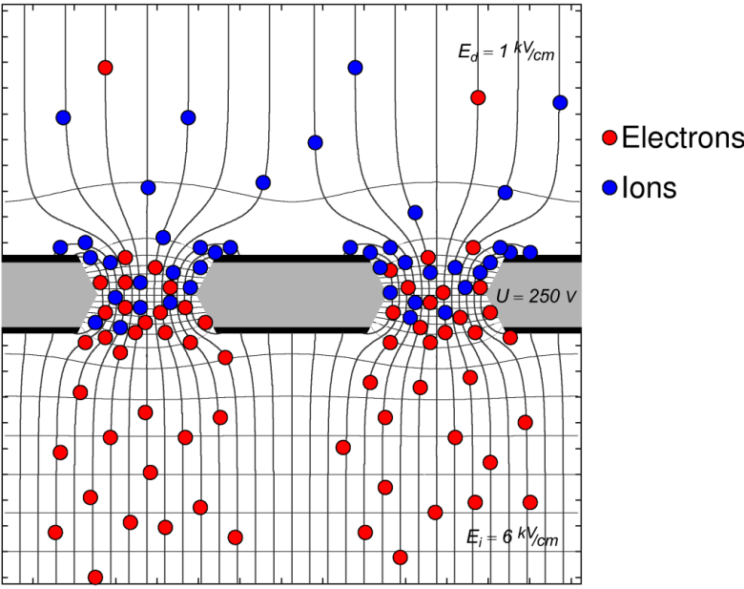
Gas Electron Multiplier (GEM)
Amplification within holes of Kapton foil coated with copper
Normally operated in cascades -> better stability
Can be operated in high rate environments (LHCb: 1 MHz/cm²)

Slide 15
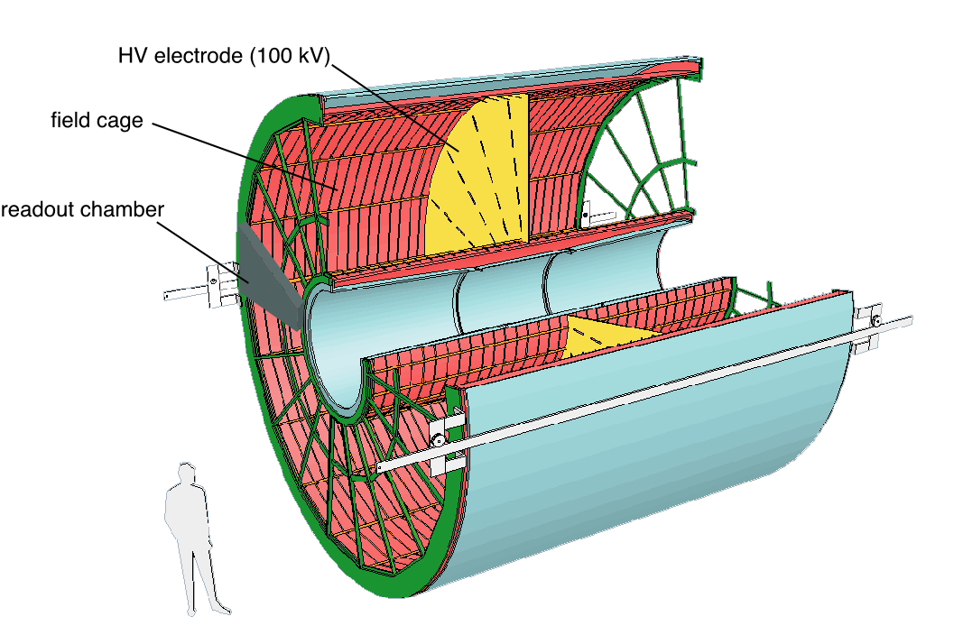
Real Detector: ALICE TPC
88 m3
~ 5 m

Slide 16
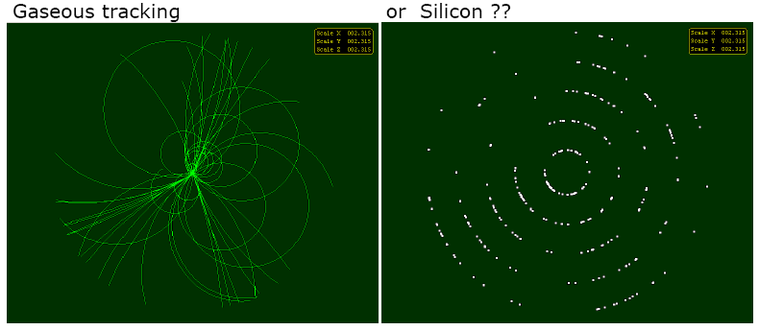
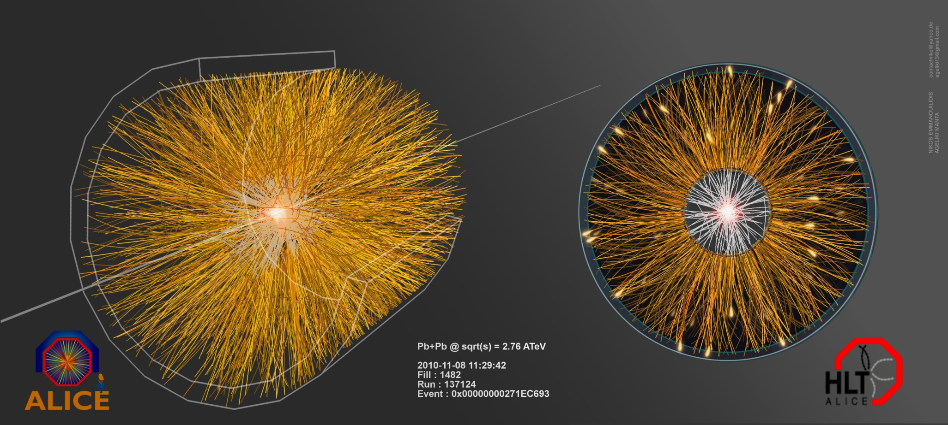
Tracking with a TPC

Slide 17
Particle Identification
Measuring dE/dx and momentum (if B is present) allows PID!

Slide 18
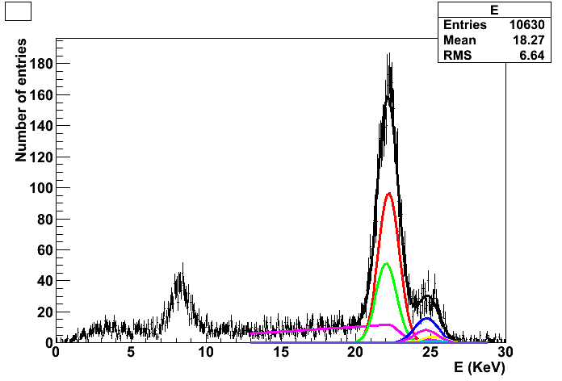
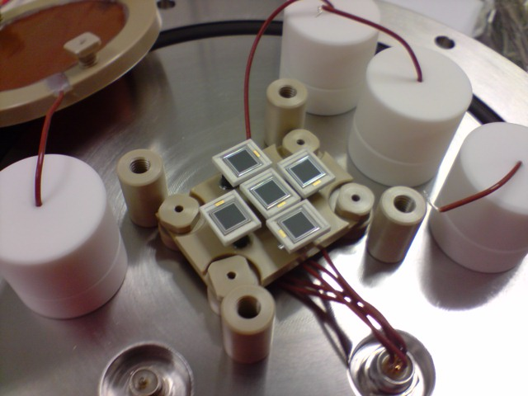
IFAE Gas Detector Projects
T2K TPCs -> see also talks from Javi (last month) and Stefania (soon)
EL TPC -> see R&D talk of Alfonso (soon)
LAr double phase prototype
Si-MPGD with MediPix readout
xenon
(8.2 ± 0.1)% FWHM
18

Slide 19
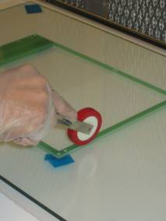
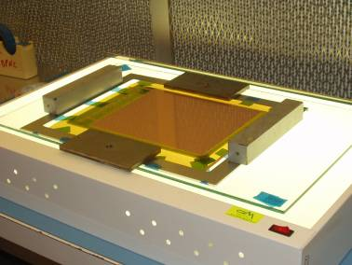
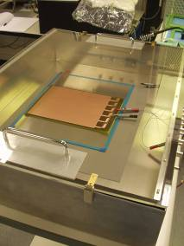
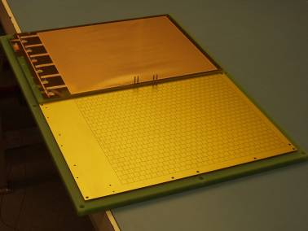
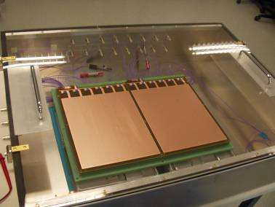
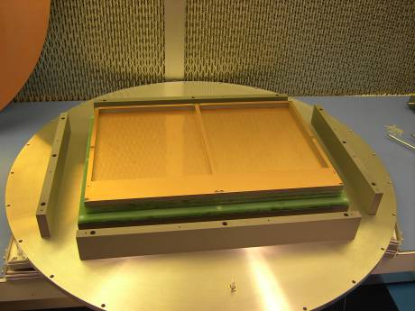
T2K: MPGD Detector R&D
2005: Start R&D efforts for a MPGD TPC for T2K
European GEM collaboration: UniGe, IFIC, INFN Bari, IFAE
2 GEM tower
3 GEM each
~20x24 cm2
also small setup at IFAE
19/19

Slide 20
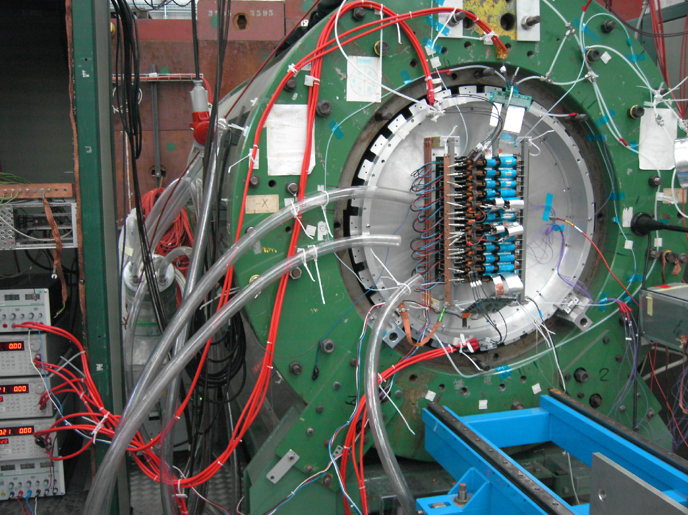
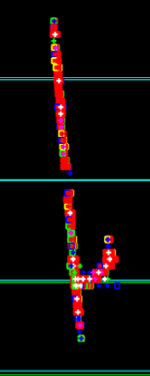
T2K: MPGD Detector R&D

Slide 21
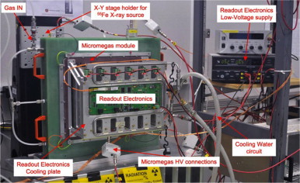
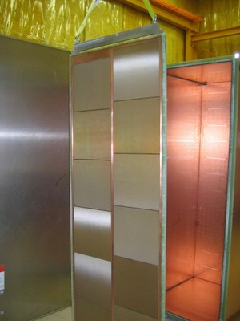
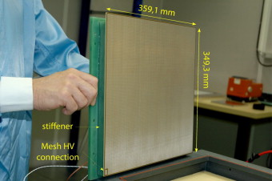
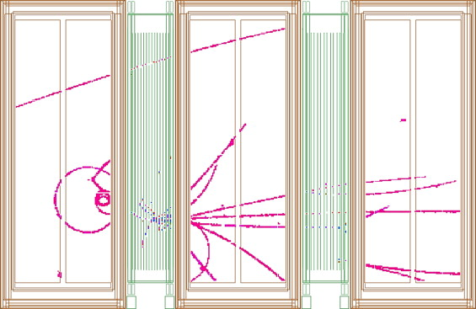
T2K: MPGD Detector R&D
IFAE participated in setting up testbench
characterization of ~ 90 MM modules
~12 m2 readout area
nowadays focus on analysis

Slide 22
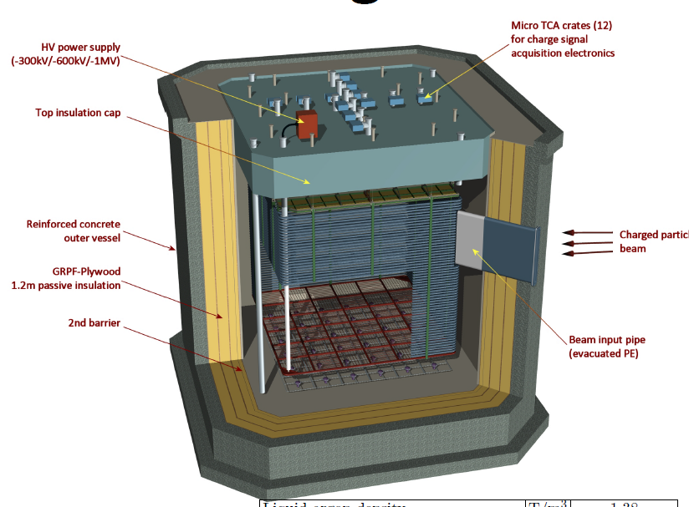
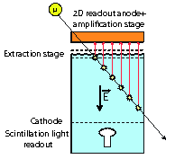
DLAr 6x6x6 m³ Prototype
Currently in the decision phase (CERN and Ministry)

Slide 23
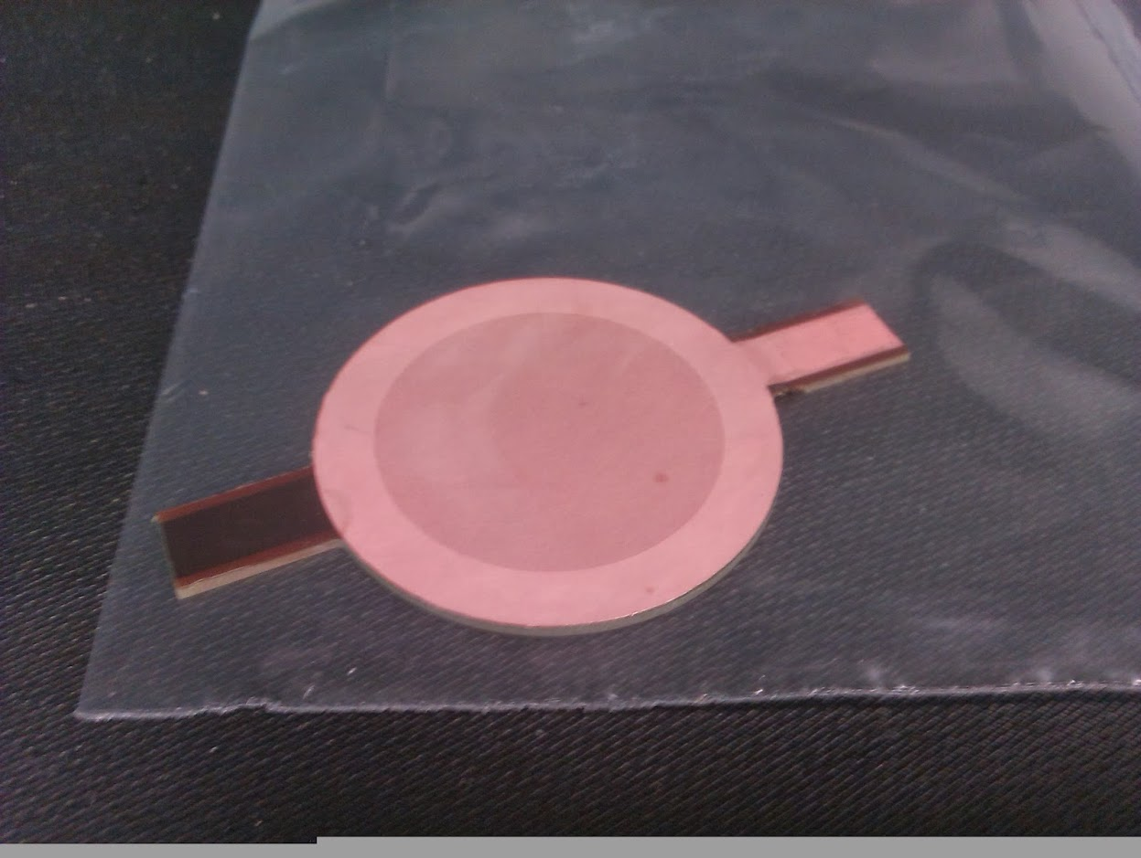
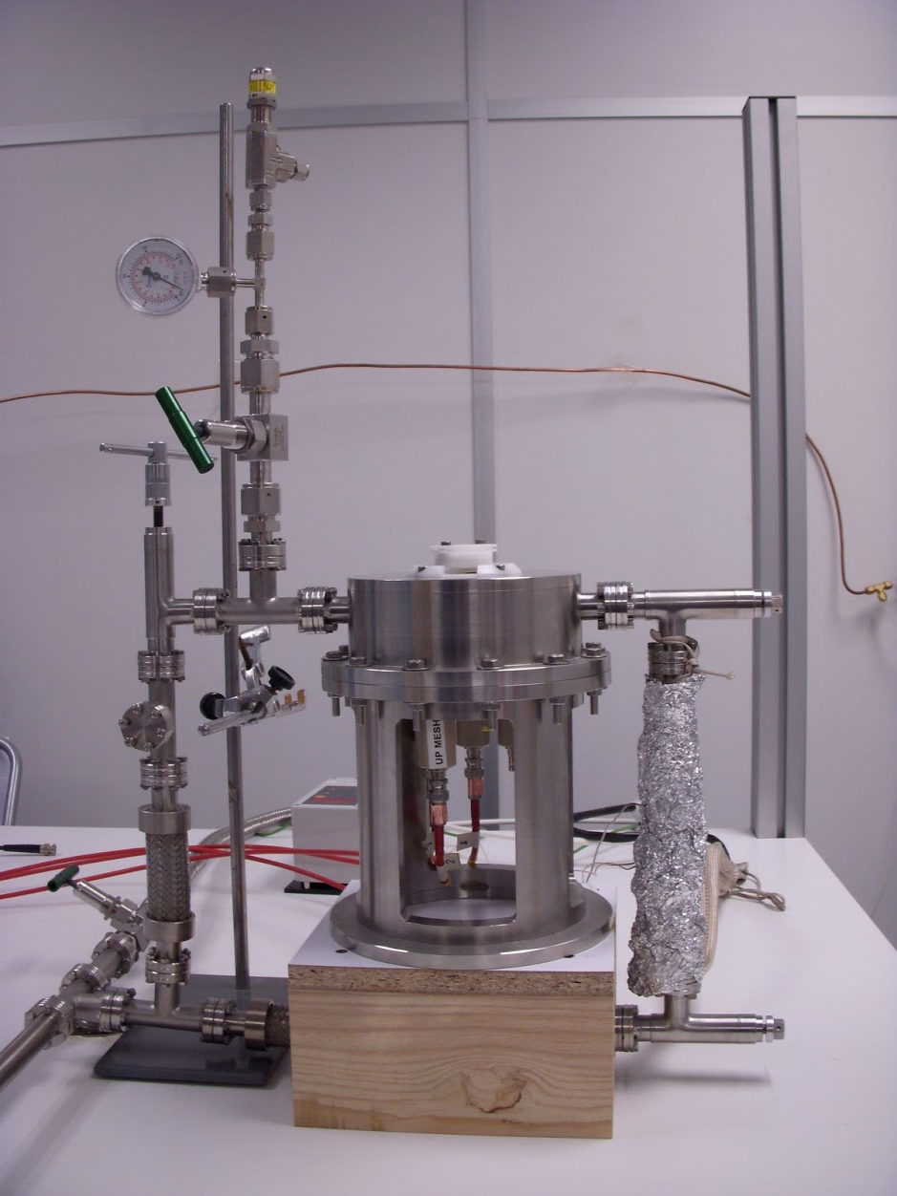
DLAr 6x6x6 m3 Prototype
Contributing to the primary scintillation light detection (together with CIEMAT)
Tests with microbulk MM in Ar:iC4H10 and pure argon -> final project of Raul

Slide 24
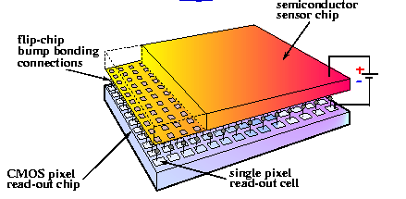
Si-MPGD Project (CNM/IFAE)
To exploit the full imaging capabilities of MPGDs classical pads are too large
Solution: Couple MPGD to MediPix/TimePix
Aiming on improved sensor fully Si
55x55 μm² pixel size
256x256 pixel
14x14 mm2 active area
2 relevant modes:
  Time over Threshold
  Time of Arrival
already used in previous CNM/IFAE project: DearMama

Slide 25
Summary
Gas detectors are a very flexible detector type
Suitable for charged particles, X-rays and photons
Choice of gas mixture and operational pressure allows optimization
MPGD technologies gave new push
TPCs allow 3D reconstruction of event + PID
I had to skip many details as e.g. attachment, …
IFAE built up during the last 9 years some experience with gas detectors
More talks about the specific projects

Slide 26
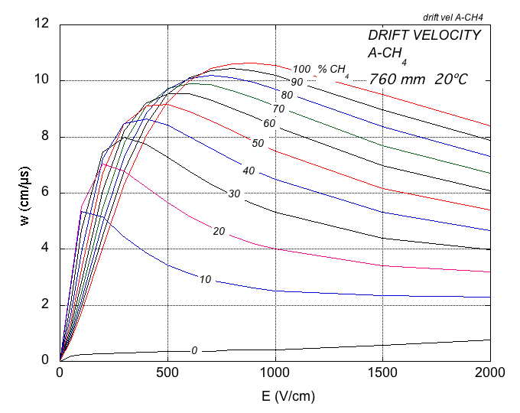
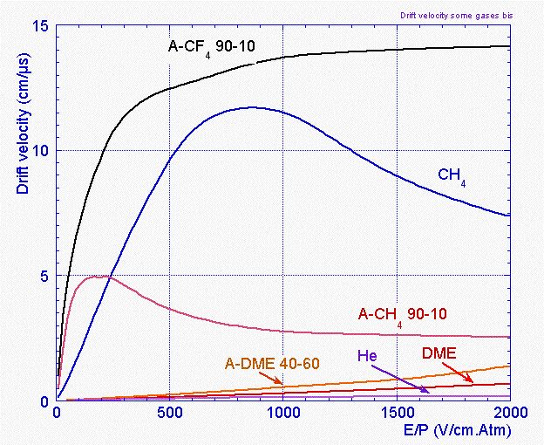
Drift Velocity

Slide 27
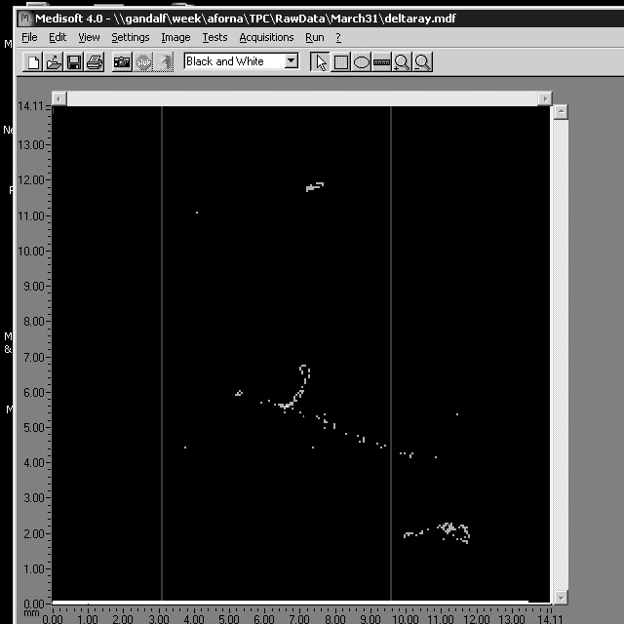
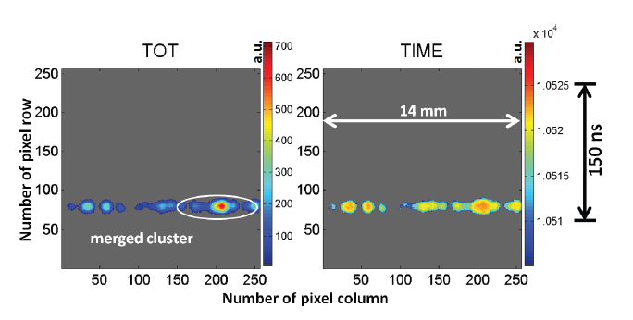
How it looks like
MM
GEM

