Slide 2

Overview of Beam Dump Facility and SHiP experiment at CERN
M. Casolino on behalf of BDF working group and SHiP Collaboration
Acknowledgements: C. Ahdida, M. Calviani, R. Jacobsson, K. Kershaw, M. Lamont, E. Lopez Sola, N. Serra, H. Vincke
IFAE,
16th November 2018

Slide 3
Outline
Motivation
BDF concept and requirements
  Details about the target and the target station
  RP challenges
SHiP
  Detectors
  Physics performances
Summary
IFAE,
16th November 2018

Slide 4
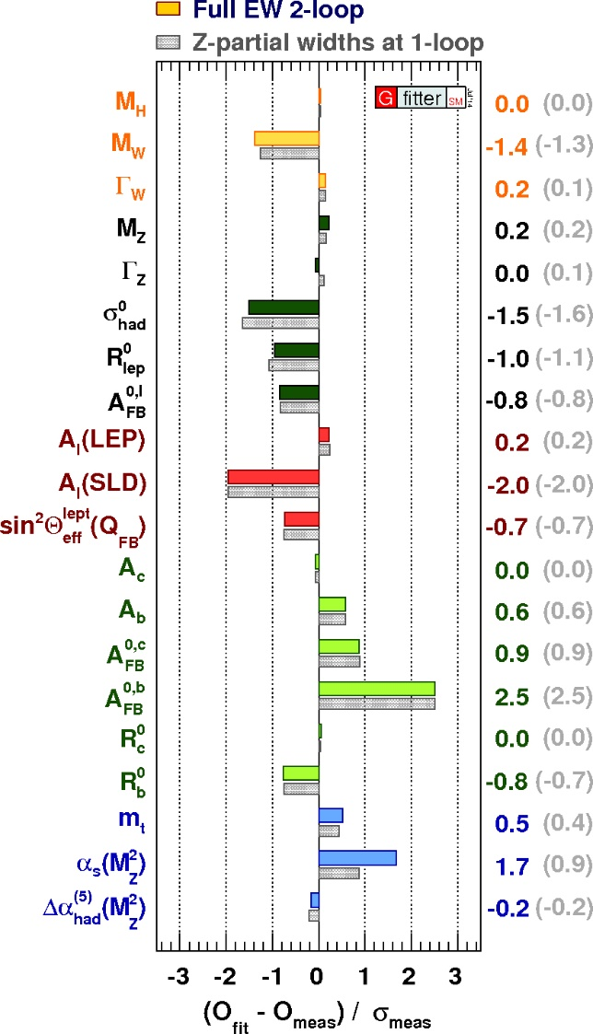
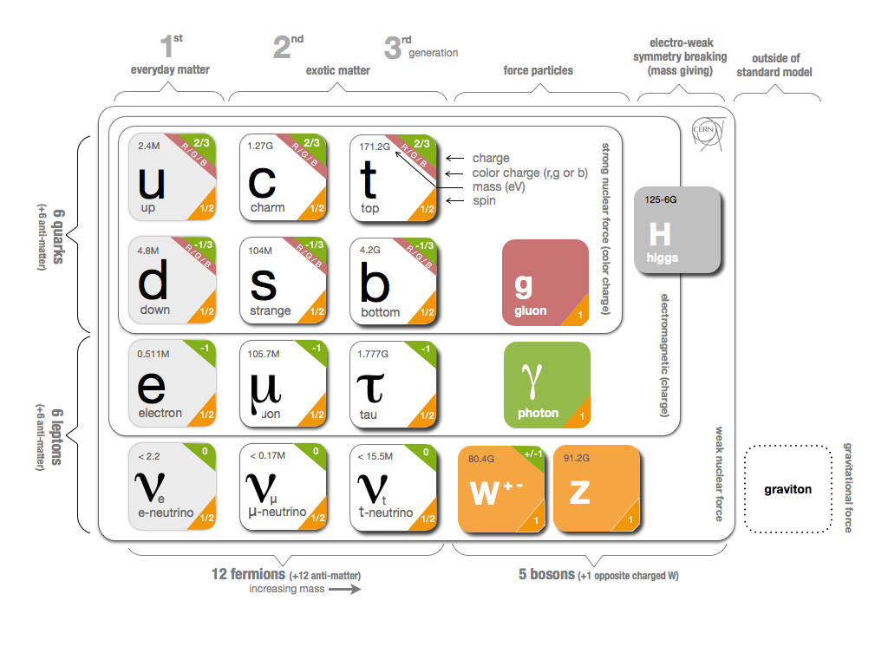
A successful theory…
The Standard Model (SM) describes the interactions between all known elementary particles, accounting for three of the fundamental forces of Nature.
IFAE,
16th November 2018

Slide 5
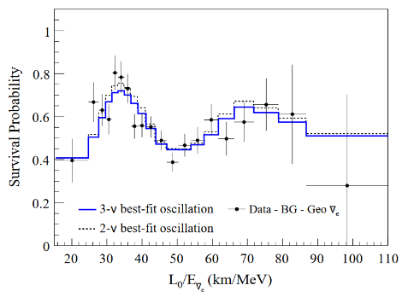
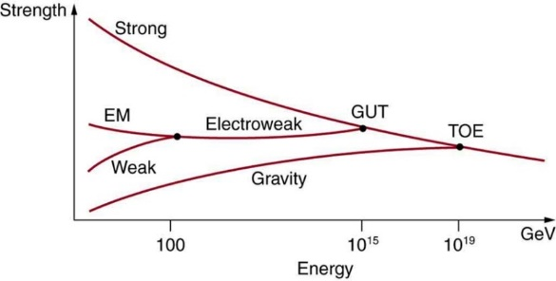

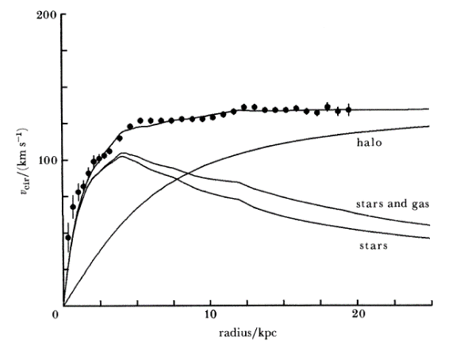

..but BSM is behind the corner
Not a complete unified theory,
what about gravity?
Why three generations?
No mass term for neutrinos
Not enough CP-violation to explain
matter-antimatter asymmetry
No candidate for Dark Matter
Naturalness and Hierarchy problem
IFAE,
16th November 2018

Slide 6

We live in a Dark Universe
It is roughly 80% of the matter in the universe
Interact with other particles weakly
It has mass, so gravitational effects → only method with evidence until now
WIMP miracle → m_{NP}~Λ_{EW}
IFAE,
16th November 2018

Slide 7
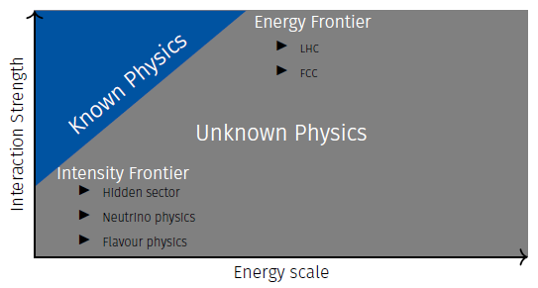
A voyage into the unknown
GeV
LDM
WIMPs
IFAE,
16th November 2018

Slide 8
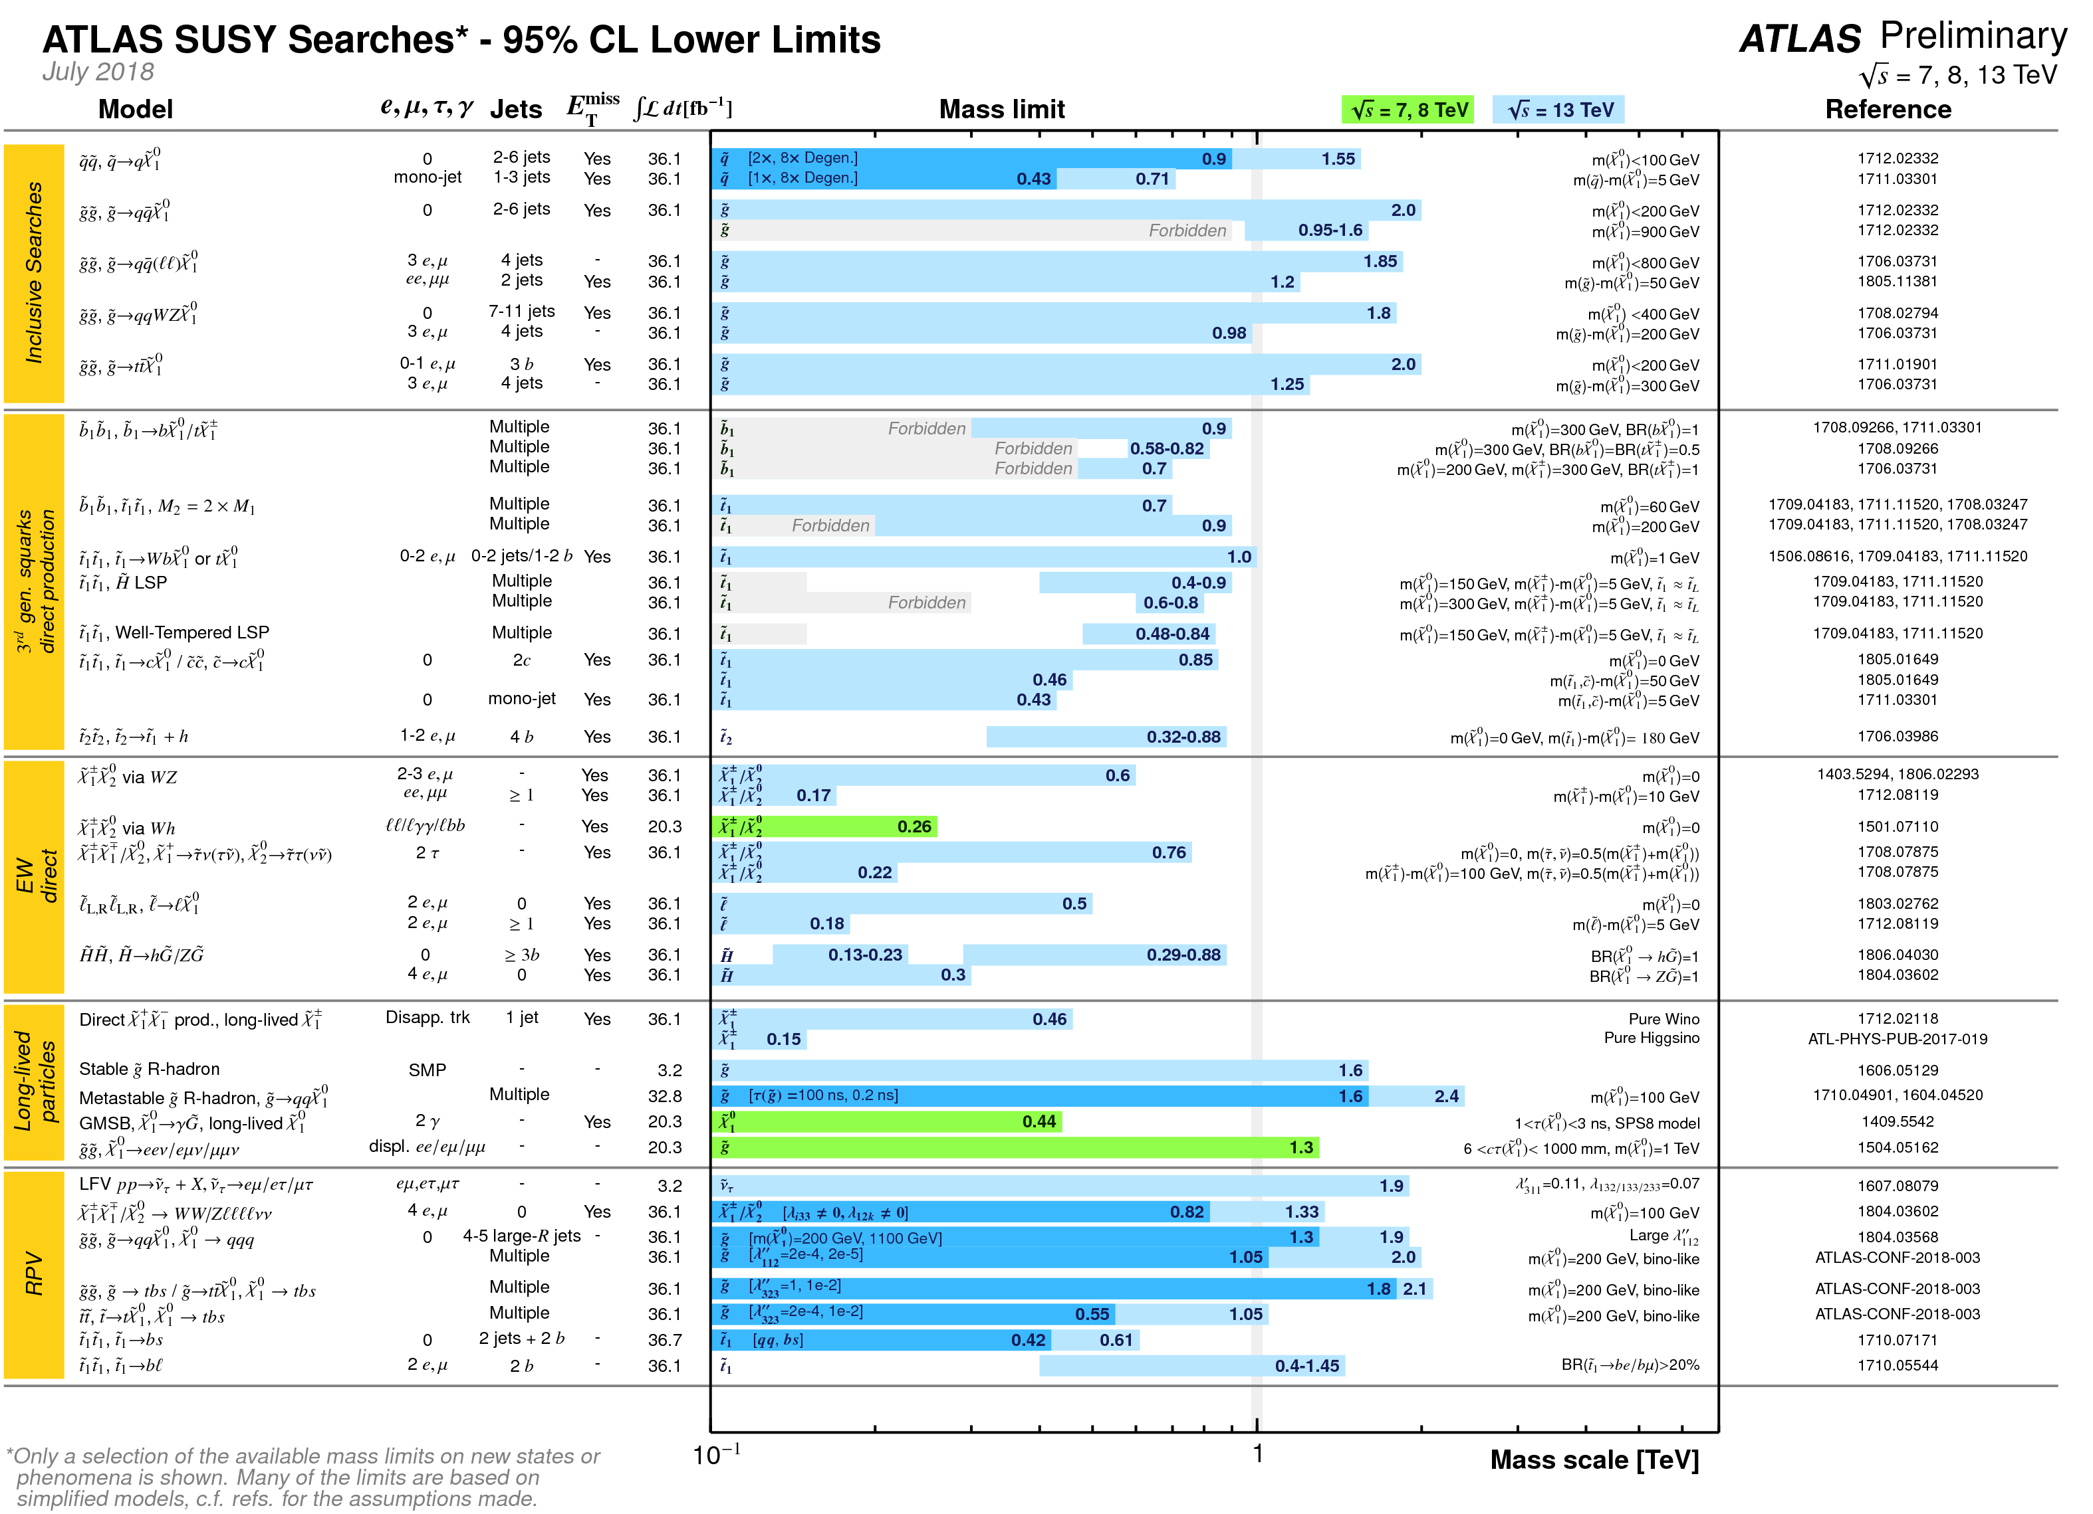
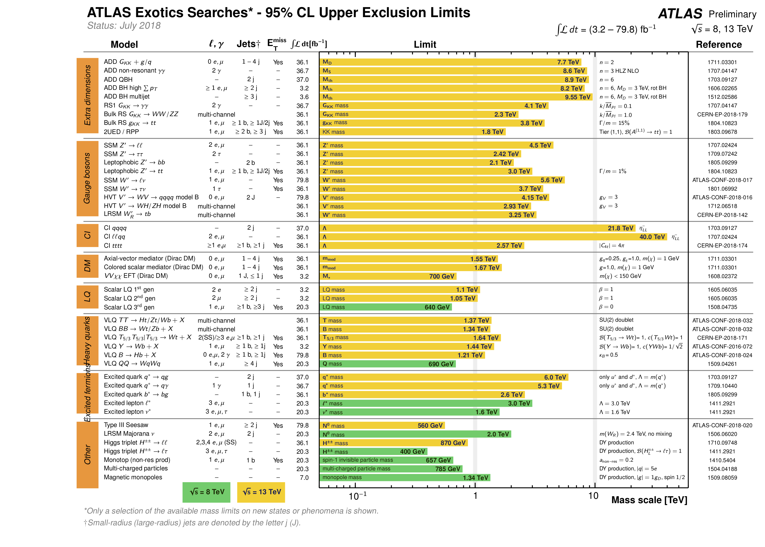
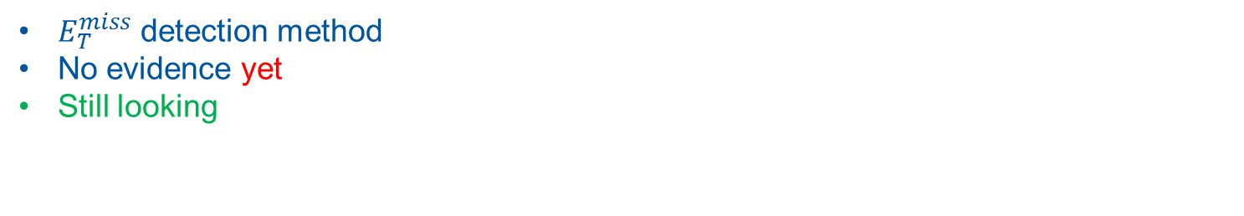
WIMP searches – Direct production at LHC
$E_{T}^{miss}$ detection method
No evidence yet
Still looking
TeV
TeV
IFAE,
16th November 2018

Slide 9
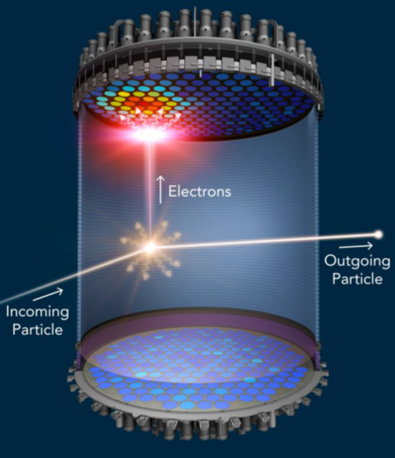

WIMP searches – Recoil method
Dark matter in the halo of our galaxy
On the earth we can detect a wind of Dark Matter
IFAE,
16th November 2018

Slide 10
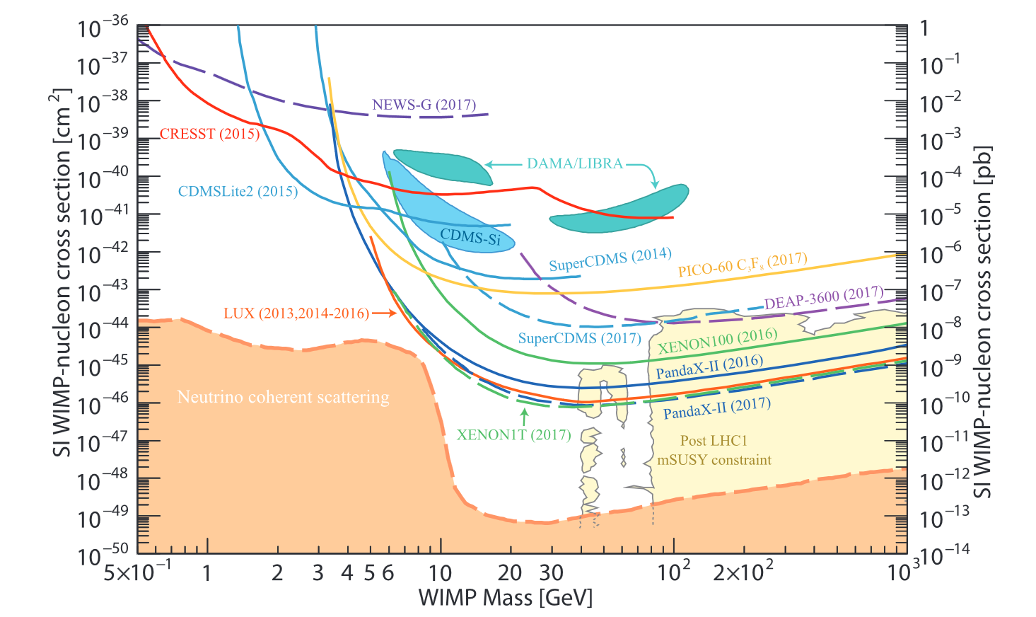
WIMP searches – Recoil method
No evidence here as well
IFAE,
16th November 2018

Slide 11


Portals to Hidden Sectors
WIMP absence → Hidden Sectors idea
Dark Matter naturally light (LDM) (m_{NP}<10 GeV)
Low Production branching ratios (<10⁻¹⁰)
Long-lived objects
IFAE,
16th November 2018

Slide 12
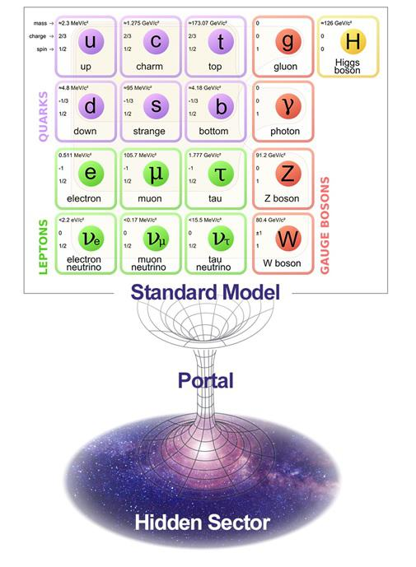
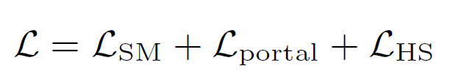




Many Portals
SM can be connected to the hidden sector (HS) through different mediators:
Scalar (e.g. dark scalar, dark Higgs)
Vector (e.g. dark photon)
Fermion (e.g. heavy neutral lepton (HNL))
Axion-like particle (ALP)
To minimize model dependence full reconstruction and PID are essential
Main experimental challenge is background suppression
IFAE,
16th November 2018

Slide 13
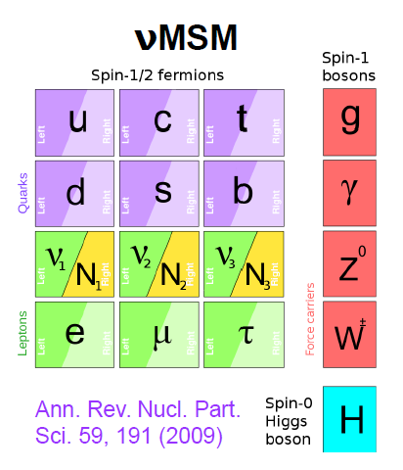
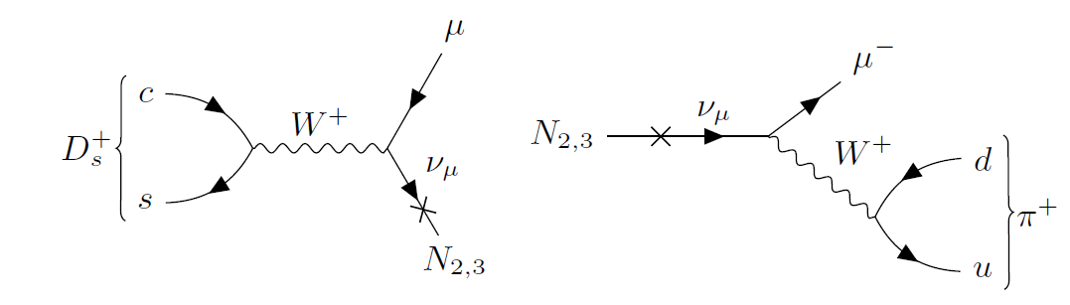
Example: Fermionic Portal
Still 3 missing pieces to the SM that can solve many experimental problems:
Adding 3 RH Majorana neutrinos N_{i}:
  Light N₁ with mass ~keV → dark matter candidate
  Heavy N_{2,3} with mass ~GeV and weakly coupled to SM
    Create baryon asymmetry of the universe via leptogenesis
    Produced in charm decays; detectable via visible decays
Best sensitivity to HNLs → Beam Dump Facility with heavy target
IFAE,
16th November 2018

Slide 14
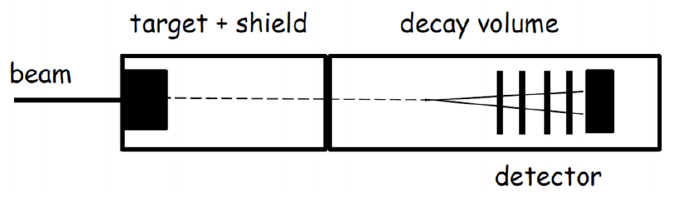
Experimental concept
High Intensity beam into an heavy target (12λ_{int}):
  Maximize NP particles production
  Particles either coming from heavy meson decays or from pN interactions
  Suppress pion and kaon decays which is source of background
Minimize the flux of SM particles in the detector
Define a (large) fiducial volume where the background level is approximately zero
Detection by decay or by interaction with matter (recoil method)
IFAE,
16th November 2018

Slide 15
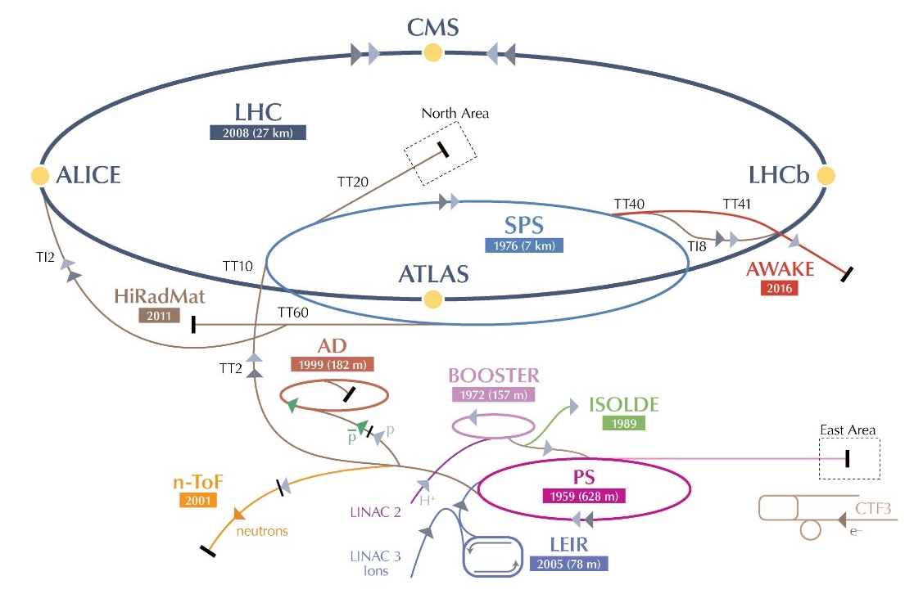
CERN accelerator complex
High energy experiments and test beams
Former CNGS line
Antimatter factory
Low energy experiments and test beams
Exploit full power of the SPS:
  About 20% running for LHC physics
  80% available for fixed target experiments!
IFAE,
16th November 2018

Slide 16
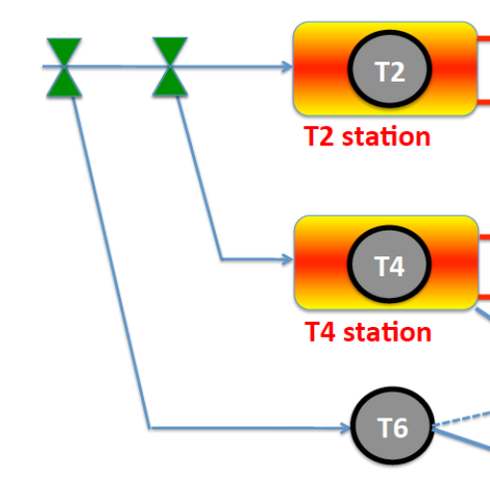
SPS North Area
Slow extracted beam at 400 GeV/c
New beam line to be added to the already existing ones
The reduction of the extraction losses is the most complex challenge
To build
BDF target
IFAE,
16th November 2018

Slide 17
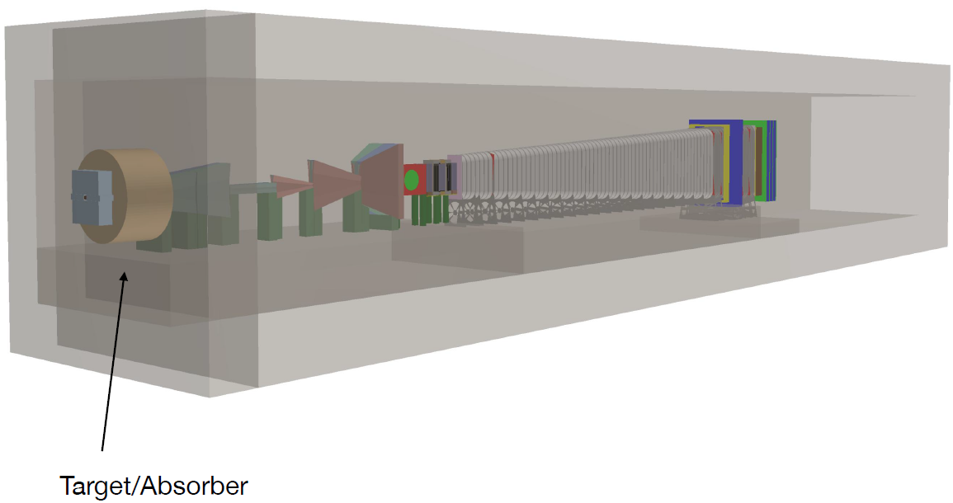
SHiP overview
BDF target and target complex
IFAE,
16th November 2018

Slide 18
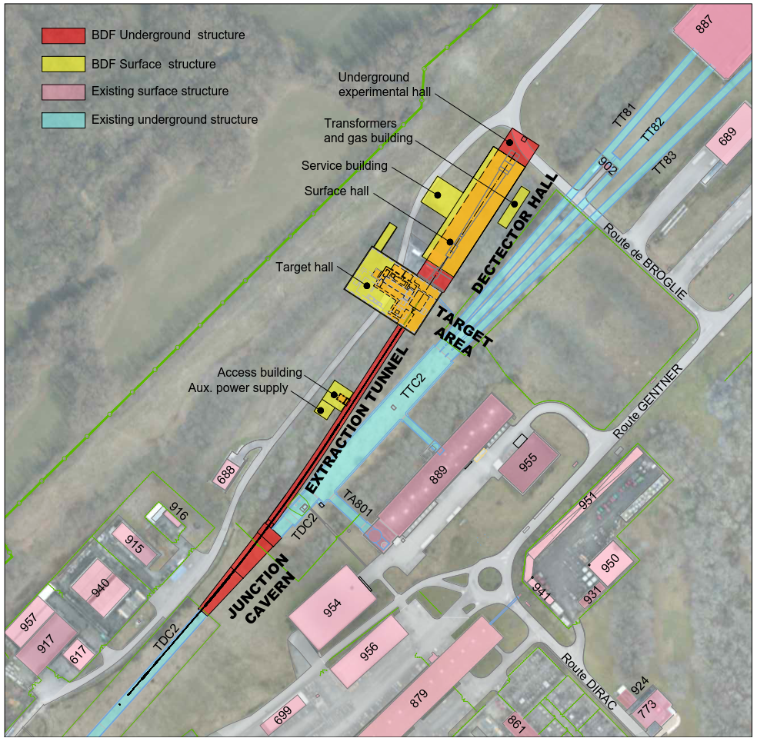
BDF at SPS
BDF is a proposed permanent facility in the North Area at CERN
High intensity proton beam slow extraction: 4*10¹³ p⁺/pulse, 355 kW average beam power, 2*10²⁰ pot/5 years
→ Design of the facility driven by RP constraints due to prompt/residual dose
Location close to experimental and public areas
→ Minimize impact on other facilities and environment
Dense TZM and W target
→ High activation expected
Keep flexibility for future installations
CE layout of BDF and surrounding facilities
IFAE,
16th November 2018

Slide 19
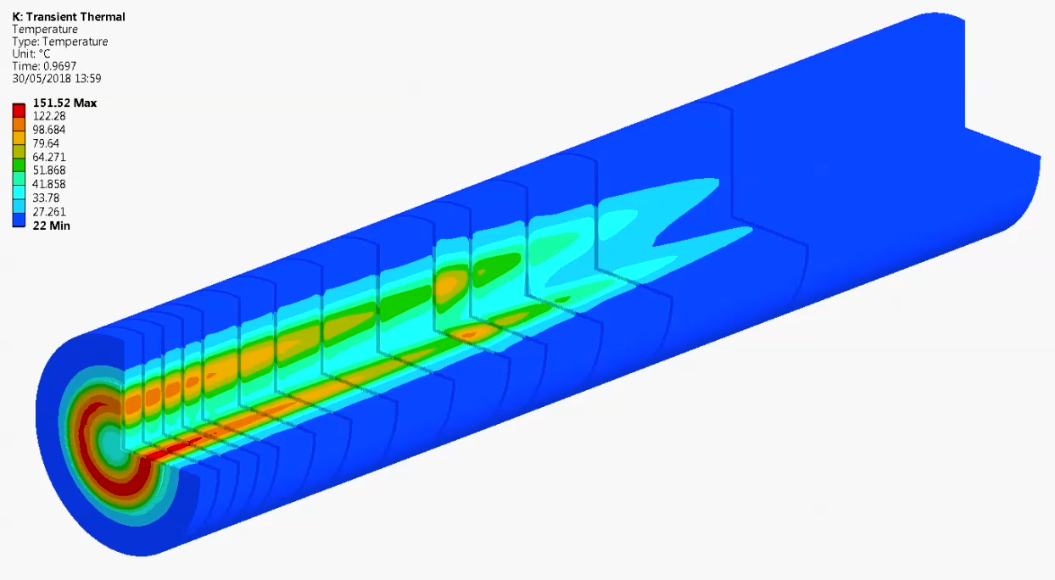
BDF target - Operational conditions
Baseline characteristics
Proton momentum | 400 GeV/c
Beam intensity | 4.0·10¹³ p+/cycle
Cycle length | 7.2 s
Spill duration (slow extraction) | 1.0 s
Average beam power deposited on target | 320 kW
Average beam power on target during spill | 2.6 MW
1 s
4·10¹³ ppp
7.2 s
Challenging target design
Dilution of the beam by the upstream magnets
  Beam dilution optimization:
    Target mechanical performance
    Magnets aperture limits
  50 mm radius, 4 turns in 1 second
Large beam spot: 8 mm 1σ
IFAE,
16th November 2018

Slide 20
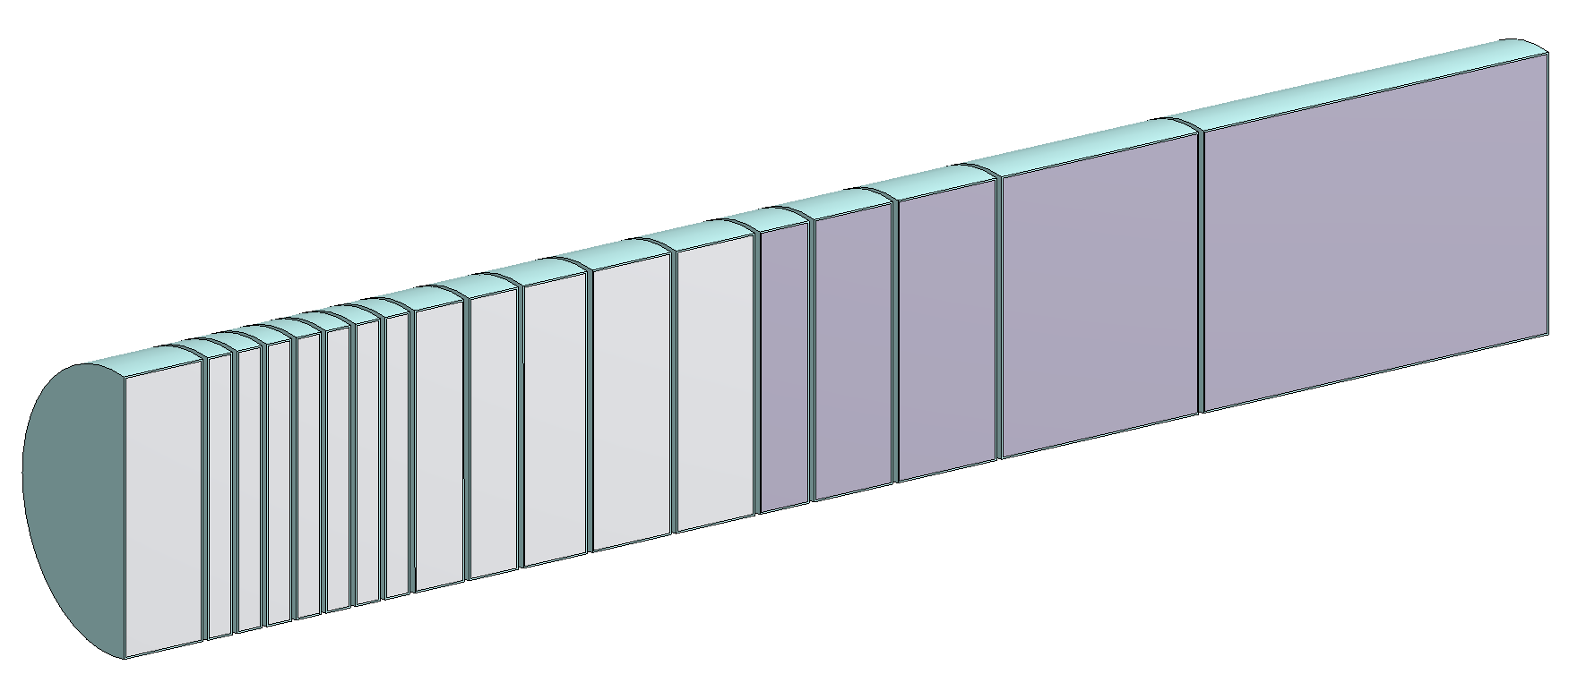
BDF target - Design
Main functions:
  Full SPS 400 GeV/c beam absorption → Target/dump
  Maximize the production of charmed mesons → physics performance
Material requirements:
  High-Z materials
  Short interaction length
Increase the reabsorption of pions and kaons
  1st part: TZM core
  Molybdenum alloy, higher strength and recrystallization temperature than pure Mo
  2nd part: Tungsten core
  High-Z and good performance under irradiation
250 mm diameter cylinders
Total length ~ 1.5 m
Optimized segmentation of the target to minimize the level of temperatures and stresses
High power deposition
forced water cooling required
5 mm gap between the blocks
  Ta/Ta2.5W cladding
Ø250 mm
Ta cladding to avoid corrosion/erosion effects
Achieved via Hot Isostatic Pressing (HIPing)
~1.5 m
IFAE,
16th November 2018

Slide 21
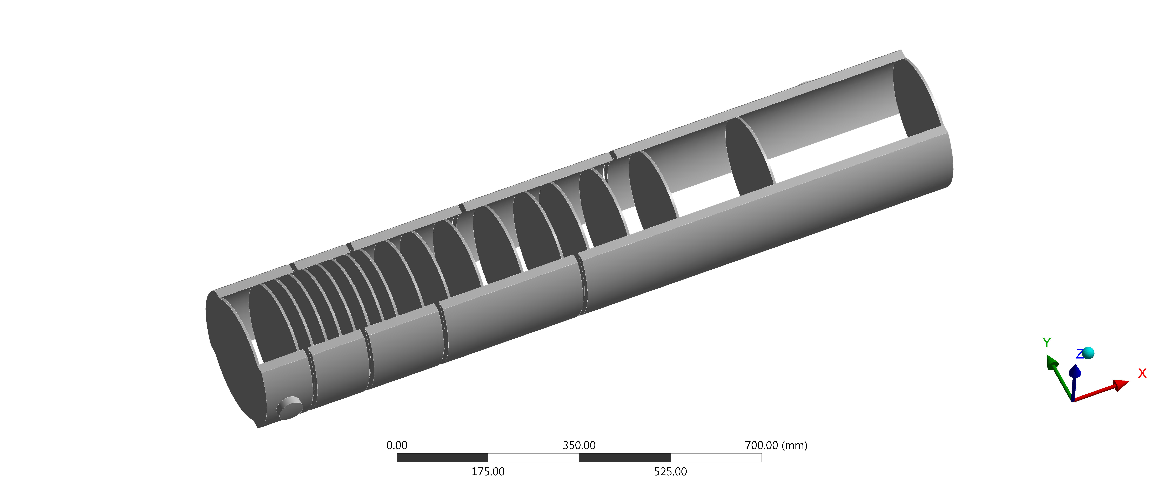
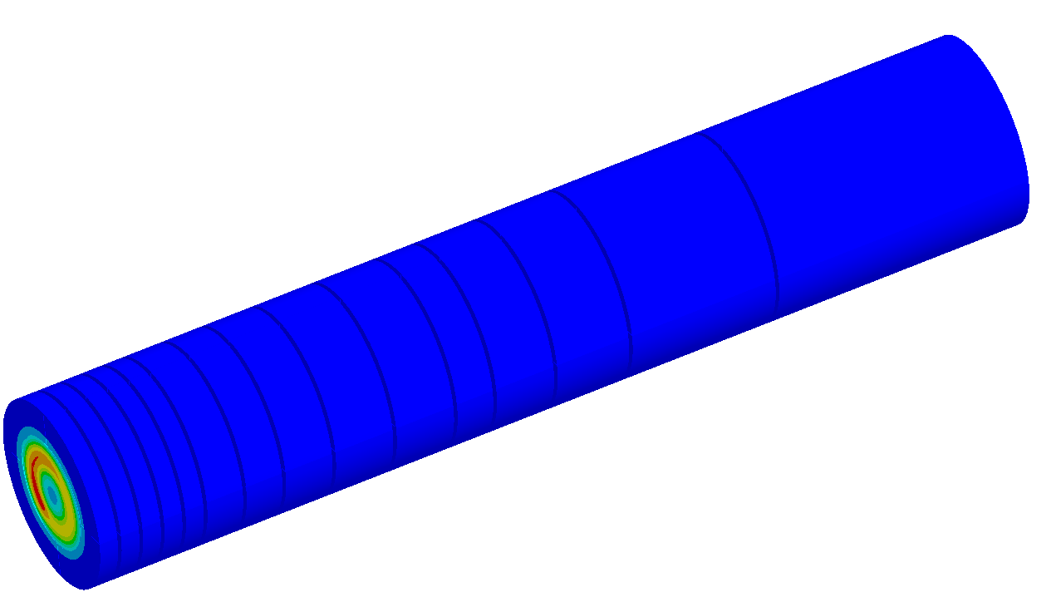
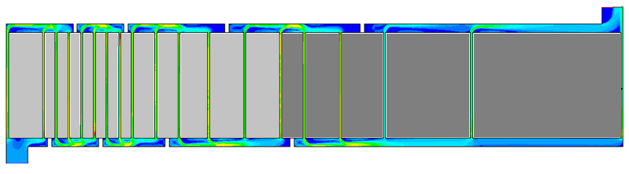
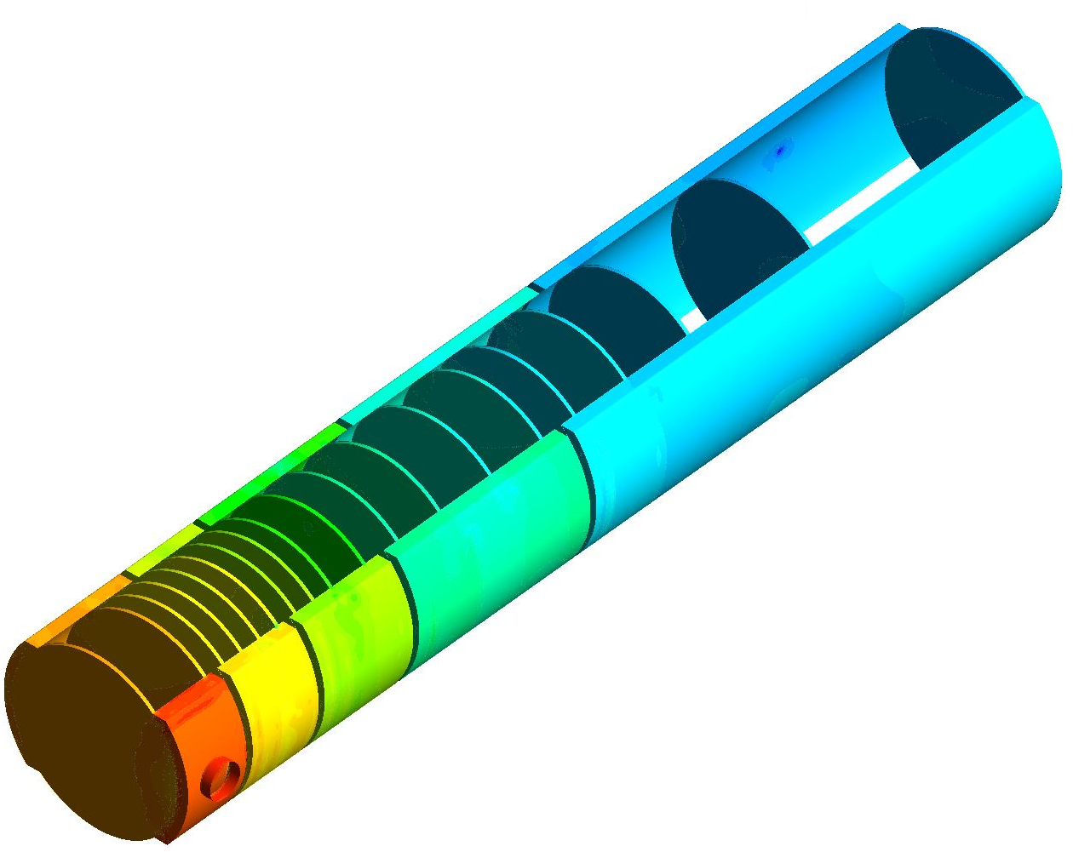
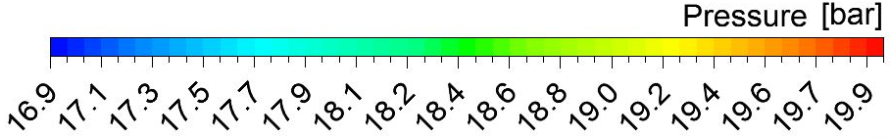
BDF target - Cooling
Outlet
Water flows through 5 mm gap between the target blocks
  Cooling of circular face of the blocks critical
  → beam impact
Homogenous water speed in the channels ~ 5 m/s
Average Heat Transfer Coefficient ~ 20000 W/m²K
Minimized mass flow rate: 10 kg/s
Pressure supply: 20 bar
    Increase water boiling temperature above 200°C
    Avoid vapor formation in contact with target block
Preliminary design of the target cooling circuit
Inlet
  2 parallel streams in series
  → avoid cooling failure in case of blockage of one channel
Total Δp ~ 3 bar
IFAE,
16th November 2018

Slide 22
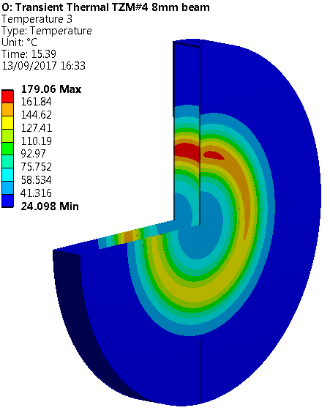
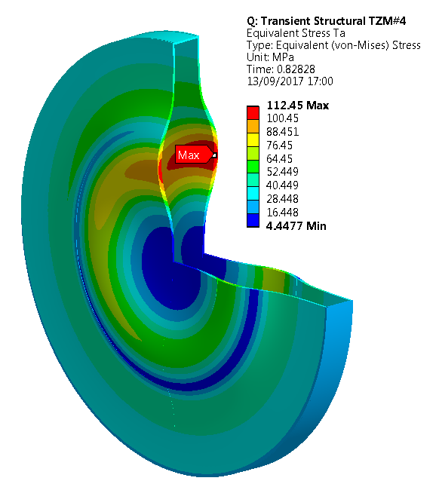
BDF target - Thermo-mechanical calculations
ΔT_{Tantalum} ~ 140°C per pulse!
Max temperature
Ta cladding 180°C
Maximum Von Mises equivalent stress ~110 MPa
High raise of temperature during beam impact: temperature limitations in the Ta cladding → vapor formation, plastic deformation of the cladding
The high temperatures reached lead to a high level of stresses
Properties of pure Ta at high temperatures not compliant with stresses→ chosen cladding material: tantalum-tungsten alloy, Ta2.5W
IFAE,
16th November 2018

Slide 23
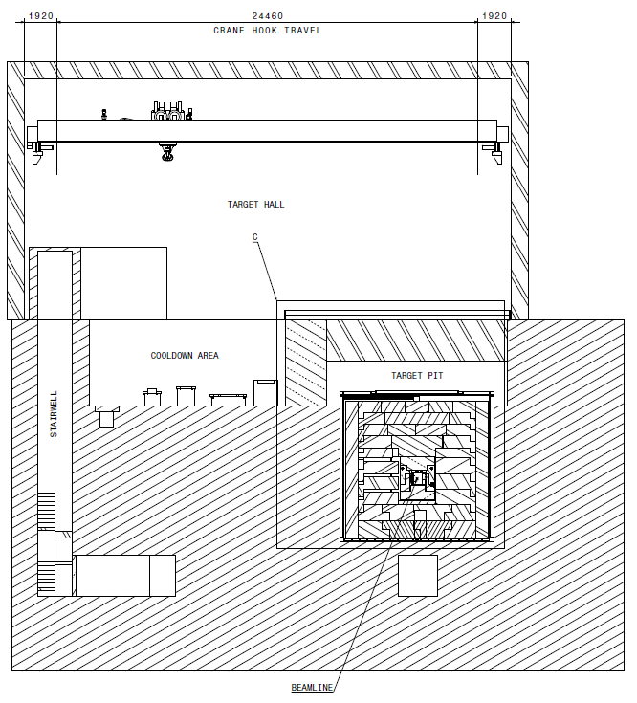
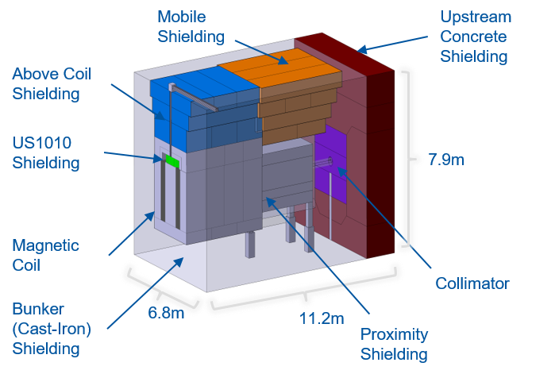
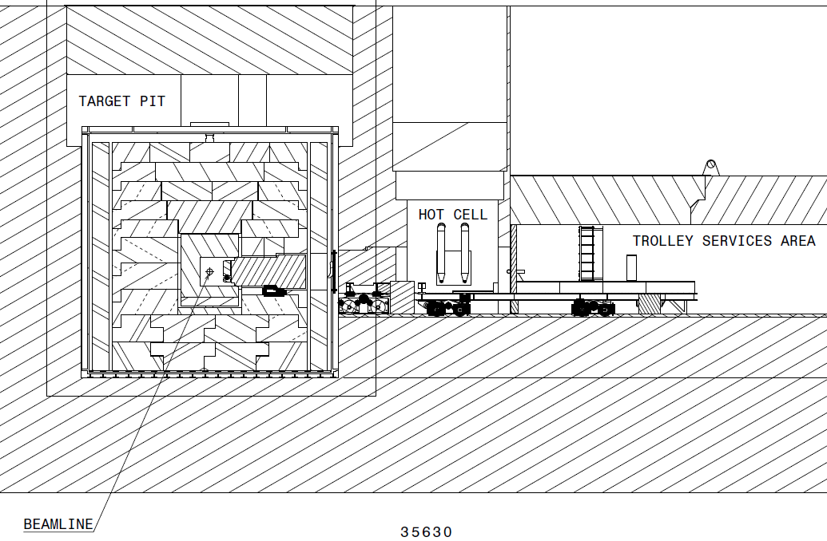
BDF target complex
Submitted to JINST (arxiv:1806.05920)
Crane concept overview
Target is located 15 meters underground
Iron hadron absorber encloses production target
Target and hadron absorber are inside a He vessel
  To avoid corrosion and air activation
Fully remote handling/manipulation
Significant attention to radiation protection
Crane and trolley concepts → equivalent shielding, but target handling safer with trolley
Target and hadron absorber
Trolley concept overview
Facilitates target exchange → safer interventions
IFAE,
16th November 2018

Slide 24
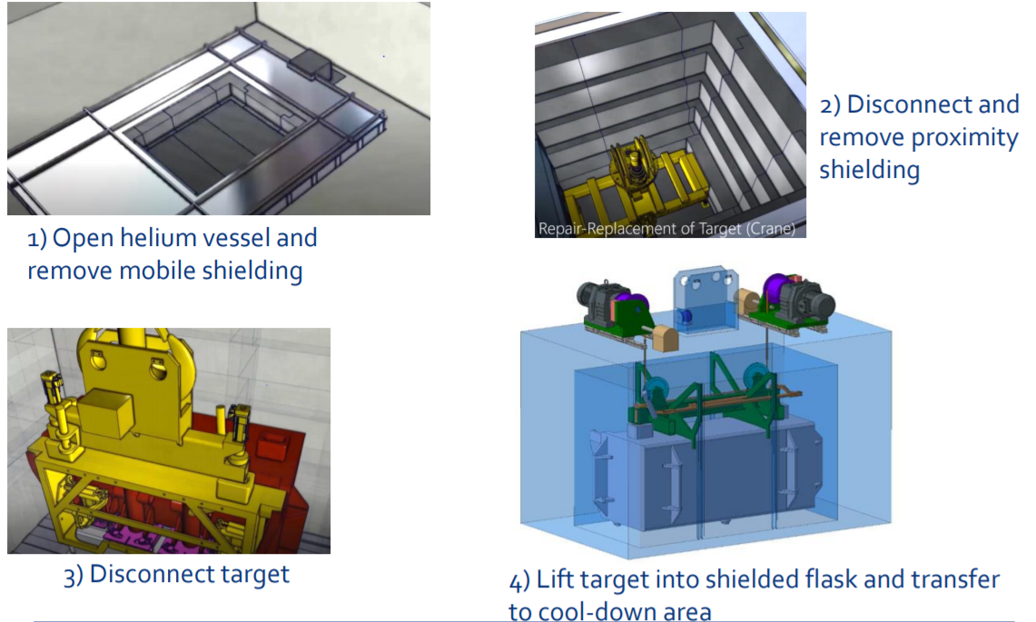
Crane concept – target exchange
IFAE,
16th November 2018

Slide 25
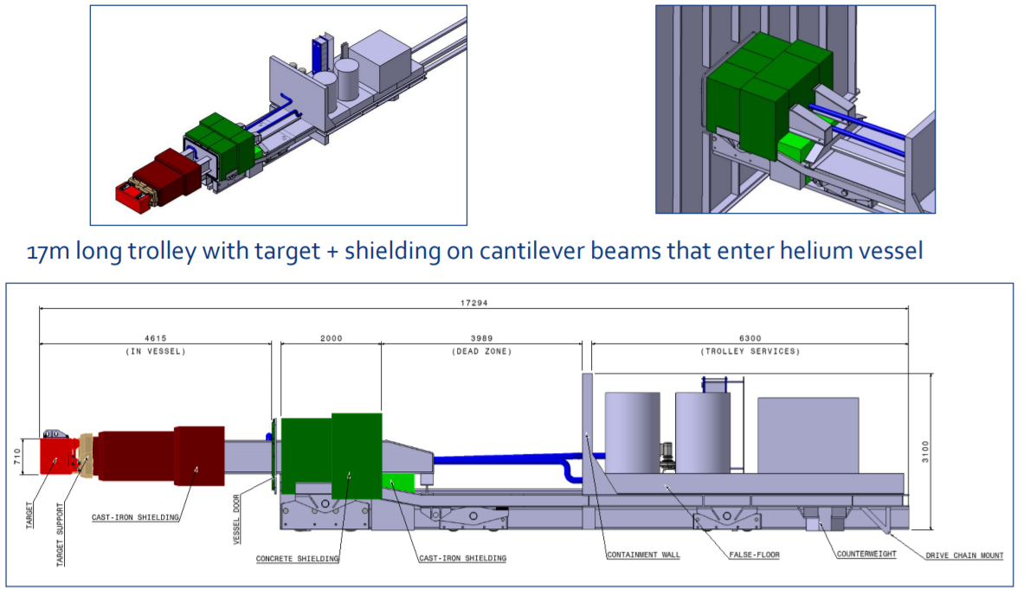
Trolley concept – the trolley
IFAE,
16th November 2018

Slide 26
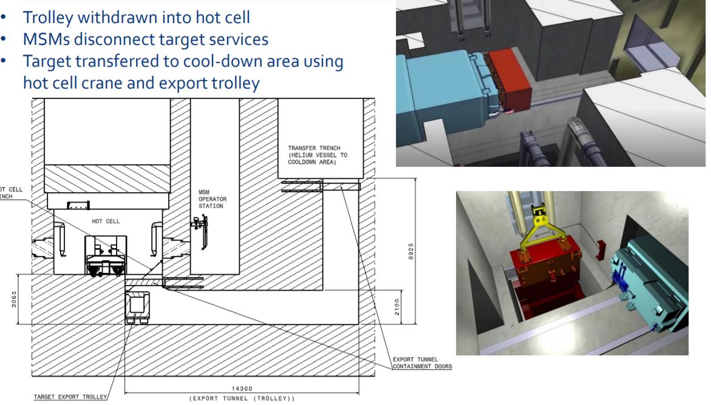
Trolley concept – target exchange
IFAE,
16th November 2018

Slide 27

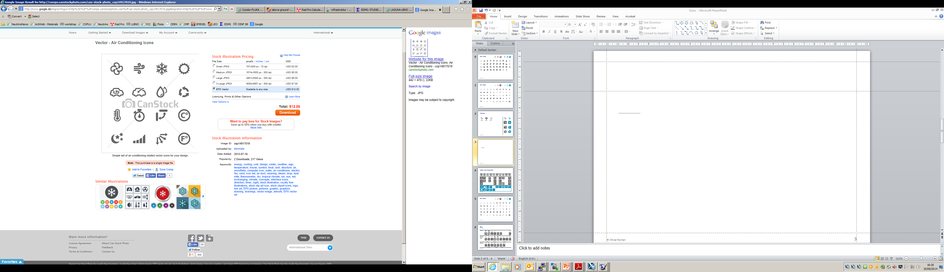

RP considerations for the BDF target complex
High prompt dose in BDF target area calls for adequate shielding around the target
Only absolute necessary equipment should be installed in “hot” areas
Depending on residual dose rate and tasks, manual interventions should partially/completely be replaced by remote maintenance/repair
Air volumes to be minimized in ‘hot’ areas or to be replaced by He/vacuum environment
Static confinement of air by physical barriers to separate air in contaminated areas from outside
Dynamic confinement by a ventilation system guaranteeing a pressure cascade from low to high contaminated areas
Prompt and residual radiation
Air and He
activation
Radiation Protection
Water cooling circuits for highly radioactive elements should be closed and separated from others
Activation and contamination of ground water and earth to be avoided
The design must consider minimization, decommissioning and dismantling of radioactive waste
Water and Ground activation
Radioactive waste
IFAE,
16th November 2018

Slide 28
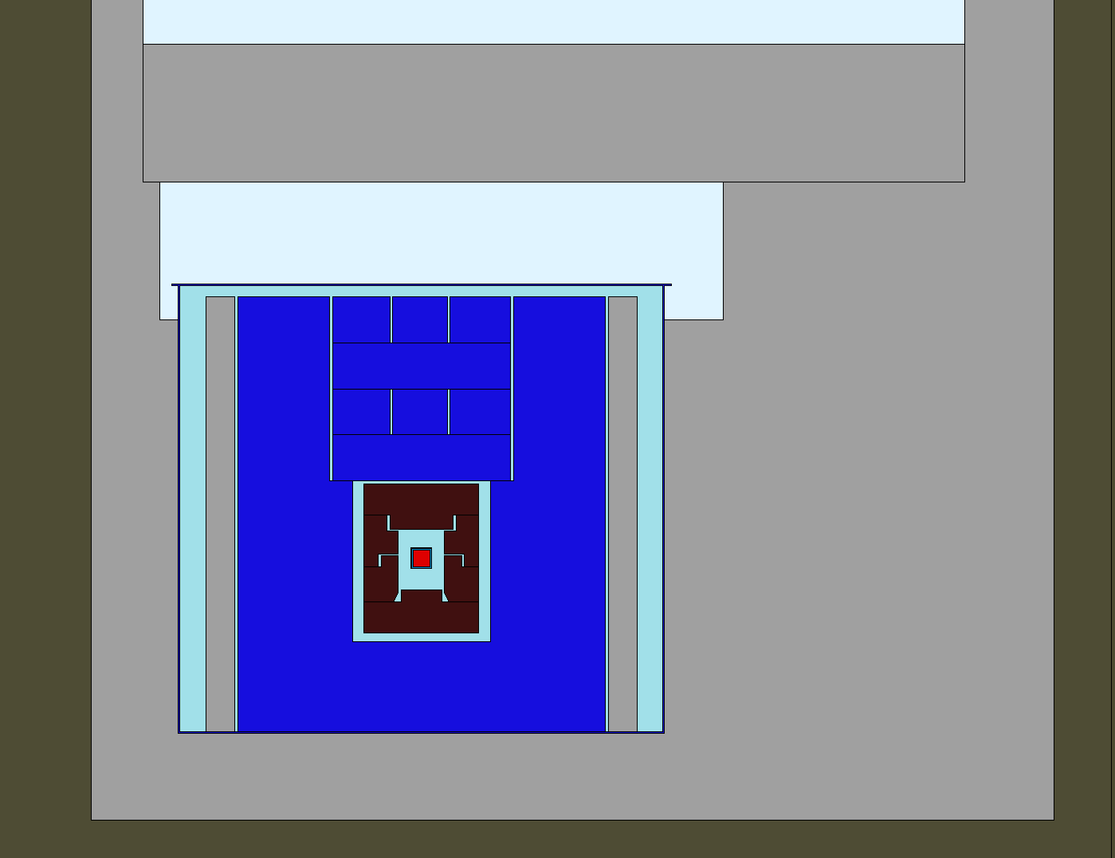
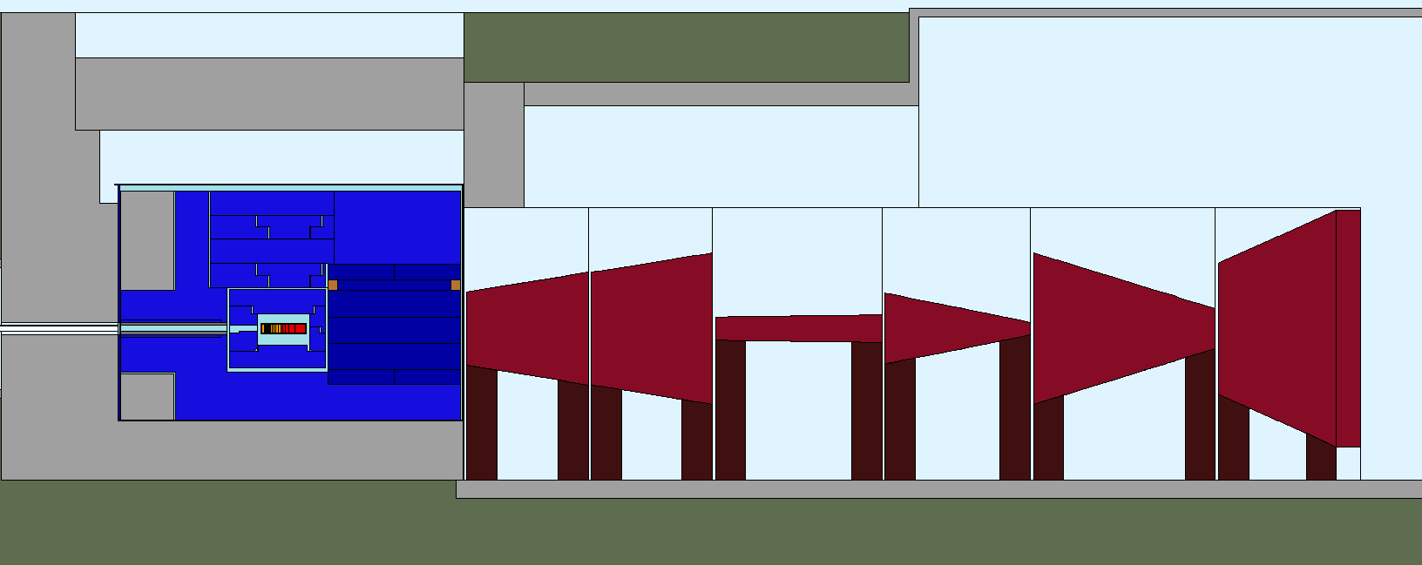
RP evaluation based on FLUKA simulations
BDF/SHiP as implemented in FLUKA
Cross-sectional view
Target Hall
Target hall
Side view
Moraine
Active muon shield magnets
Helium Vessel
Concrete
Detector hall
Helium Vessel
3.2 m
Cast Iron
Moraine
Concrete
11 m
1.5 m
0.8 m
4.5 m
2.0 m
Target
0.6 m
0.5 m
y
x
Magnetic part of hadron stopper
1.5 m
z
Target
Cast Iron
29 m
y
z
x
No access during operation into the detector hall is the main condition for current design
Massive shielding to keep prompt/residual dose rate and airborne radioactivity as low as possible
Most critical area was embedded in He-environment
Shielding was optimized to reduce ground activation to negligible levels
Active muon shield with magnets (1.8 T) from the SHiP experiment was included
IFAE,
16th November 2018

Slide 29
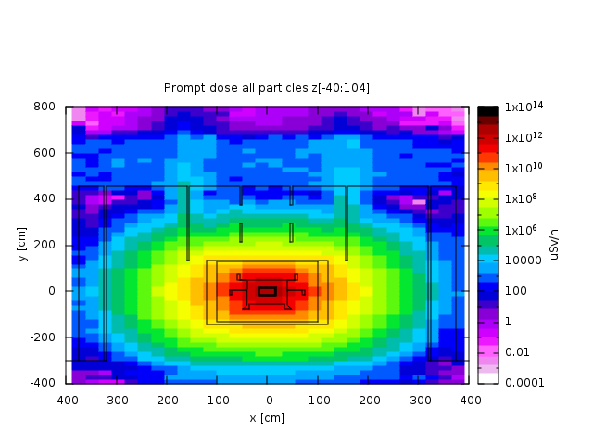
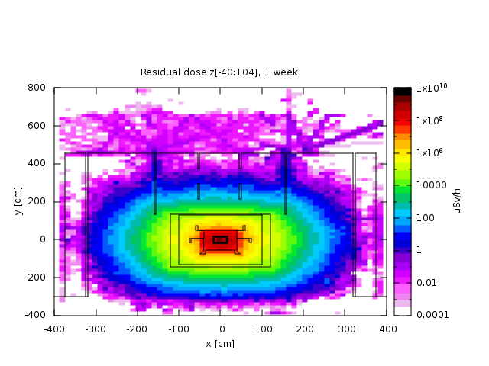
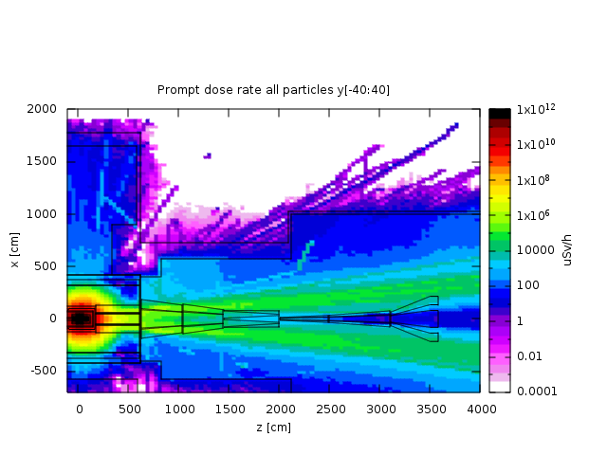
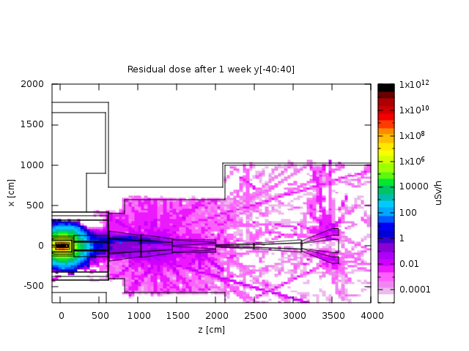
Expected dose rates in the target and experimental area
Prompt dose rate at 4×10¹³ p / 7.2s
Residual dose rate at 2×10²⁰ pot (1 week cooling)
Target area:
Prompt dose rates reach ~100 mSv/h above He-vessel and drop down to < 1 µSv/h above top concrete shielding (conservative gaps)
→ Expected classification: Supervised Radiation Area (up to 2000h/year) (< 3 µSv/h) in the target hall
Residual dose rates of a few µSv/h above and next to He-vessel
Very high residual dose rates next to target and cast iron shielding O(100) Sv/h
→ Remote handling and designated storage areas are therefore foreseen for these elements
Experimental area:
Prompt dose rates reach ~100 mSv/h at magnet mainly due to muons
Residual dose rates close to first part of muon shield reach ~10 µSv/h
→ Expected classification during beam off: Supervised Radiation Area (<15 µSv/h) or Simple Controlled Radiation Area (<50 µSv/h) in experimental hall
100 rem = 1Sv
IFAE,
16th November 2018

Slide 30
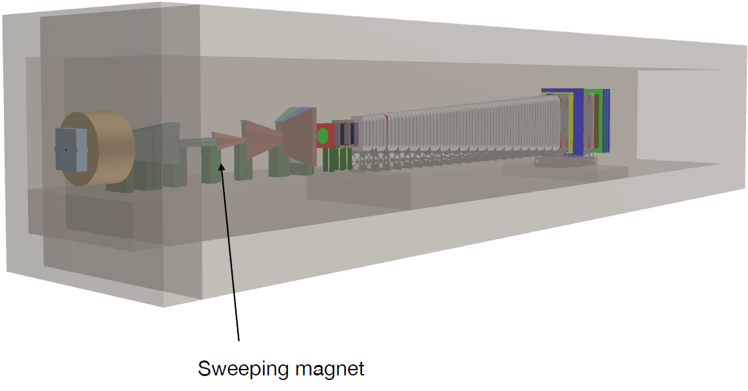
SHiP overview
IFAE,
16th November 2018

Slide 31
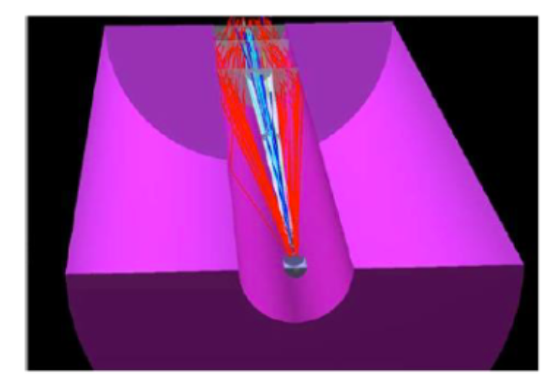
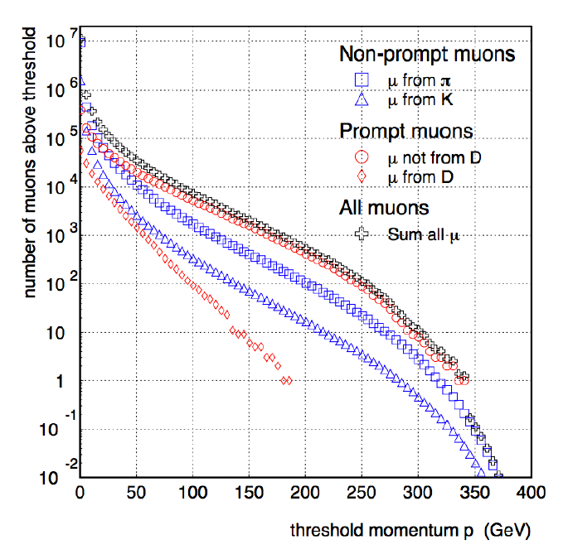
Active muon shield
Distribute the bkg over a long spill: 4x10¹³ p/ 7.2s
Sweeping magnet
Decay volume to be far away from the walls
Heavy target stops hadrons before the decay. After the target and the hadron absorber only muons survive
Muons come mainly from η, η’, ω
IFAE,
16th November 2018

Slide 32
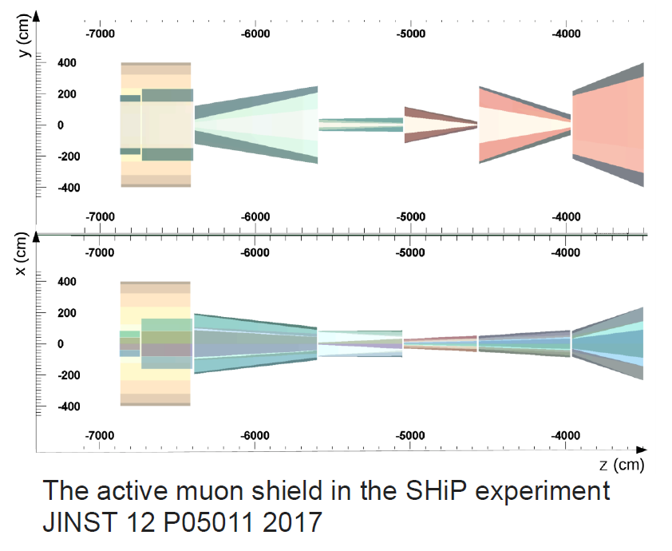
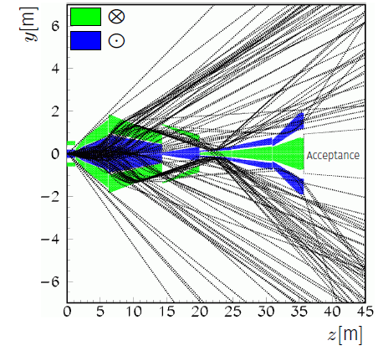
Active muon shield
Optimization of the magnetic field with Machine Learning techniques
Challeging aspects:
Narrow separation between field directions
Aiming to 1.7T to minimize lenght ( with grain oriented steel sheets)
Have reliable muon sample to optimise
The muon shield is the critical component to optimise to maximise the experimental acceptance
Reduces the background by 6 orders of magnitude (in the fiducial volume background free experiment)
Kinematic range up to p~ 350 GeV and p_{T} ~ 8 GeV
IFAE,
16th November 2018

Slide 33
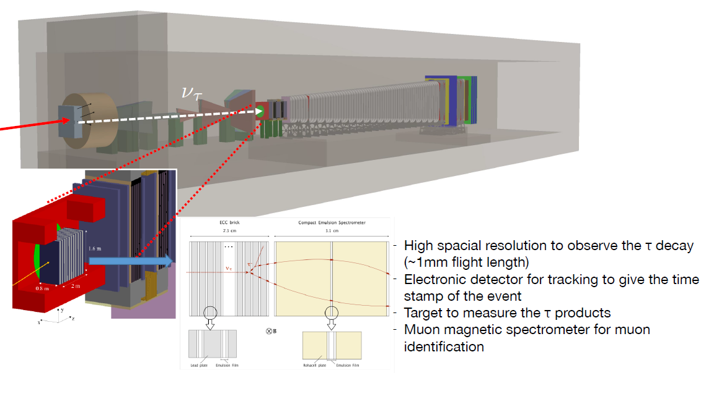
SHiP overview – Emulsion detector
High spacial resolution to observe the τ decay (~1mm flight length)
Electronic detector for tracking to give the time stamp of the event
Target to measure the τ products
Muon magnetic spectrometer for muon identification
IFAE,
16th November 2018

Slide 34
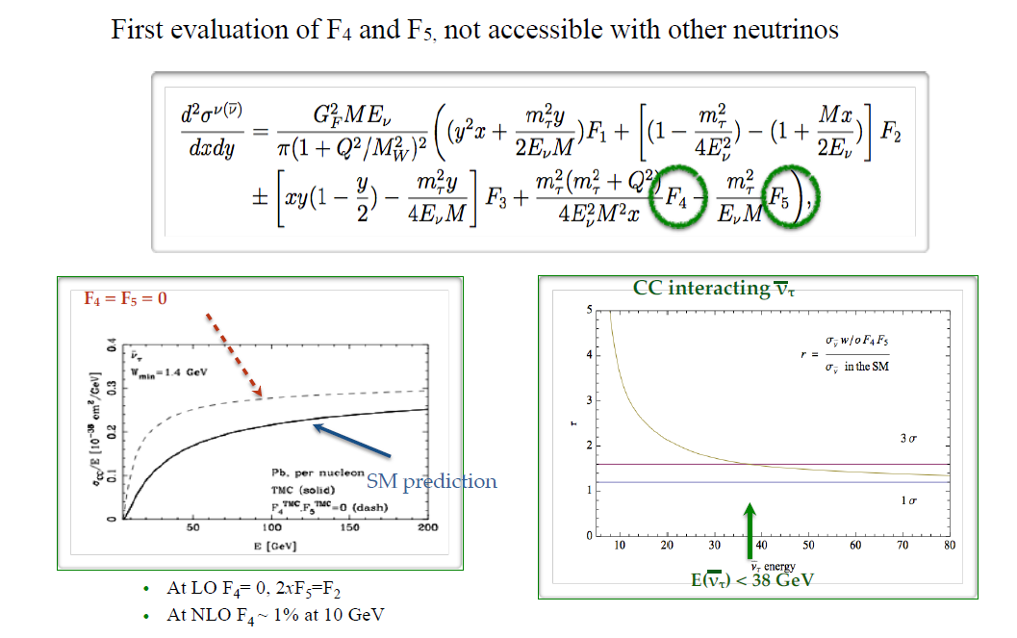
ν_{tau}- Physics
IFAE,
16th November 2018

Slide 35
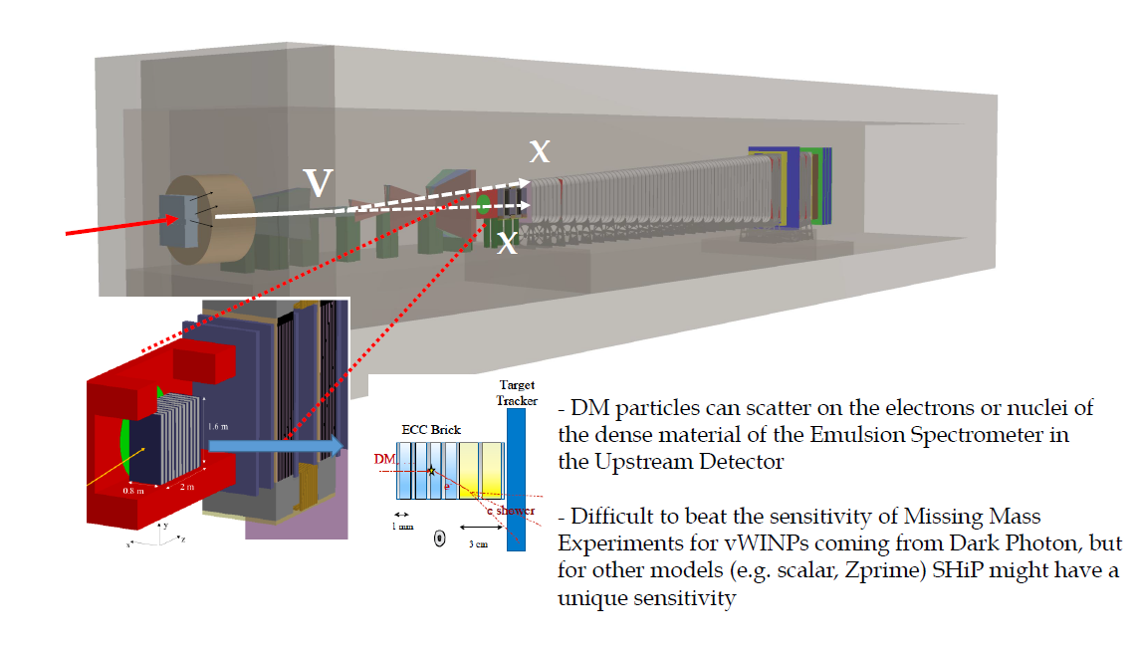
iSHiP
DM particles can scatter on the electrons or nuclei of the dense material of the Emulsion Spectrometer in the Upstream Detector
Difficult to beat the sensitivity of Missing Mass Experiments for vWINPs coming from Dark Photon, but for other models (e.g. scalar, Z’) SHiP might have a unique sensitivity
IFAE,
16th November 2018

Slide 36


Accelerator based LDM searches
χ could be lighter than HS mediator (e.g. V) V→ χ χ allowed
With 10²⁰photons in SHiP:
A LDM beam downstream the dump
Scattering experiment χe→ χe on the atoms of the SHiP detector (emulsions)
LDM search beyond relic density
Emulsion detector ideally suited for Light DM
searches thanks to:
1) micrometric position resolution
2) mrad angular resolution
3) High electron identification efficiency
IFAE,
16th November 2018

Slide 37

Fiducial Volume
To have a background free experiment need of a fiducial volume with at least 10⁻³ mbar to have negligible background from neutrinos interacting in the air
Veto system around the fiducial volume:
Liquid or plastic scintillating in the vacuum vessel walls for vetoing
Upstream veto before the entrance window
Tracking veto after ~5m of the entrance window
IFAE,
16th November 2018

Slide 38


HS Spectrometer
1) Fully reconstructed signal: at least two charged particles e.g. N→μ⁺π⁻ or N→ρ⁺μ⁻
2) Partially reconstructed signal (neutrinos in the final state) e.g. N→μ⁺vv
3) Fully neutral channels e.g. A—> γγ
IFAE,
16th November 2018

Slide 39

Backgrounds
IFAE,
16th November 2018

Slide 40




Physics Performance – Dark Photon
Production at SHiP:
Meson decays e.g. π⁰ → γV (~ε²)
p breamsstrahlung on target nuclei pp → ppV
Large m_{V} → direct QCD production through underlying $q\overline{q}→V$
arXiv:0906.5614
arXiv:1311.3870
arXiv:1205.3499
Decay:
$$Γ_{tot}=Γ\left(l^{+}l^{−}\right)+Γ\left(hadrons\right)+Γ(χ\overline{χ})$$
IFAE,
16th November 2018

Slide 41

Physics Performance – Dark Scalar
IFAE,
16th November 2018

Slide 42



Physics Performance – ALPs
Pseudo-scalar can arise from spontaneously broken U(1) symmetry:
An example is the axion, introduce to solve the strong CP problem (m ~10⁻⁵ eV)
Axion-Like particles (ALPs) can arise from other broken symmetries
ALPs can couple to: gauge bosons, fermions or gluons
Coupling proportional to 1/f_{a} (scale of the spontaneous broken symmetry)
IFAE,
16th November 2018

Slide 43

Physics Performance – HNL
Production and decays are both suppressed by U² , so the sensitivity is proportional to U⁴
If the mass is small enough they can be produced in semileptonic meson decays (pions, kaons, D-mesons, B-mesons), at higher masses they will be produced by W and Z
IFAE,
16th November 2018

Slide 44



Physics Performance – HNL
IFAE,
16th November 2018

Slide 45
Summary and conclusions
SHiP intends to explore the intensity frontier searching for long-lived and very weakly interacting particles:
Possibility to search a broad variety of signals
• SHiP also hosts a compact neutrino detector to perform SM physics studies
  it can be used to search indirectly for HS particles via the vWIMP scattering
HS particle can be searched for in an inclusive way in the fiducial volume
Many challenges have been faced for the target complex and the detectors
Roadmap for Dark Matter discovery:
Decision on approval following conclusion of the ESPP (end 2019):
Construction: 2021-2026
Start of data taking after Long Shutdown 3
IFAE,
16th November 2018

Slide 46
Thank you for your attention!

Slide 47

PBC
IFAE,
16th November 2018

Slide 48

SHiP detectors
IFAE,
16th November 2018

Slide 49

SHiP detectors
IFAE,
16th November 2018

Slide 50

SHiP detectors
IFAE,
16th November 2018

Slide 51

Background estimation
IFAE,
16th November 2018

Slide 52

IFAE,
16th November 2018

Slide 53

IFAE,
16th November 2018

Slide 54

IFAE,
16th November 2018

Slide 55

IFAE,
16th November 2018

Slide 56

IFAE,
16th November 2018

Slide 57

Light ALPs
IFAE,
16th November 2018

Slide 58

IFAE,
16th November 2018

Slide 59


Target assembly design
Target inner tank
  Supports target core blocks
  Encloses the target cooling system
Target outer tank
  Water-leak tightness
  Provides interfaces with water and electrical connectors
  Dry environment + leak monitoring
  Replacement of the whole box in case of target failure
  Compatible with target complex handling and integration design
Target tank enclosed inside a Helium containing box
Target outer tank
IFAE,
16th November 2018

Slide 60
Material R&D – Use of Ta2.5W
Target cladding material: Ta2.5W
  Bonding quality with tungsten and TZM expected to be the same
  2.5% content of W
  Similar thermal properties to Ta
  Good corrosion-erosion resistance
  Higher strength, specially at high temperatures
Cladding material | Maximum Von Mises eq. stress expected | Yield strength | Safety factor
Tantalum (preliminary design) | 110 MPa | 80 MPa (at 180°C) | 0.7 ✗
Ta2.5W (new design) | 110 MPa | 200 MPa (at 180°C) | 1.8 ✓
Additional considerations:
Fatigue properties for 10⁷ cycles
Radiation damage (ongoing)
IFAE,
16th November 2018

