Slide 1
Covid19 status 11/1/2020
Martine Bosman

Slide 2
Outline
Status of implementation of remaining functionality
Impact of mobility
Add λ mobility term to fraction of workers using public transport
Data available. Needs to study the characteristics of the mobolity data to finalize the model: pattern of mobility in different regions, work mobility and also week-end mobility?
Use the evolution of intensity of mobility as a proxy to confinement measure
Add 40k persons in ”Residencias”
Population has been generated. Need to finalize the location of the “residencies”
Studies of factors influencing the impact of the propagation of the pandemics
Correlation with census characteristics, etc.
Calibration with data
Available data: data per ABS time dependent; data per ”Barris” integrated for “Ola1” and “Ola2”
A.O.B

Slide 3
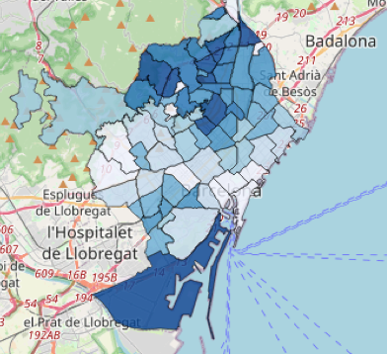
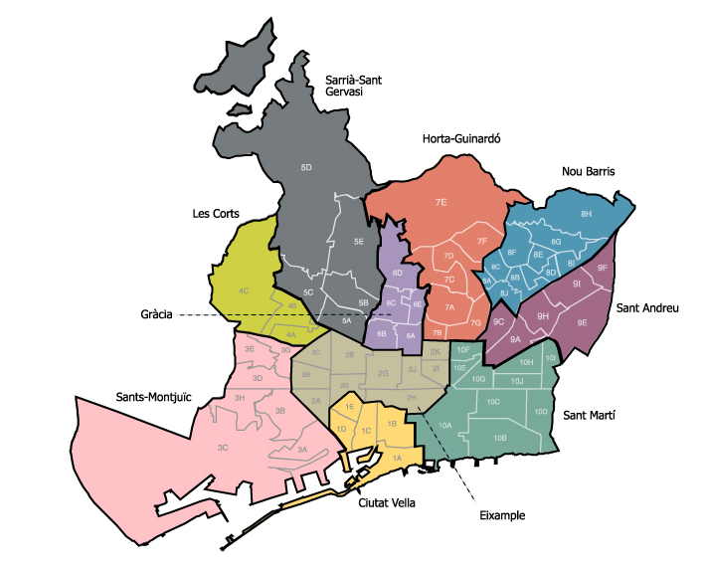
Barris
ABS

Slide 4
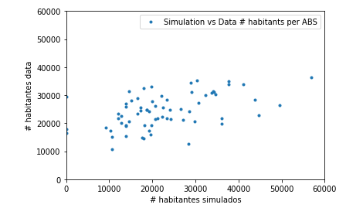
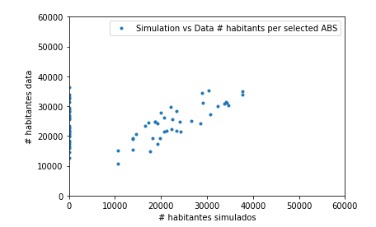
Population per ABS area: caveat
The correspondence matrix was built “by-hand”. The correspondence is not perfect. Some barris have to be divided, other joined to form ABS
Sometimes the shape do not correspond well
Select the ones were the agreement on population is within 25%
→ Comparison data-simulation with ABS has limited precision

Slide 5
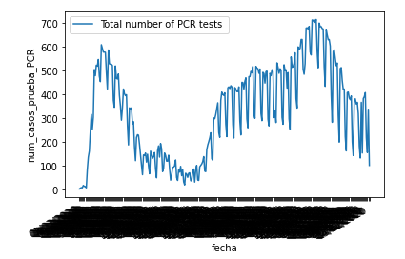
DATOS PCR ABS Catalunya
Excel file: casos_sexe_abs_UTF_ordered.csv
For ABS we have the full time dependence in an Excel file
For “Barris” we only have the integrated number in “Ola1” (<21Jun20) and “Ola2” () (extracted manually from the interactive figure)
Both set of data are available with and without people in “residencias”

Slide 6
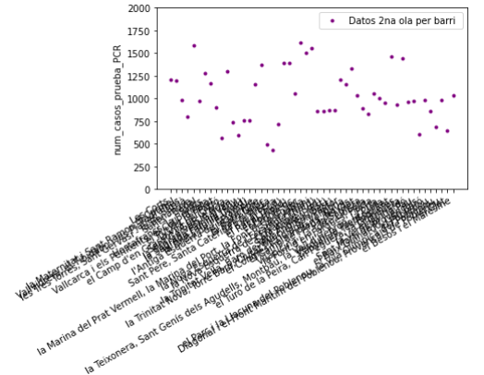
REAL DATA per “Barri” integrated from 20/6/2020 to 15/12/2020
We will compare number of PCR diagnosed people per 10k habitants per region in two interval of time
Variation in between barris (or ABS) can be large

Slide 7
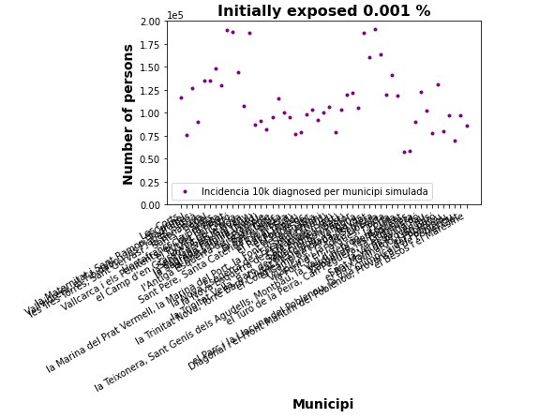
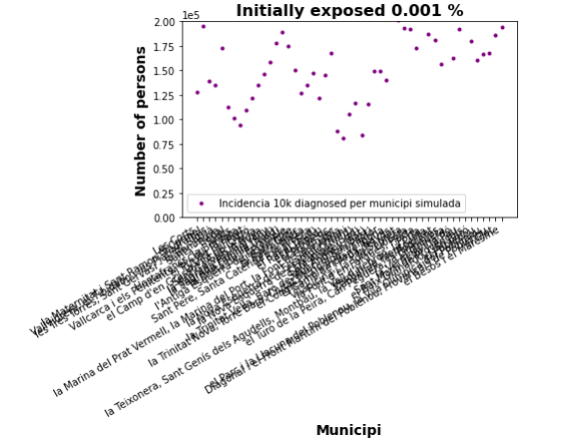
Simulated data
Run 1
Run 2
Municipis with high incidencia: Sant Gervasi 5A (187k), El Congrés I els Indians 9C (186k), la Sagrera 9A (190k), Vallcarca 6C,6D,6E (189k), Putxet 5B (188k)
Municipis with high incidencia: El Congrés I els Indians 9C (211k), El camp del Arpa I el Clot (201K) la Sagrera 9A (193k), Vilapicina (191k), Porta (218k), El Turo1 de la Peira (211k), La Verneda (192k), Sant Marti (210K), El Besós (194k)

Slide 8
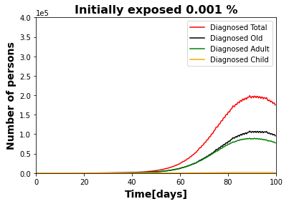
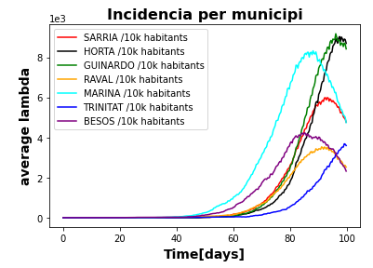
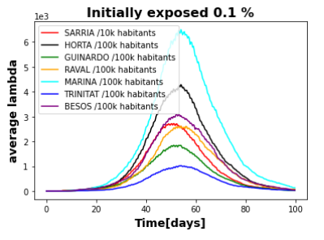
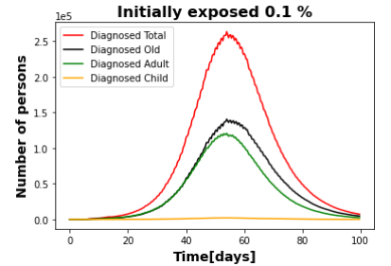
How to calculate the “incidencia per 10k” in the simulation
So far mainly done starting randomly from 0-1 infected person per Barri
This is strongly correlated to the time profile
Cutting at 100 days introduce large fluctuations
Remember the data themselves are the result of “1 fluctuation”
Starting from about 10 infected per Barris randomly distributed this reduce the fluctuations

Slide 9
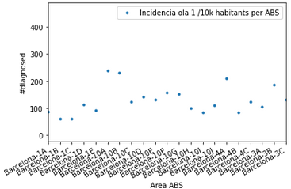
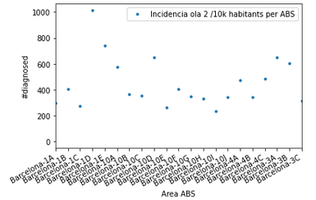
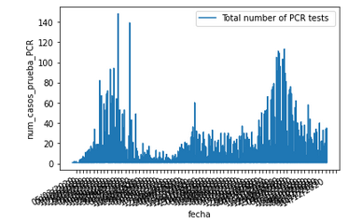
Datos reales ABS Barcelona
Correct handling of dates
Incidencia accumulada por 10k habitants en las ABS de Barcelona
La figura de arriba es para la ola a hasta el 21-06-2020
La de abajo para la ola 2 de 22-06-2020 hasta 31-10-2020
Hay algunas variaciones entre los 2 periodos, pero los resultados son bastante correlacionados
No hay correlacion tan fuerte entre los 2 periodos

Slide 10
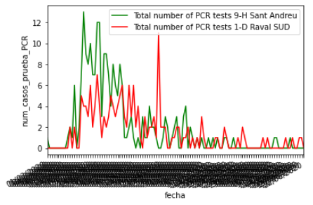
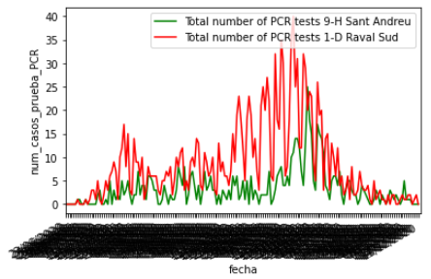
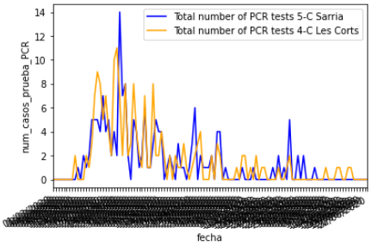
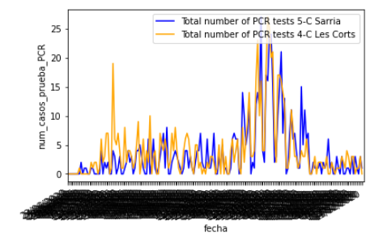
Data from ABS

Slide 11
Data vs simulation
Study data: differences per Barris/ABS, time profile
When simulation model is completed, and main features adjusted, we can use it to compare to data
The simulation helps us to interpret better the features of the data
We will eventually be able to use the simulation to study the dependencies on the characteristics of the population in a quantitative way (with uncertainty estimation), and some prediction (for example impact of vaccine deployment?)

