Slide 1
Datos segunda Ola vs información censal del CED
Martine Bosman

Slide 2
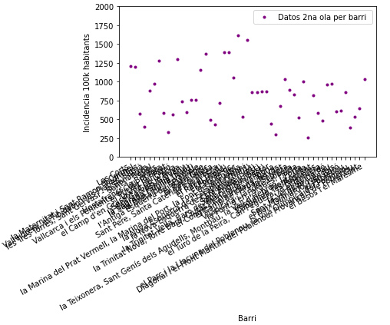
Datos Ola 2 por los 51 Barrios
Incidencia de PCRs integrada de 21 Junio a 15 Diciembre 2020
Incidencia por 100k habitants
Población por barrio típica es de 20k habitants. El número de personas es del orden de la incidencia por 100k / 5

Slide 3
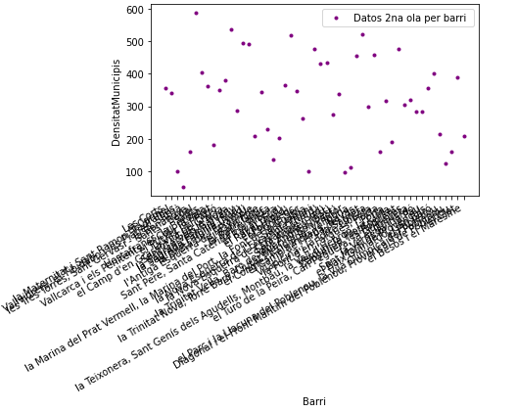
Datos censo por los 51 Barrios
Densidad: habitants por hectaria

Slide 4
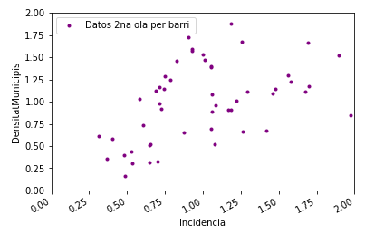
Datos Ola 2 por los 51 Barrios
Incidencia PCR por habitantes vs densidad de població
Normalizadas a los promedios:
mean density = 309
incidencia media 100k = 818
Se observa alguna correlación. Ver studio correspondiente mas abajo
Sants Badal

Slide 5
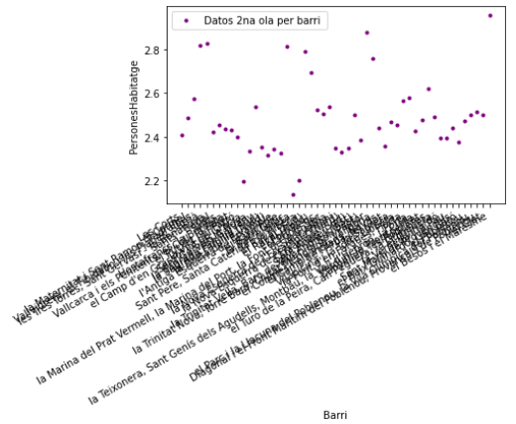
Datos censo por los 51 Barrios
Número de personas por hogar

Slide 6
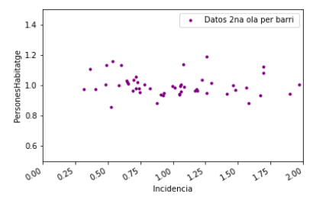
Datos Ola 2 por los 51 Barrios
Numero de personas por hogar vs densidad de població
Normalizadas a los promedios de persones habitatge = 2.5
incidencia media 100k = 818
No correlation observed

Slide 7
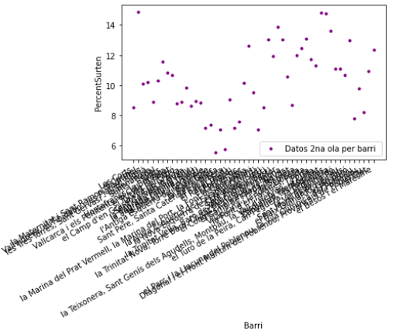
Datos Ola 2 por los 51 Barrios
Percentage de personas que salen del barrio
No correlation observed

Slide 8
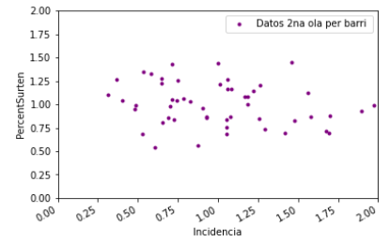
Datos Ola 2 por los 51 Barrios
Percentage de personas que salen del barrio vs densidad de població
Normalizadas a los promedios:
mean percentage = 10.3%
incidencia media 100k = 818
No correlation observed

Slide 9
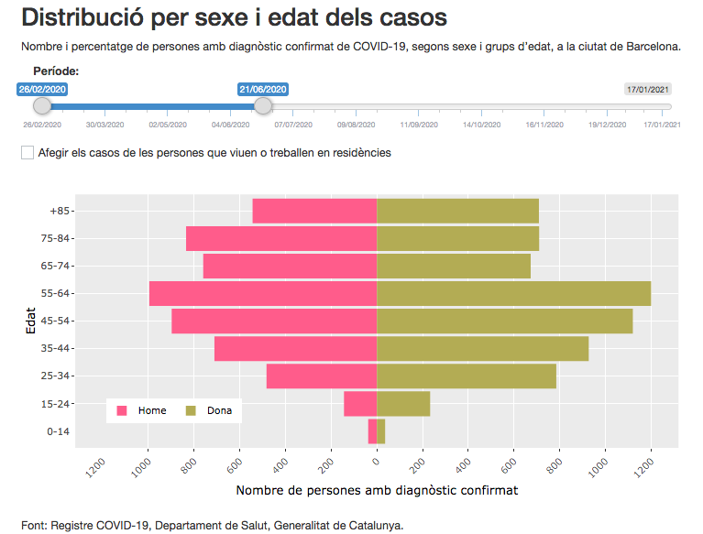
Perfil sexo y edad de los diagnosticados en los datos
Ola 1 : hasta 21/062020
Ola 2 : del 21/06/2020 hasta 15/12/2020

Slide 10
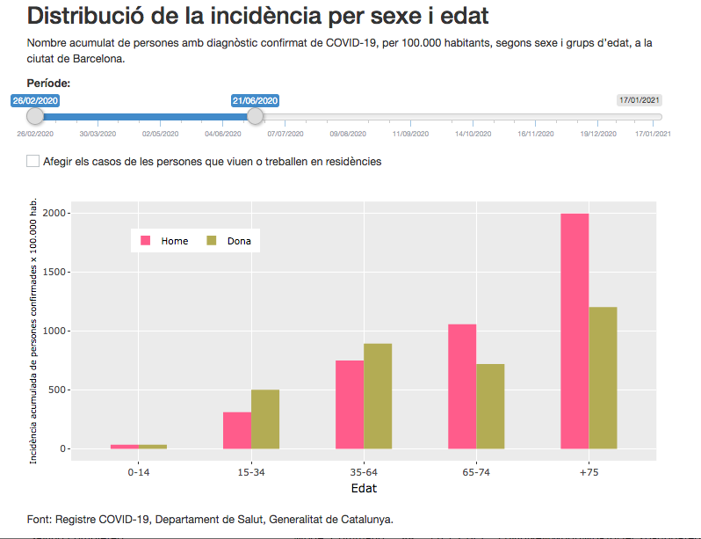
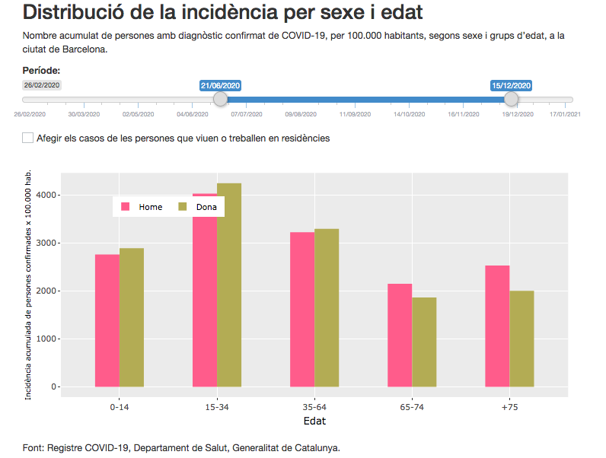
Perfil sexo y edad de los diagnosticados en los datos
Al principio, solo se hacian PCR a las personas con sintomas en el hospital, la mayoria personas de mas edad. Durante la segunda ola se empezó a hacer PCR a los contactos. Actualmente en la simulación la probabilidad de ser diagnosticado en funcción de la edad ha sido tomado del perfil de edad de los diagnosticados en la primera ola.
Ola 1 : hasta 21/062020
Ola 2 : del 21/06/2020 hasta 15/12/2020

Slide 11
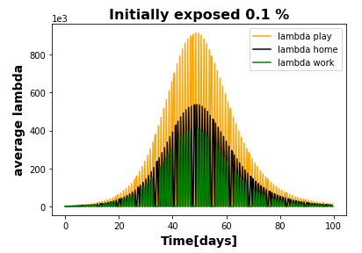
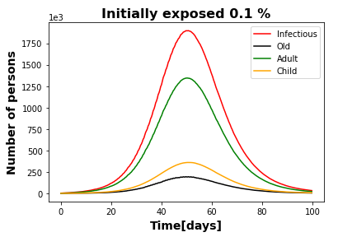
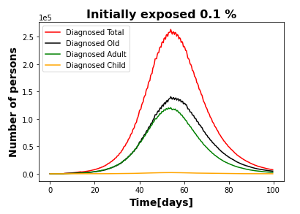
Current characteristics of diagnosed in the simulation
SimulatIon:
55% “old” , 44% “adult”, <1% “child
Data:
65% “old” , 35% “adult”, <1% “child in Ola1
25% “old” , 56% “adult”, 19% “child in Ola2
Caveat: one has to keep in mind when interpreting the results following below, that we compare data of Ola2 with simulation better suited for Ola 1. We will need to compare also to data from Ola 1, and implement a version of the probability of being diagnosed applicable to Ola 2

Slide 12
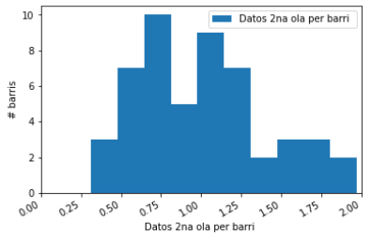
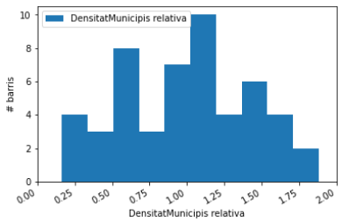
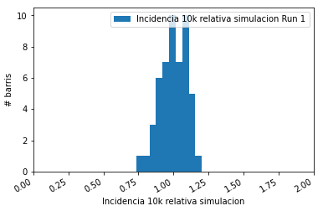
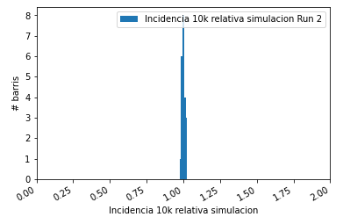
Distributions normalized to mean
DATOS
diagnosed
Las fluctuaciones de los diagnosticados entre barris es del orden de 50% en los datos (Ola 2)
Del orden de 25% en los diagnosticados en la simulación
Muy pequeña en los infectious en la simulación
SIMULACION
diagnosed
La densitad varia bastante entre barrios
SIMULACION
infectious

Slide 13
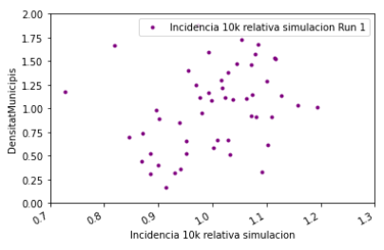
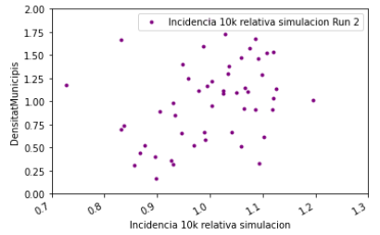
Studying correlations of simulation (0.1% configuration ) with intrinsic properties of the census
Run 1 y Run 2 son simulaciones con distinta muestra aleatoria de los infectados iniciales. La disperción de diagnosticados en función del barri es sistemática, no estadística
Se observa una cierta correlación entre la incidencia y la densitat:

Slide 14
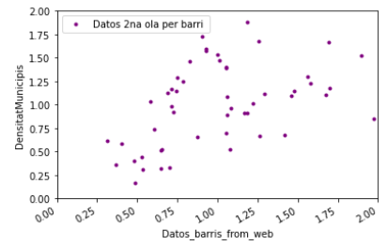
Studying correlations of data with intrinsic properties of the census

Slide 15
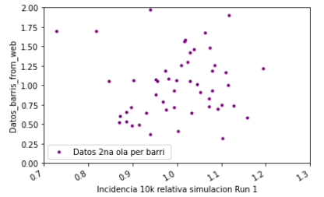
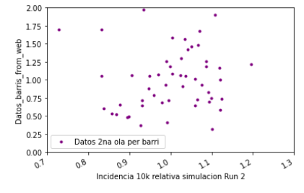
Studying correlations of simulation (0.1% configuration ) with data
2 regions with x10diff in density
Poble Sec
40k habitants
Sant Antoni
Raval Nord, Sud
Removing 4 outliers

Slide 16
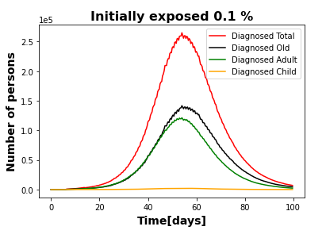
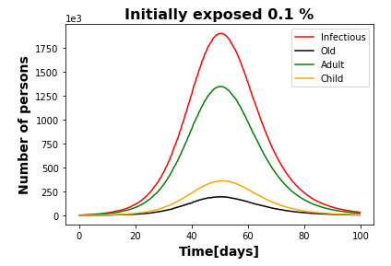
Studying correlations of simulation (0.1% configuration ) with intrinsic properties of the census
In the next slides we study both diagnosed and infectious persons
One should keep in mind that infectious are mostly adults, while diagnosed people are shared between old and adults.
When comparing to data, the current age profile of probability for an infectious to be diagnosed is more appropriate for Ola1 than for Ola 2
SimulatIon:
55% “old” , 44% “adult”, <1% “child
Data:
65% “old” , 35% “adult”, <1% “child in Ola1
25% “old” , 56% “adult”, 19% “child in Ola2

Slide 17
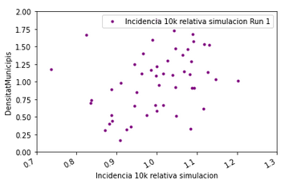
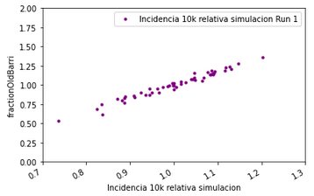
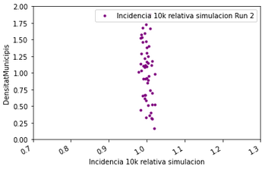
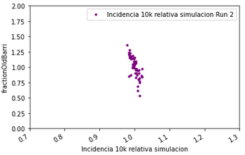
Correlations of simulation with population density: what is its origin?
DensitatBarri
Percentatge “old” >65
diagnosed
diagnosed
diagnosed
Incidencia diagnosed
infectious
infectious
Incidencia infectious
There is a very strong positive correlation between rate of diagnosed people and the fraction of “Old” persons in a “barri”, while there is a negative correlation of infectious is with the fraction of “adult”.

Slide 18
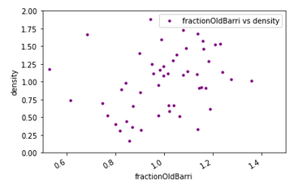
Correlations of simulation with population density: what is its origin?
Diagnosed vs density
Fraction of old vs density
diagnosed
diagnosed
The correlation between rate of diagnosed with density of “barri” that we observe in simulation (left plot) is the result of the correlation between the fraction of “old” and the density of the “barri” (right plot).
It is good to remember that correlation does not mean causality. Here the relevant underlying causal effect in the model is that the probability for a person to be diagnosed by PCR is much higher for “old” than “adult”,
We see some anticorrelation in infectious, because they are dominated by adult, and the higher the fraction of old in a “barri”, the lower the fraction of adult.

Slide 19
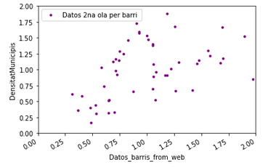
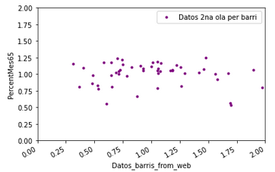
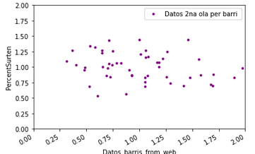
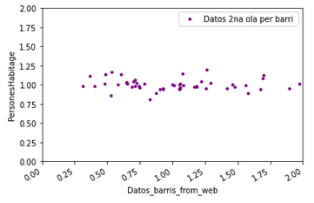
Correlations of data with census characteristics
diagnosed
Density
> 65y
mobility
Home size

Slide 20
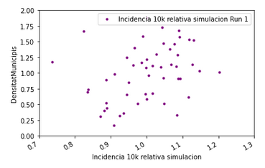
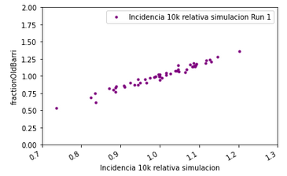
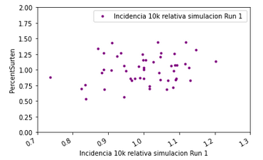
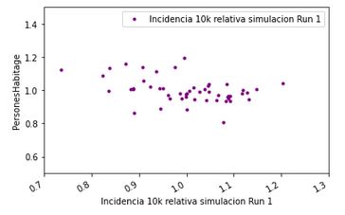
Correlations of simulation diagnosed with census characteristics
diagnosed
Density
> 65y
mobility
Home size

Slide 21
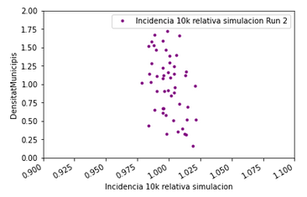
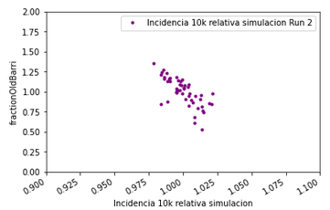
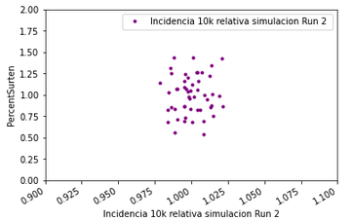
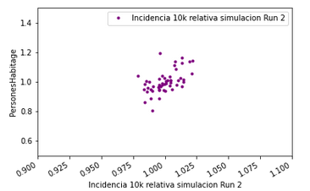
Correlations of simulation infectious with census characteristics
diagnosed
Density
> 65y
mobility
Home size

Slide 22
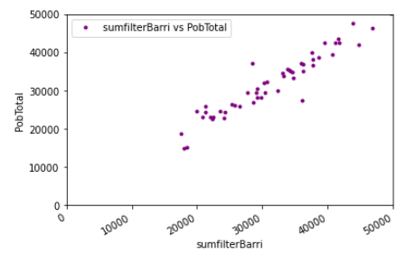
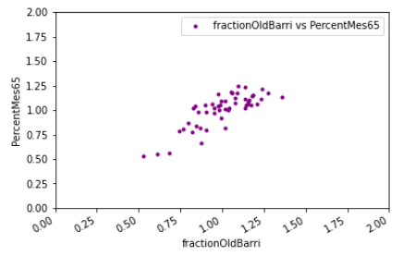
Sanity check info censo 2011 and more recent (2019)
diagnosed
Good correlation is observed
NB: percentage is defined as >=65 (2011) and >65 (2019)

Slide 23
To-do list
Provide data Ola 1
Provide data Ola 1 & Ola 2 including “residencies”
Provide age dependent probability of being diagnosed more suited for Ola 2
Release the analysis code
Implement mobility data
Etc.

